Slide 1
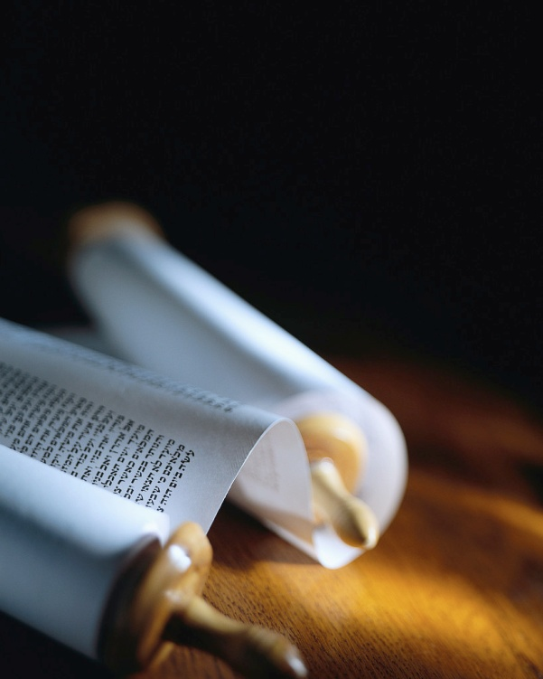
“The wages of sin is death, but the free gift of God is eternal life in Christ Jesus our Lord.”
Romans 6:23 ESV
Notes:
It has often been said that Christianity is just for people with problems.
That’s true,… because we ALL have a very BIG problem, that’s the problem of evil.
No human being has ever escaped the temptation to sin, according to Bible Ja1v14
What are the consequences ?
We all are condemned to die for our sin : the strongest, the richest, the most loved… we all will face death some day ! [read]
M/A 171210 avec notes / 180128 English Lafayette CA
Écran settings 100% de1366x768px.
Animation Pane 50/50 et diapos mini.
10 lignes max de notes avec Zoom 187% & diapos ci-dessus enn face de diapo 10.
Lignes de cette longueur maximum>>>>
Presenter View > diapo mini à gauche & rien en haut avec zoom notes 2x.

Slide 2
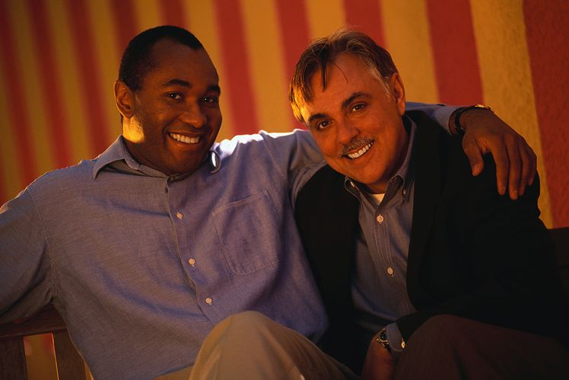
There is Good News…
Notes:
Let’s look in the Bible for what it says about personal and eternal salvation.
Lk2v10-11 say, “I bring you good news of great joy that will be for all the people. For unto you is born this day in the city of David a Savior, who is Christ the Lord.”
A Saviour from what… and why ?

Slide 3
All the Bible in its Context
What are we looking for when we bring someone to the Lord Jesus Christ ?
Personal Salvation
Notes:
Let’s read Luke 24v46-48…
The biblical context here is neither the Kingdom of Heaven, nor the Reformation of the Church, nor politics, nor social work.
What was the goal Jesus Christ had ?
The goal is personal & eternal salvation.
Let’s remember the Mission that Christ left in 5 Key Verses : Ac 1v8, Lk 8v11, Lk1v17, Jonah 2v9 et Mt 28v19à20.
Salvation is a MIRACLE, not just a faith !

Slide 4
Forgiveness
“It is written, that the Christ should suffer and on the third day rise from the dead, and that repentance and forgiveness of sins should be proclaimed in his name to all nations, beginning from Jerusalem.”
Luke 24:46-47 ESV
Forgiveness is possible.
Notes:
The MIRACLE of Salvation begins with the forgiveness of sins.
The Key Verse in our text summarizes the Mission World of Jesus Christ. [read]
1st We are reminded of the Good News, the Gospel that the Lord Jesus Christ died and rose again.
2nd We are reminded that repentance is essential to be saved.
Finally, we can be forgiven by God.

Slide 5
Notes:
How can anyone be totally forgiven by a perfect Heavenly Father ?

Slide 6
Forgiveness
"Who can forgive sins
but God alone ?" Mark 2:7 ESV
Jesus Christ is God.
Notes:
Let’s be clear, forgiveness of our sins is not automatic, just because God is good.
The first text in the Bible that speaks of forgiveness in Ex32v30 reveals that it must be obtained from Almighty God. [read]
Here we read that neither Moses nor any human can forgive our sins against God.
Ps130v3-4 & Da9v9 say, “LORD, …with you there is forgiveness.”
Lk1v17 reveals the meaning of “Jesus”…

Slide 7
Forgiveness
“If we confess our sins,
He is faithful and just to forgive us our sins and to cleanse us from all unrighteousness.”
1 John 1:9 ESV
The responsibility is ours.
Notes:
Let’s also be clear, forgiveness of our sins is not automatic, just because God is kind.
We must say what God says about our sins, confessing to Him that it was wrong.
If we do our part, He will do His. [read]
This takes faith in Him, trusting Him. Eph2v8 says, “By grace you have been saved through faith.”
It’s clear that no one is punished for their sins unless they refuse to confess them.

Slide 8
Forgiveness
“Without the shedding of blood there is no forgiveness of sins.”
Hebrews 9:22 ESV
Christ died in our place.
Notes:
How does God offer forgiveness, when He reveals from Ge 2v17 to Rm 6v23 that the consequences of sin is death ?
Capital punishment is God’s rule, and He will not violate His own law. [read]
Since the creation of man, we have all sinned against God according to Rm 3v23.
God made another law that surpasses the law of sin and death, as aerodynamics surpasses the law of gravity.

Slide 9
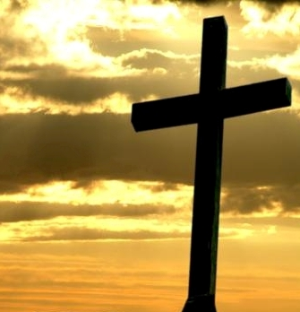
« Christ died for our sins. »
1 Corinthians 15:3
Notes:
The Good News is just that !
The Gospel is NOT, “Clean up yourself” so God will accept you in Heaven”.
The Gospel is NOT the bad news that we are all condemned.
We know that, because everyone is headed for the grave !
The Good News is that Christ died in our place to pay for our sins AND He is risen by His own power to do the same for us today.

Slide 10
Forgiveness
“To him (Christ) all the prophets bear witness that everyone who believes in him (Christ) receives forgiveness of sins through his (Christ) name.”
Acts 10:43 ESV
Trust Him enough to call.
Notes:
5x in the book of Acts, the forgiveness of sins is the 1st work of salvation.
In speaking of Jesus, Peter says this was the message since the beginning. [read]
Peter reminds us that forgiveness from sins requires trusting enough to call on JC.
No one calls or prays in the Name of Jesus, if they don’t believe He is still alive !
Rm 10v13 says, “Everyone who calls on the Name of the Lord will be saved.”

Slide 11
Forgiveness
“Where there is forgiveness of these, there is no longer any offering for sin.”
Hebrews 10:18 ESV
There is no more guilt.
Notes:
What effect does forgiveness of sins by Christ have on a person ?
The Bible reveals that the MIRACLE of salvation frees a person once for all. [read]
Notice the plural (these) and the singular (sin) in this wonderful promise.
Heb 9v14 & 10v2 say that our bad conscience about sins will be miraculously cleansed.
That truly IS Good News !

Slide 12
Forgiveness
“Happy are those who have forgiveness for their wrongdoing, and whose sins are covered.”
Romans 4:7 BBE
Ready to bear other’s burdens !
Notes:
What effect does forgiveness of sins have on my every day life?
Paul quotes Psalm 32. [lire]
A gloomy or depressed Christian has not understood or has forgotten forgiveness.
Perhaps it’s a sign the MIRACLE of salvation has not taken place !
There is no burden of sin to carry, but a joyful heart to carry other’s sorrows.
We love to share this Good News !

Slide 13
Notes:
Do you have the joy of sins forgiven ?
Let’s pause right here and pray that you will ASK Christ to give you that joy !

Slide 14
Forgiveness
“In him (Christ) we have redemption through his blood, the forgiveness of our trespasses, according to the riches of his grace,
Ephesians 1:7 ESV
Forgiveness cost a lot.
Notes:
Beware of a “bloodless salvation” taught by some today.
From Genesis to Revelation, the blood of sacrifice for salvation is revealed.
There was a REAL price paid for your salvation, and it was the blood of the Lord Jesus Christ. [read]
God has decided to NOT just say a word, like He did to create all things but, He sacrificed Himself to save us from sin.

Slide 15
Forgiveness
« This is my blood of the covenant, which is poured out for many for the forgiveness of sins. »
Matthew 26:28 ESV
A Christian is not perfect, just forgiven !
Notes:
The sacrifice of Christ to forgive our sins is at the very heart of the New Testament.
The Lord Jesus Christ wants us to never forget His blood shed for our sins. [read]
So the 1st part of the MIRACLE of salvation is the forgiveness of our sins.
A person needs to trust Christ enough to ask Him for forgiveness.
A person who receives the forgiveness of God is a humble Christian.

Slide 16
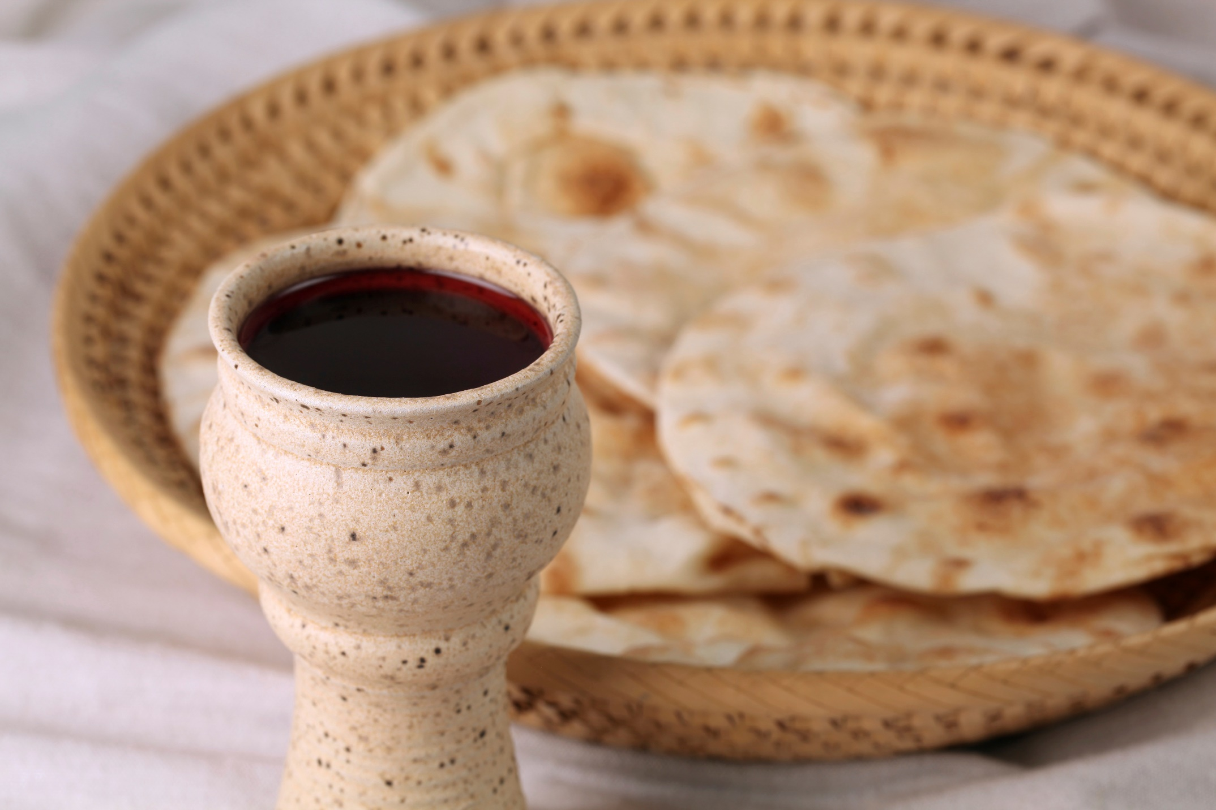
This do in remembrance…
Notes:
Christians celebrate the 1st part of the MIRACLE of salvation every Sunday, when they come to the Table of the Lord.
Forgiveness is total release from the consequences of our sin. (cf Jn8:11)
There will never be more to do because Christ has done it all. (cf Heb10:12)
Forgiveness will never be retracted if we fall again into sin. (cf. Heb9:12)
This is “so great a salvation” !

Slide 17
Review, React and Return !
Why lead others to Christ ?
For them to trust Christ enough to ask Him for personal salvation.
Romans 10:13
For the forgiveness of their sins.
Luke 24:46à48
www.AzBible.yolasite.com/fr
Notes:
The 3 R’s of education are not Reading, Writing and Arithmetic !
The big question today is this. [read]
[read]
[read]
This is only 1 of over 24 aspects of personal salvation that are listed on the summary sheet given out today.
We’ll come back to this topic next time we meet, or you can look it up on this site…

