Slide 1
The Gospel according to John
Why trust Jesus ?
Because of the witnesses…
Because of His words…
Because of His followers…
Because of His death & resurrection !
ABC… All the Bible in its Context
Notes:
>Let’s continue our survey of the books of the Bible in the Gospel of Jn.
>Is1v18 says : “ ‘Come now, and let us reason together,’ says the LORD, ‘Though your sins are as scarlet, they will be as white as snow; though they are red like crimson, they will be like wool.’ ”
There are good reasons to trust Jesus enough to ask Him to save us !
>Jn1-3 show we can trust Him because their were witnesses.
>Jn4-11 show us we can trust Him because of what He says.
>Jn12-17 show us we can trust Him because He has transformed lives.
>Jn18-21 show us we can trust Him because He died and rose again.
>When we read any part of John’s Gospel, we need to keep in mind this context “why I can trust Jesus enough to ask Him for salvation”.

Slide 2
Let’s take up our journey with John in chapter 8.
Why trust in Jesus ?
Because of His words (ch4-11)
His Word is liberating (ch8)
His Word can free from sin !
Let’s read John 8v1-11…
Notes:
>Turn with me in your Bible to John chapter 8.
>Let’s look for the answer to this question !
>Let’s remember that there have been several reasons His words bring us to trust Him :
Jn4 His words are convincing
Jn5 His words are healing
Jn6 His words are compassionate and nourishing
Jn7 His words are revealing
>Jn8 shows His words are also liberating.
>We are NOT talking about “liberation theology” which has to do with politics and economy without dealing with the question of sin !
>Let’s read what the Bible actually says about Jesus’ liberating words…

Slide 3
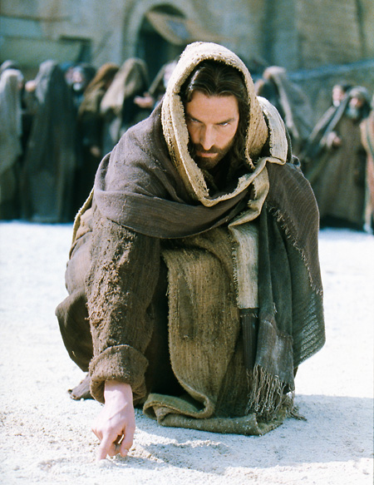
What did He write ?
His written Word !
Notes:
>The Bible is like poetry… using the least words to say a lot !
Some people think we cannot know what Jesus wrote, but we CAN.
>Jesus is God and as God, whatever He writes is the written Word of God.
This is the only place in the Bible that says Jesus wrote.
It surprised the Scribes that a carpenter’s son knew how to write.
Mt13v55-57 says, "Is not this the carpenter's son? Is not His mother called Mary, and His brothers, James and Joseph and Simon and Judas? "And His sisters, are they not all with us? Where then did this man get all these things?" And they took offense at Him.“
Remember what it says in Ac4v13, “Now as they observed the confidence of Peter and John and understood that they were uneducated and untrained men, they were amazed, and began to recognize them as having been with Jesus.”
Jesus did not have to copy the written Word of God like the Scribes, He wrote the Book !

Slide 4
The effect was dramatic.
"You shall not commit adultery... You shall not covet your neighbor's house ; you shall not covet your neighbor's wife."
Exodus 20v14 & 17
Convincing & Convicting !
Notes:
>Heb4v12 says, “The word of God is living and active and sharper than any two-edged sword, and piercing as far as the division of soul and spirit, of both joints and marrow, and able to judge the thoughts and intentions of the heart.”
>It is obvious that Jesus wrote the Ten Commandments on the ground.
>The first step in Jesus’ liberation by His Word is convincing us of our need.

Slide 5
The woman had been caught.
"Teacher, this woman has been caught in adultery, in the very act.” John 8v4
"He who is without sin among you, let him be the first to throw a stone at her." John 8v7
The men were also caught.
Notes:
>The first person in this story is the woman.
>Not every one gets caught now, but one day ALL sins will be exposed.
The Bible says in Rev20v12, “I saw the dead, the great and the small, standing before the throne, and books were opened; and another book was opened, which is the book of life; and the dead were judged from the things which were written in the books, according to their deeds.”
>What about the man who was committing adultery with this woman ????
If she was caught in the act, so was the man !!!
Jesus’ words cut to the heart of everyone in the crowd.
>Not one man was left standing there.

Slide 6
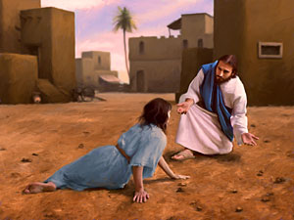
Jesus Word can liberate.
She was first convicted and then forgiven of her sin.
Notes:
>We cannot be liberated from sin if we don’t recognize our sinfulness.
>It took time for each person in the crowd to admit their guiltiness… from the youngest to the oldest.
With age we realize more and more how many sins we have committed.
That is why there are more older people in churches this morning.
But, we all need to start with repentance in order to be liberated.
>The woman had lots of time to think about her sin exposed by the Word of God.
Once she was alone before a Holy God, she did not defend her actions.
She did not run away.
Her heart was broken and she expected the first stone to fall.
But, Jesus spoke to her… words instead of stones !

Slide 7
Jesus’ words are precise.
"Jesus said, ‘I do not condemn you, either. Go ! From now on sin no more.’ "
John 8v10-11
Liberated from the penalty and the power of sin.
Notes:
>He could have condemned her to death.
>Jesus distinguished himself from the others who did not have the right to condemn her.
Remember what he says a little later in Jn8v46, “Which one of you convicts me of sin?”
He was sinless and yet did not condemn her.
He called sin SIN, but he liberated her from it in two ways.
>Two words that start with the letter P are very important in the Bible.
We are never liberated from the PENALTY of sin in order to go right out and “keep on sinning that grace may abound” (Rm6v1).
Jesus promise in His Word to forgive the repentant sinner is to liberate us from the penalty AND the power of sin.

Slide 8
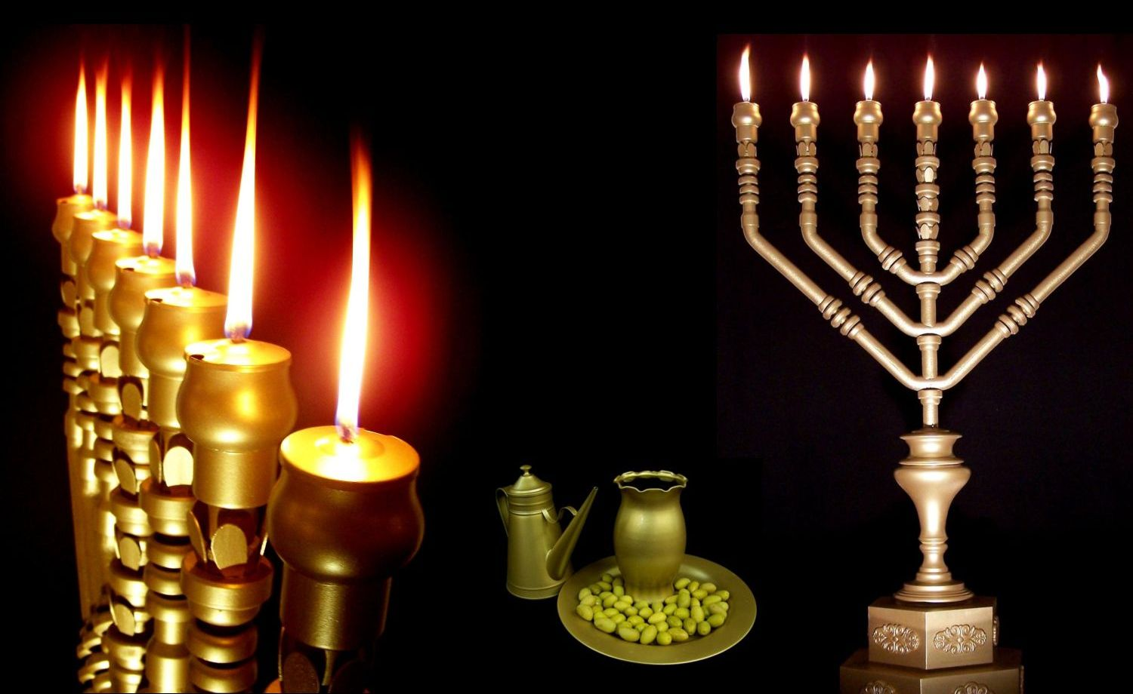
Let’s read John 8v12-20…
“Make a lamp burn continually.”
Exodus 27v20
Notes:
>The second way Jesus’ words liberate us is shown in vs12-20…
>Jesus had come inside the Temple where there was no sunlight.
His announcement was well staged !
>Everyone knew what the Law given to Moses commanded.

Slide 9
Jesus arrived for the lamp lighting (cf. Jn8v2).
“I am the Light of the world ; he who follows Me will not walk in the darkness, but will have the Light of life.” John 8v12
Jesus’ words enlighten !
Notes:
>From v2 we know that Jesus also timed his arrival.
>What a powerful liberation in a world of lies and darkness !
Light is necessary to walk without falling into a trap.
Light is also necessary to live without being forced to die.
>The light of Jesus’ words frees to “think outside the box”.
There is another way to walk and live than “the broad way which leads to destruction” (Mt7v13).

Slide 10
The world is in darkness.
“You do not know where I come from or where I am going… You know neither me nor my Father ; if you knew me, you would know my Father also."
John 8v14 & 19
His words free the mind.
Notes:
>Let’s face it, the world is a mess.
>Jesus said this 2000 years ago, but He is still saying it today.
Jesus prayed in Jn17v25-26, "O righteous Father, although the world has not known You, yet I have known You; and these have known that You sent Me; and I have made Your name known to them, and will make it known, so that the love with which You loved Me may be in them, and I in them."

Slide 11
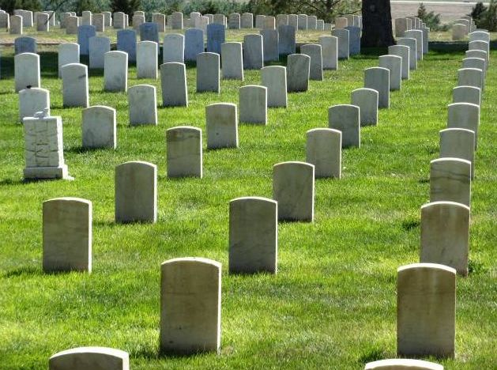
Let’s read John 8v21-30…
His words free from death.
Notes:
>The third way Jesus’ words liberate is beyond the grave…
>Three times in this short text He says, “you will die in your sins”.
Death is final if you die in your sins !
There is no second chance according to Heb9v27.
>Jesus tells us what to do to liberated from the grave.

Slide 12
He said it very clearly.
"Therefore I said to you that you will die in your sins ; for unless you believe that I am [God], you will die in your sins."
John 8v24 (cf. v21)
He put in words what to do.
Notes:
>Many think the Bible is difficult to read, but it is not.
>Jesus plainly said we need to trust that He is the Eternal God, the great “I am” who was and is always there, who created all things and who has all authority over every one of us.
>Trust Him !

Slide 13
Let’s read John 8v31-47…
“They answered Him, ‘We are Abraham's descendants and have never once been enslaved to anyone ; how is it that You say, 'You will become free ?’ " John 8v33
How quickly we forget !
Notes:
>The fourth way Jesus’ words liberate is before the grave, right here and now…
Jesus’ salvation is not just for life after death.
>We have the same false idea today !
Americans like the word FREEDOM and have come to think that they are totally free to do anything they want… even spit in the face of Christ.
The world has not changed in the last 2000 years.
>Charles DeGaulle once said that those who forget history are condemned to relive it !

Slide 14
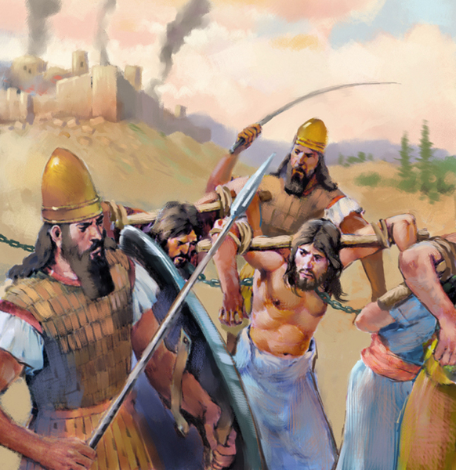
Israel had been enslaved many times.
From Egypt to Rome !
Notes:
>They said they had never been slaves to any man !
>History proves the contrary.
>Israel had been enslaved right from the start and still was in the time of Jesus.

Slide 15
The worse slavery is to sin.
“Jesus answered them, ‘Truly, truly, I say to you, everyone who commits sin is the slave of sin.’ ”
John 8v34
Jesus wants to free us.
Notes:
>We are ALL slaves of sin right from the start, the day we were born.
>Jesus’ words are so true.
Just try breaking a bad habit… try to be perfect this week !
And even if you succeed for a short time by sheer will power, when you get old and your mind becomes weak, you will return to the slavery of sin.
>Jesus wants to expose those chains and break them.

Slide 16
Jesus offers true freedom.
“Jesus was saying to those Jews who had believed Him, ‘If you continue in my word, then you are truly disciples of mine ; and you will know the truth, and the truth will make you free." v31-32
We need to trust & obey.
Notes:
>Jesus is not offering reformation.
>Jesus offers the source of freedom that will never run dry : His Word !
By reading and putting into practice His Word every day, He will keep you from the slavery of sin.
Notice that He is speaking to those who believed Him !!!
Jesus said “IF you continue in my word” because it is a choice every day.
>This liberation from Jesus’ word is for those who BOTH trust Him and obey Him.

Slide 17
Jesus explains how it works.
"So if the Son makes you free, you will be free indeed. John 8v36
…My word has no place in you. I speak the things which I have seen with My Father ; therefore you also do the things which you heard from your father." John 8v38
Who’s word do WE listen to ?
Notes:
>Just so we don’t miss the point…
>It really works !
>But, we need to chose who will will listen to every day.
>How much time do you spend in His Word every day ?

Slide 18
Even Jesus was amazed !
“Why do you not understand what I am saying ? It is because you cannot hear my word. …Which one of you convicts me of sin ? If I speak truth, why do you not believe me ?” John 8v43 & 46
It’s so simple !
Notes:
>If you look around at Christians today you too will be amazed.
>Jesus is very clear : liberation comes from paying attention to His words.
It’s just not reasonable not to trust Him.
>The plan of salvation is understandable by a child : just listen to Jesus and He will set you free from sin’s punishment and power.

Slide 19
Let’s read John 8v48-59…
"Truly, truly, I say to you, if anyone keeps my word he will never see death."
John 8v51
This is the ultimate liberation.
Notes:
>The fifth way Jesus’ word liberates those who trust Him is wonderful.
>His word is food for eternity, sustenance even in Heaven.
This is what He meant in Jn6v58, "This is the bread which came down out of heaven; not as the fathers ate and died; he who eats this bread will live forever.“
>Not only does Jesus offer liberation now and at the resurrection, but for all eternity.

Slide 20
He is the Eternal God.
“Jesus said to them, ‘Truly, truly, I say to you, before Abraham was born, I am.’”
John 8v58
Only He can promise eternal life in plain words.
Notes:
>He alone can keep His word forever, because He is the Eternal God.
>Ps90v2 says, “Before the mountains were born or you gave birth to the earth and the world, even from everlasting to everlasting, you are God.”
>No one else can assure us he will be there to keep us.
He alone merits all our confidence, all our trust.

Slide 21
Review, react and remember:
Why trust Jesus ?
John 8 continues in context… trust Him because of His Word.
His Word is Liberating !
He wants to free me from sin.
…its penalty and its power !
Notes:
>Let’s not forget what we have heard !
>It’s all about this question.
>We can trust Jesus because of His words.
>His Word liberates from
sin’s penalty and power (vs1-11)
spiritual darkness (vs12-20)
physical death (21-30)
slavery habits (31-47)
eternal death (48-59)
>Simply put: Jesus word frees from sin…
>Free from the penalty AND the power of sin !

