Slide 1
The Gospel according to John
Why trust Jesus ?
Because of the witnesses…
His words…
His followers…
His death and His resurrection.
ABC… All the Bible in its Context
Notes:
>Let’s continue our journey with John… to see Jesus.
>This is one of the most important questions in life !
>The book of John gives 4 BIG REASONS why we trust Him…
>Every part of this book of the Bible was written to answer this question.

Slide 2
The key word in the book of John is believe (98x) meaning trust.
You can trust Jesus thanks to :
The witnesses in ch1-3
His words in ch4-11
His followers in ch12-17
His death & resurrection ch18-21
The key verse is Jn20v31.
Notes:
>By counting the number of times a word is repeated in any text we can know what the subject is.
The Greek word translated “believe” simply means “trust”.
>By reading the whole book with the key word in mind we can discover where the author is going.
He wants us to trust Jesus w/ more than a blind faith.
This is a book to discover AND grow in faith !
>There is always a key verse in every book of the Bible that summarizes the message.

Slide 3
This is the context of the whole book of John.
“ These have been written so that you may believe that Jesus is the Christ, the Son of God ; and that believing you may have life in His name. John 20:31 NASB
…the context of every part.
Notes:
>The key verse explains the context in which all the others were written.
>The key word is used two times in this one verse !
>This is the reason each story is told in this book.

Slide 4
Let’s continue with John 4-11
Trust Jesus because His Word is :
Convincing, Jn4v1-42
Healing, Jn4v43-5v47
Compassionate, Jn6v1-21
Nourishing, Jn6v22-71
Revealing, Jn7
And the list continues…
Notes:
>Let’s continue our journey with John to see Jesus.
>Underlying the first of the four big reasons to trust Jesus are nine examples of how His Word draws us out to trust Him.
>The women at the well and all her city came to trust Jesus because His Word was convincing… convicting !
>The lame man of Bethesada came to trust Jesus because His Word was healing… restoring !
>The hungry crowd came to trust Jesus because His Word was compassionate… loving !
>The disciples came to trust Jesus because His Word was nourishing… satisfying !
>Some of the Jewish authorities began to trust Jesus because His Word is revealing… exposing !
>There is still more…

Slide 5
John 4-11 is rich in reasons.
Trust Jesus because His Word is :
Liberating, Jn8
Sight giving, Jn9
Leading, Jn10
Life giving, Jn11
We have already look at Jn4v1-5v24
Notes:
>There are nine examples of how Jesus’ Word gets us to trust Him.
>Here are the last four examples in John’s Gospel…
>The adulterous woman came to trust Jesus because His Word is liberating… freeing from sin’s punishment and sin’s power !
>The blind man came to trust Jesus because His Word is sight giving… opening blind eye !
>The followers of Jesus came to trust Him because His Word is leading… the one and only truly Good Shepherd !
>Many in Jerusalem came to trust Jesus because his Word is life giving… resurrecting !
>We are now in chapter 6 of the Gospel of John.

Slide 6
Let’s take up our journey in John 6...
Why trust in Jesus ?
Because His Word is compassionate !
His Word is people oriented.
Let’s read John 6v1-15…
Notes:
>Please open you Bible with me to John chapter 6.
>Let’s remember the context of the whole book.
>Let’s remember the context of this section, chapter 4-11.
>We are about to see that there is an immediate context in vs1-15 that will help us understand each individual verse in its context.
>Let’s look for that immediate context as we read vs1-15…

Slide 7
He only said three things ?
“Where are we to buy bread, so that these may eat ?” v6
“Have the people sit down.” v10
"Gather up the leftover fragments so that nothing will be lost.” v12
John leaves out the rest.
Notes:
>It is always remarkable how short, but powerful Jesus’ words are.
>In this chapter the word “bread” is used 17 times !
It is the key word, the subject of the chapter.

Slide 8
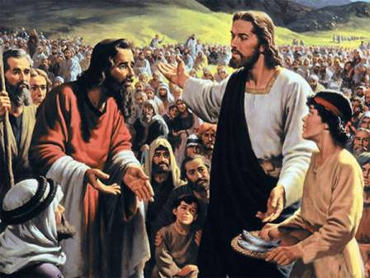
His Word is not just sermons.
Even His disciples were surprised and impressed.

Slide 9
Jesus Word is for and all about you and me.
Why trust in Jesus ?
Because His Word is compassionate !
His Word is people oriented.
He is talking to you !

Slide 10
Let’s read John 6v16-21…
This time He only spoke once !
"It is I ; do not be afraid."
John 6:20 NASB
This is our greatest need.

Slide 11
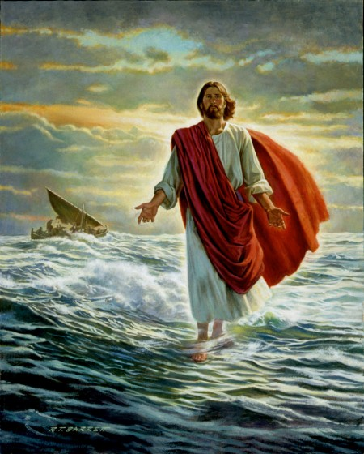
His word gives us peace.
John leaves out Peter’s story.

Slide 12
Jesus speaks peace to us.
Why trust in Jesus ?
Because His Word is compassionate !
His Word is peace giving.
They received Him into their storm tossed boat.

Slide 13
Let’s read John 6v22-71…
“You seek Me, not because you saw signs, but because you ate of the loaves and were filled. Do not work for the food which perishes, but for the food which endures to eternal life, which the Son of Man will give to you."
John 6:26-27 NASB
His word is nourishing !

Slide 14
Jesus’ Word can be difficult.
“Therefore many of His disciples, when they heard this said, ‘This is a difficult statement ; who can listen to it ?’ ”
John 6:60 NASB
It’s not all milk and toast !

Slide 15
For example…
“I am the bread of life.” v48
“Unless you eat the flesh of the Son of Man and drink His blood, you have no life in yourselves.” v53
How can Jesus feed us ?

Slide 16
He explains it in context !
“It is the Spirit who gives life ; the flesh profits nothing ; the words that I have spoken to you are spirit and are life.”
John 6:63 NASB
His Word is nourishing.

Slide 17
Many just don’t get it.
“As a result of this many of His disciples withdrew and were not walking with Him anymore.”
John 6:66 NASB
They don’t trust His Word.

Slide 18
A small number do get it.
“So Jesus said to the twelve, ‘You do not want to go away also, do you ?’ Simon Peter answered Him, ‘Lord, to whom shall we go ? You have words of eternal life.’ ”
John 6:67-68 NASB
Jesus Word is real food.

Slide 19
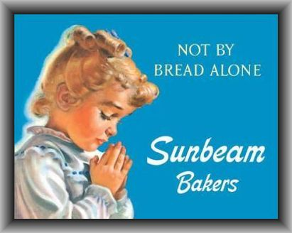
Taking communion is not it !
Listening to Jesus is food.

Slide 20
Jesus’ Word feeds the hungry soul.
Why trust in Jesus ?
Because His Word is nourishing !
His Word is real food.
His Word satisfies.

Slide 21
Review, react and remember:
Why trust Jesus ?
John chapter 6 continues in the context of His Word.
His Word is compassionate.
His Word is nourishing.
His Word touches the soul !

