Slide 1
All the Bible in its Context
John 14
One more reason to trust Jesus
…because His followers have an unearthly peace !
Let’s read the text…
Notes:
>We are continuing our study of the Gospel according to John.
>Turn with me in your Bible to John 14.
>We have already discovered 16 GOOD REASONS to trust Jesus in the Gospel of John.
When put all together, they point to ONLY ONE TRUSTWORTHY Lord and Savior !
WHY TRUST JESUS ?
Jn1-3 because of the witnesses :
(1) John the baptist
(2) Andrew
(3) Philip
(4) Disciples
(5) Nicodemus
Jn4-11 because of His Word :
(6) convincing
(7) healing
(8) compassionate
(9) nourishing
(10) revealing
(11) liberating
(12) sight giving
(13) leading
(14) life giving
Jn12-17 because of His followers :
(15) transformed lives
(16) love for one another
(17) unearthly peace
>Today John reveals another reason to trust the Lord Jesus Christ !
>Let’s read John 14…

Slide 2
There are some key words :
“Believe(s)” 7x… the most repeated word in this Gospel.
“You” 49x… a personal talk !
“I” 38x… directly from Jesus !
They are all in the key verses.
Notes:
Words that are REPEATED are always the KEYS to understanding a message !

Slide 3
What sums it all up ?
"Do not let your heart be troubled; believe in God, believe also in me.
…Peace I leave with you ; my peace I give to you ; not as the world gives do I give to you. Do not let your heart be troubled, nor let it be fearful. John 14v1 & 27 NASB
He gives unearthly peace.
Notes:
>The key verse of this chapter says it all.
>« Do not let your heart be troubled. » is repeated twice.
>This is a peace the WORLD cannot give !

Slide 4
There are 7 natural divisions.
vs1-6 a Heavenly home
vs7-11 a Heavenly Father
vs12 a Heavenly work
vs13-14 a Heavenly access
vs15-26 a Heavenly indwelling
vs27 a Heavenly peace
vs28-31 a Heavenly Savior
This is a perfect peace.
Notes:
Jesus CHANGES subjects, but KEEPS the same theme.
>Notice from where this peace comes…
>I like to call this an UNEARTHLY peace !

Slide 5
Let’s see how it works.
There is an overall link…
but, it’s not Heaven !
It is the « I am » of Heaven…
Remember the word « I » is repeated 38 times.
Jesus gives us this peace.
Notes:
It is NOT WHAT He gives, but WHO HE IS that gives us this unearthly peace !
>Let’s look closely at the text.
>One of our simple tools for serious Bible study is counting words ☺
>The word “I” is the key to this unearthly peace.

Slide 6
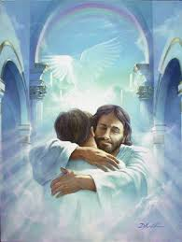
Notes:
In the FIRST NATURAL SETION, vs1-6 are about a Heavenly home.

Slide 7
Let’s see how Jesus gives unearthly peace in vs1-6.
“Do not let your heart be troubled ; believe in God, believe also in me.”
John 14v1 NASB
“You trust God ? Trust me !”
Notes:
I don’t know about you, but that gives me peace, passing through this world of trouble.
>But, it’s not the place in Heaven that gives me peace, it’s the One who is in Heaven !
>You can trust Jesus because He is God !

Slide 8
Look at what Jesus is doing !
“In My Father's house are many dwelling places ; if it were not so, I would have told you ; for I go to prepare a place for you.”
John 14v2 NASB
That gives us peace.
Notes:
Jesus is NOT INACTIVE in Heaven, just waiting for the time to pass before He comes back to straighten out this messed up world.
>There is no peace in this world that can match the ANTICIPATION we have.
>Knowing Jesus loves us and is getting Heaven ready right now for our arrival gives real peace !

Slide 9
He is coming again.
“If I go and prepare a place for you, I will come again and receive you to myself, that where I am, there you may be also.” John 14v3 NASB
That gives us hope.
Notes:
Jesus always kept His word and this PROMISE is no different.
>How can you match what the Bible calls our « blessed HOPE » according to 2Tim2v13 ?
>We have a SURE hope as an anchor for the souls.

Slide 10
He is the way to Heaven.
“Jesus said to him, ‘I am the way, and the truth, and the life ; no one comes to the Father but through me.’ ”
John 14v6 NASB
That gives us assurance.
Notes:
JESUS is the REASON we have an unearthly peace, because He is coming back to take us to Heaven. It’s not Heaven that gives me that peace, but the Savior !
>The direct context of this verse is NOT GETTING SAVED, but the return of the Lord. We often forget that in our zeal to share the Gospel.
>This verse gives ASSURANCE of salvation when we are trusting Jesus to COME BACK and take us to Heaven.
There is NO OTHER WAY to Heaven and to have peace ; we can’t get there on our own… nor by any Church, nor Saint, nor Angel.

Slide 11
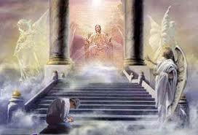
Notes:
So the SECOND ASPECT of this unearthly peace is WHO gives it.

Slide 12
Let’s see how Jesus gives us unearthly peace in vs7-11.
“Jesus said to him, ‘Have I been so long with you, and yet you have not come to know me, Philip ? He who has seen me has seen the Father ; how can you say, ‘Show us the Father’ ?’ ” John 14v9 NASB
Jesus IS the Almighty God.
Notes:
In the SECOND NATURAL SECTION of this passage, we SHOULD take time to meditate on EACH VERSE.
>HOWEVER, here is the KEY VERSE that reveals this aspect of why we have unearthly peace trusting Jesus.
He is « the fullness of God in bodily form » according to Col2v9 GKLIT.
He is called « the everlasting Father » in Is9v6 !
>Jesus and His Father are ONE GOD, and that gives us unearthly peace trusting Him.

Slide 13
Notes:
The THIRD NATURAL SECTION of this passage is one verse.

Slide 14
Let’s see how Jesus gives us unearthly peace in v12.
“Truly, truly, I say to you, he who believes in me, the works that I do, he will do also ; and greater works than these he will do ; because I go to the Father.”
John 14v12 NASB
Jesus works through us.
Notes:
Promises are good and truths are reassuring, but SIGNS confirm Jesus’ words.
Did you realize that ALL OF ISRAEL was evangelized by Jesus, BUT THE WHOLE WORLD can hear from you !
Jesus fed the poor and helped the sick, but millions are cared for in His Name today.
>Jesus Holy Spirit inside the believer’s heart gives him OR her the COMPASSION and CAPACITY to reach more than the Master did in His three years of ministry.

Slide 15
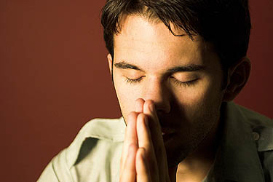
Notes:
The FOURTH ASPECT of why we have unearthly peace is PRAYER !

Slide 16
Let’s see how Jesus gives us unearthly peace in v13-14.
“If you ask me anything in my name, I will do it.”
John 14v14 NASB
We have access in Heaven.
Notes:
JESUS hears our prayers as the « one mediator between God and man » 1Tim2v5.
>To pray « in Jesus’ Name » is NOT JUST adding a formula at the end of our prayers.
It is not asking the Father using Jesus’ “signature” like a forged check.
It is addressing Almighty God by calling Him BY HIS NAME, “Jesus” !
Peter did it when he cried out “Lord, save me !” in Mt14v30
Steven did it when he said, “Lord JESUS, receive my spirit !” Ac7v59.
We will all do it before the LAMB according to Rev5v9.
>This verse clearly says WE CAN ADDRESS JESUS in our prayers.
The Greek text is strongly supported by all the old manuscripts as noted by experts such as Vincent’s Word Studies, AT Robertson, the Cambridge Greek, MacLaren, etc.
Someone REMOVED the word « me » to deny the direct access we have to God.
There is no greater peace than knowing we have direct access to God because He has become a human and done away with priests and ritual for prayer.

Slide 17
Notes:
The FIFTH ASPECT of the unearthly peace we have also merits much MEDITATION !

Slide 18
Let’s see how Jesus gives us unearthly peace in vs15-26.
“I will ask the Father, and He will give you another Helper, that He may be with you forever ; the Spirit of truth …He abides with you and will be in you.”
John 14v16-17 NASB
The fruit of the Spirit is peace.
Notes:
This is one of the most precious aspects of the unearthly peace we have : the INDWELLING SPIRIT of God.
>Here are the key verses that SUMMARIZE this wonderful miracle.
Jesus helped His disciples, but His Spirit, the Holy Spirit of God, would not only be with them, but inside forever !
>There is NO PEACE as solid as this !
He will NEVER LEAVE (this is eternal security) and He will REMIND the true Christian of Christ’s Word (v26) to PRODUCE the fruit of the Spirit which is « LOVE (vs15 & 23-24), joy, PEACE… » Ga5v22.

Slide 19
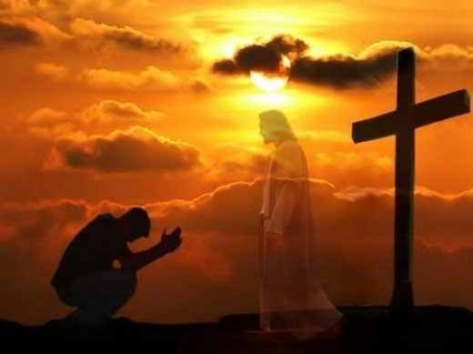
He gives us His peace !
Notes:
The SIXTH ASPECT of this unearthly peace is the revelation IT IS A GIFT.
The Lord Jesus Christ GAVE His life TO GIVE YOU peace with God.
The Bible says that “for the joy set before Him endured the cross, despising the shame, and has sat down at the right hand of the throne of God.” Heb12v2
>That unearthly peace He had as He went to the cross, He gives to us !

Slide 20
Let’s see how Jesus gives us unearthly peace in v27.
“Peace I leave with you ; my peace I give to you ; not as the world gives do I give to you. Do not let your heart be troubled, nor let it be fearful.”
John 14v27 NASB
God’s peace is spiritual gift.
Notes:
Just as forgiveness and salvation from sin is an UNMERITED GIFT of grace, so we NEED TO RECEIVE the gift of peace offered by the Lord Jesus.
>When He says « Peace I leave with you » it could be translated « I leave it on the table for you to pick it up ; I leave it behind ! »
That is why He IMMEDIATELY says, « Do NOT let your heart be troubled ! »
We have a CHOICE to receive the gift of peace or to hold onto our troubles and fears !
>Do people trust Jesus because you do ?
Or do YOU REFUSE Jesus’ GIFT and THUS WITNESS to the world that your heart is troubled like theirs ?

Slide 21
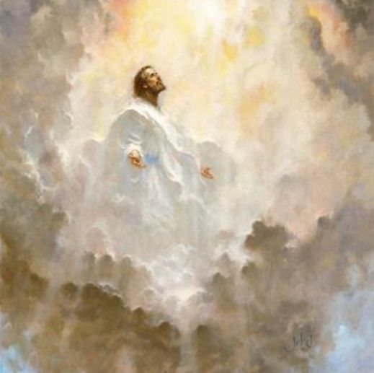
Notes:
The last natural section in this passage is on the mountain top !

Slide 22
Let’s see how Jesus gives us unearthly peace in v28-31.
“You heard that I said to you, 'I go away, and I will come to you.' If you loved me, you would have rejoiced because I go to the Father, for the Father is greater than I.”
John 14v28 NASB
We have a Heavenly Savior.
Notes:
Our peace is from outside of this world.
>Jesus is God FROM Heaven and has GONE BACK to His Father.
He is the source of our UNEARTHLY peace.
Our Savior who died and rose again is NOW IN HEAVEN.
We LOVE Him and REJOICE in His accomplished work.
>HE IS OUR PEACE !

Slide 23
Review, react and remember:
We trust Jesus because He gives us unearthly peace.
John 14 reveals 7 aspects of this heavenly peace.
May the world trust Jesus because we have His peace.
www.AzBible.yolasite.com
Notes:
Let’s review, react and remember what we have learned and decided !

