Slide 1
All the Bible in its Context
The Gospel of John
Why trust Jesus ?
Chapters 11-17
…because of His followers ;
Chapter 13
…they love one another.
Notes:
Good morning !
>Let’s get right back into the context of the Gospels.
>We are looking at the fourth Gospel.
It answers this important questions : Why have confidence in Jesus enough to ask Him for salvation from sin ?
>This part of the book reveals another good reason to trust Jesus.
People Jesus has saved are proof that He is trust worthy.
>What happens to people who are saved by Jesus ?
Jesus says they will love one another.

Slide 2
Let’s remember John 11 & 12.
Jesus’ followers are living proof
that He can raise the dead, Jn11
& turn their hearts to praise, Jn12.
The world is watching !
Notes:
Let’s pause right here are remember what we have read recently.
>We have seen two other reason to trust Jesus because of His followers.
>Like Lazarus, no true follower of Jesus can live the same after being given a NEW LIFE.
>Like Palm Sunday, all true follower of Jesus love to PRAISE HIM publicly.
>Let’s remember who is watching us.

Slide 3
John 13
“By this all men will know that you are my disciples, if you have love for one another.”
John 13v35 NASB
Love is powerful proof !
Notes:
Let’s read this chapter…
>This is the key verse !
The key word repeated 38x in this chapter is “you” and it appears twice in this verse.
It’s all about “you” as a disciple of Christ.
But, this is a conditional sentence with the word “IF” in the center.
Are YOU a true disciple of Christ or just an adherent to Christianity ?
The acid test is if you love His disciples like He does !
>It’s impossible to question true love, you can only witness it.

Slide 4
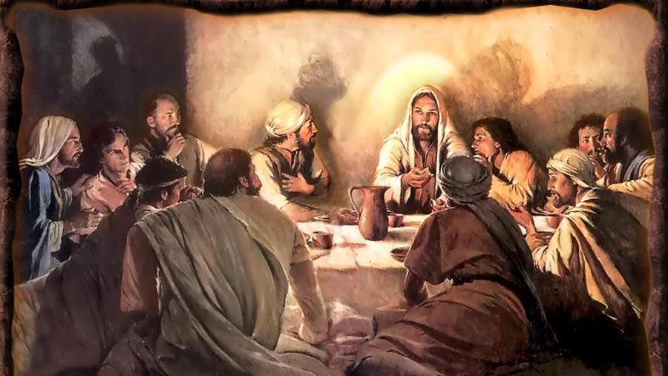
Notes:
Jesus’ last supper with His disciples is highly important.
He wanted them to be the light of the world after He went back to Heaven.
Their most powerful tool would be love, the fruit of His Holy Spirit.

Slide 5
But, not just any kind of love !
“Now before the Feast of the Passover, Jesus knowing that His hour had come that He would depart out of this world to the Father, having loved His own who were in the world, He loved them to the end (the ultimate limit).”
John 13v1 NASB
This is agapé love.
Notes:
Even THIEVES show a kind of love for one another.
But, like most love in this world, it is for what they GET out of it that they love.
>Jesus was about to DIE for His disciples.
He had already GIVEN up Heaven to reach them with love.
The noun “end” has no compliment, like “time” so it means simply “the ULTIMATE LIMIT” not just the end of His ministry on earth.
>Jesus shows us what this KIND of love He wants us to have for one another.

Slide 6
He washed Judas feet !
“Then He poured water into the basin, and began to wash the disciples' feet and to wipe them with the towel with which He was girded.”
John 13v5 NASB
The Servant’s heart.
Notes:
In vs 2-17 Jesus revealed the kind of love He wants us to have.
It says in vs 2-3 that Jesus knew Judas would betray Him.
>The disciples had been arguing who was the greatest, Lk22v24 !
No one had gotten up and to wash the others’ feet before the meal.
You can imagine the RED FACES when Jesus did it !
>Jesus took the lowliest place to wash smelly feet.
But, He would go even lower to the death of the cross for them.
They NEVER forgot Jesus kneeling at Judas feet !

Slide 7
Jesus defines true love.
“If I then, the Lord and the Teacher, washed your feet, you also ought to wash one another's feet. For I gave you an example that you also should do as I did to you.” John 13v14-15 NASB
He makes the application.
Notes:
Before we can SHOW the world Christ is trust worthy, we must KNOW what true love is.
>Jesus did NOT say “do this”, but “I gave you an example”.
It is NOT a ritual of foot washing that will speak to world of our love.
True “agapé” love will drive us to our knees to seek God’s will, how we can humbly serve our brothers and sisters.
>The first lesson of love is SILENT HUMILITY.
Jesus saw a need and just got up and took care of the disciples.

Slide 8
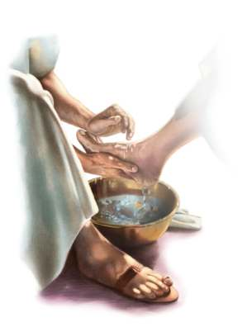
Notes:
The FIRST lesson about love was that true love takes the place of a servant.

Slide 9
Jesus’ love has no limits.
“When Jesus had said this, He became troubled in spirit, and testified and said, ‘Truly, truly, I say to you, that one of you will betray Me.’ ”
John 13v21 NASB
It often hurts to truly love.
Notes:
It’s fun to serve for a while, but not always !
>Vs 18-32 contain the SECOND LESSON on love.
In v18 Jesus quotes Ps41v9 about Judas eating with Him.
But, Jesus love went even deeper than eating with the Pharisees.
He actually chose Judas to represent Him as an apostle, v20 !
Jesus entrusted Judas with more than the money box, v29 ; He entrusted him with his love, v26.
>Jesus was hurting in His Spirit because His love was being rejected.
That is the depth of the love of the cross.

Slide 10
His love glorifies His Father.
“Therefore when he had gone out, Jesus said, ‘Now is the Son of Man glorified, and God is glorified in Him.’ ”
John 13v31 NASB
This is agapé love.
Notes:
We are awed by the love of Jesus for a lost world.
>Again, Jesus gave us an example that we should follow.
Just as He loved Judas to the ULTIMATE LIMIT, so we should love our enemies… and God will get the glory !
>Only Jesus is capable of such love.
In the next verse His Father glorifies His Son because of His great love.
We can love like this only if we let Christ dwell in us as LORD.

Slide 11
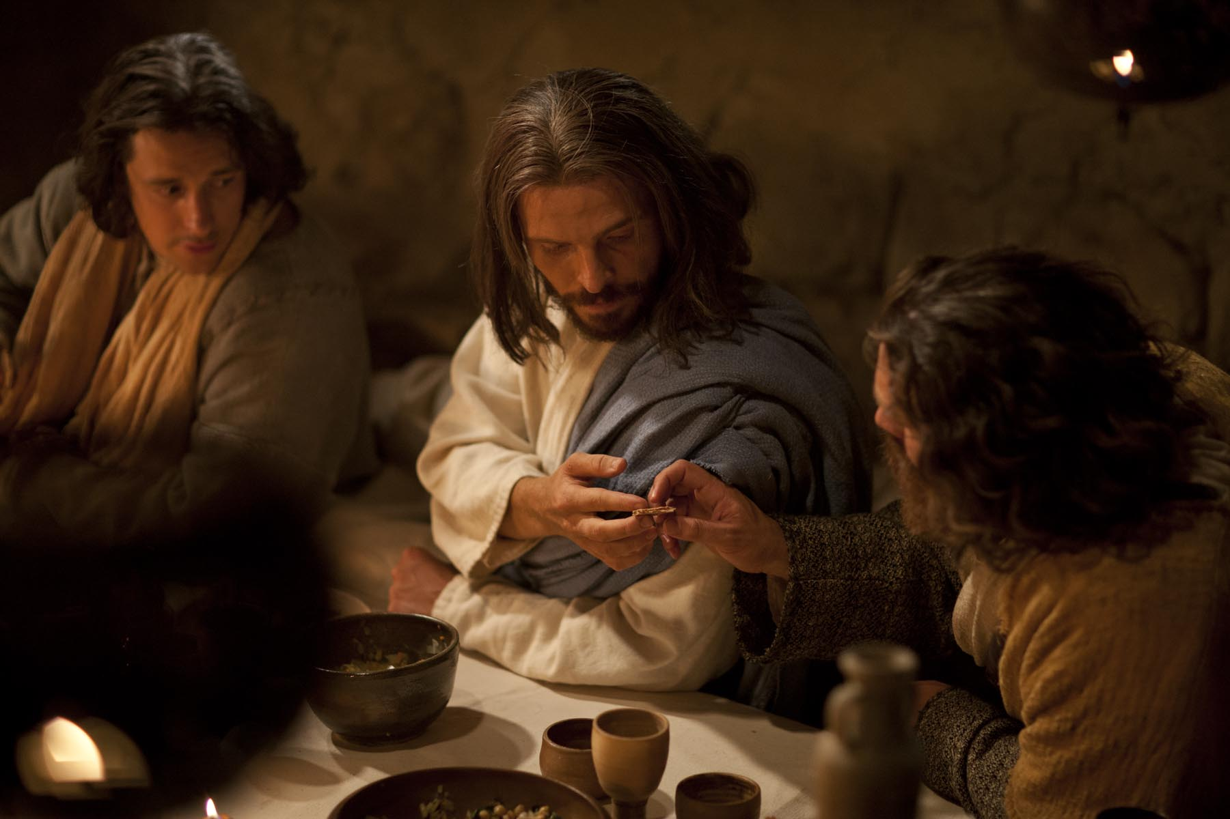
Notes:
The SECOND lesson about true love is that it has no limits.
When you count the cost, you’ve stopped loving !

Slide 12
“This is my commandment”
“A new commandment I give to you, that you love one another, even as I have loved you, that you also love one another.”
John 13v34 NASB
Only God’s Spirit can !
Notes:
Jn15v12 echoes this great passage because it is SO important.
>This is more than just loving you neighbor as much as yourself !
In vs33-38 Jesus commands His followers to lay down their life for one another.
That means my brother or sister takes PRIORITY over me !
Teaching that we need to love ourselves FIRST so that we can love others as much as ourselves is OT legalism.
The law was given as a school master to bring us to Christ, but it cannot produce agapé love.
>The Holy Spirit wants to take control of our emotions and produce godly love.
The world has never seen anything like it.

Slide 13
Peter thought he was able.
“Jesus answered, ‘Will you lay down your life for Me ? Truly, truly, I say to you, a rooster will not crow until you deny Me three times.’ ” John 13v38 NASB
“Apart from me you can do nothing !” Jn15v5 NASB
Notes:
Peter thought he had gotten the three lessons about love.
He was that student with the hand up before the question is asked : “Will you?”
>Peter wanted to love like Jesus did, but he was not capable.
Without the indwelling Holy Spirit no one can love like Jesus !
>Jesus’ Spirit comes into a true believer and gives him the power to love.
It’s “Christ living in me” Ga2v20 ; that produces “the fruit of the Spirit” Ga5v22 !

Slide 14
Notes:
The THIRD lesson about true love is sacrifice.
One lesson builds on another to the ultimate goal.

Slide 15
Review, react and remember:
People trust Jesus because His followers truly love one another.
Jn13v1-17 Love humbly serves.
Jn13v18-32 Love has no limits.
Jn13v33-38 Love gives it all.
www.AzBible.yolasite.com
Notes:
Let’s REVIEW what we have learned from Jesus.

