Slide 1
All the Bible in its Context
The Gospel according to John
“Why trust Jesus ?”
Because of the witnesses, 1-3
Because of His Word, 4-11
Because of His followers, 12-17
Jesus transforms lives !
Notes:
>Good morning !
>Please make sure you have the printed summary of John in your hands.
We are going to dive right into chapter 12, but remember its context !
>The key word repeated 98x in this book is “believe” meaning “trust”.
The Name of “Jesus” is repeated 245x so we know WHO to trust !
The Gospel of John was written to answer the question of “faith”.
God wants us to TRUST His Son ENOUGH to ASK Him for salvation !
>We can trust Jesus because of all the TALK ABOUT HIM.
>We can trust Jesus because of WHAT HE SAID himself.
>But, we can also trust Jesus because His disciples are LIVING PROOF !
>It’s a FACT that Jesus SAVES people all around the world.

Slide 2
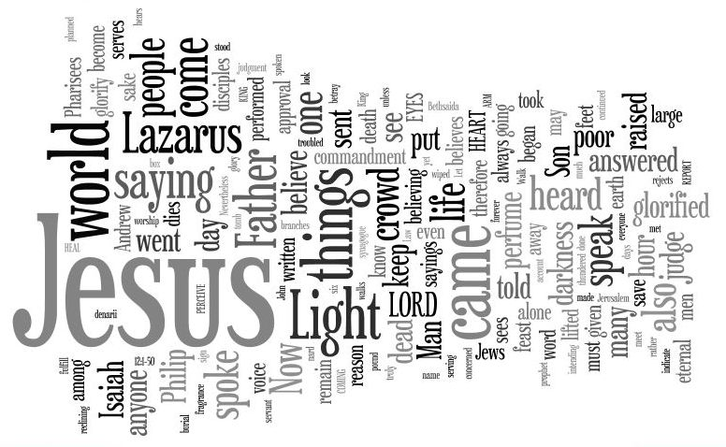
Let’s read John 12…
“Word Cloud” www.wordle.net
Notes:
Let’s read the story in John 12 and LOOK FOR NEW REPEATED WORDS ! [Read Bible]
>Here is a computerized “word cloud” of the most frequently used terms.
>Jesus’ Name is mentioned 16x
The world or crowd are mentioned 11x.
Believe or believing are mentioned 9x.
Light is mentioned 6x.
And Lazarus’ name is mentioned 5x.
>This pretty much gives us the message of John 12 : The world saw the light and trusted Jesus because of Lazarus !
You can use this tool on internet to quickly find the most repeated word in any text you copy-and-paste into the free program.

Slide 3
The key verse sums it up…
“The chief priests planned to put Lazarus to death also ; because on account of him many of the Jews were going away and were believing in Jesus. John 12v10-11 NASB
They SAW a new life !
Notes:
Every text can be summarized to remember it.
>[Read screen] The key verse uses all the key words !
v18 repeats the message that they believed on Jesus thanks to Lazarus.
This is what Jesus wants and will make very clear in Jn12-17.
It is a wonderful privilege, but also dangerous to follow Jesus !
Notice once again that they believed IN JESUS, not just about Him…
They put their TRUST IN HIM and immediately became His followers, v12
>The application is easy to make : Does the world trust Jesus because they see a new life in me ?

Slide 4
Six short stories
“Mary then took a pound of very costly perfume of pure nard, and anointed the feet of Jesus and wiped His feet with her hair; and the house was filled with the fragrance of the perfume.” v3
Is my life a sweet savor ?
Notes:
Let’s see how it works ; how others trust Jesus because we follow Him.
>The first short story is Mary’s in vs1-8. [read screen].
This demonstration of devotion to Christ affected everyone in that house.
Judas rejected it as a waste, like so many in the world around us.
But, in Mt26v13 & Mk14v9 Jesus revealed that her act would be told around the world along side of the Gospel.
>Why ? Because it is PROOF that Jesus changes lives.

Slide 5
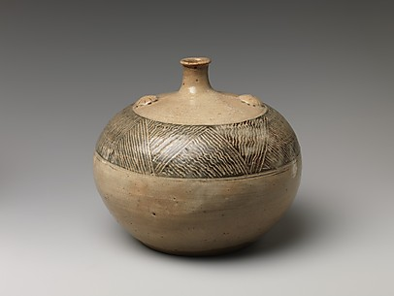
Mary gave the best she had.
Once broken there was no turning back.
Notes:
What can we glean from this story of Mary ?
>The perfume bottles were of clay and broken open for a one time use.
That’s a strong image of us, made of clay and needing to be broken if we are ever of any real value.

Slide 6
Lazarus’ story
“The large crowd of the Jews then learned that He was there; and they came, not for Jesus' sake only, but that they might also see Lazarus, whom He raised from the dead.” v9
Is my life the proof needed ?
Notes:
Lazarus’ story is in vs9-11.
>Many came to Jesus because of Lazarus. [read screen]
They could have come previously, just to see Lazarus, but they did not.
When Jesus arrived they were drawn to Him thanks to Lazarus.
He was the “click” they needed… the “bait” for the fish !
>How am I doing standing out of the crowd for Jesus ?

Slide 7
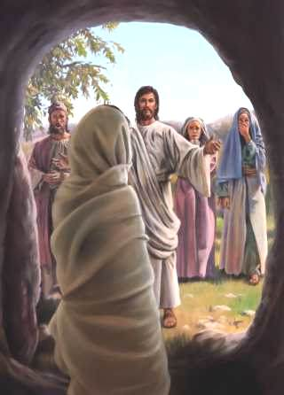
Lazarus owed it all to Jesus.
Once raised, life changed.
Notes:
What else can we glean from Lazarus’ story ?
>We can imagine Lazarus didn’t live like he did before.
He must have talked about being raised by Jesus to everyone !
That’s a wonderful example for us who are born again by God’s grace.

Slide 8
The disciples’ story
“These things His disciples did not understand at the first; but when Jesus was glorified, then they remembered that these things were written of Him, and that they had done these things to Him.” John 12v16 NASB
Is Jesus the king of my life ?
Notes:
The 12 also drew a crowd in vs12-16.
>Thanks to the disciples getting the donkey and offering their coats for a saddle, the crowd followed Jesus. [read screen]
The disciples didn’t expect it, but understood later how important it was.
We often are not aware that others are watching our actions.
But, that is repeatedly the reason many come to trust Jesus !
>The world knows what our priorities are by watching us.
People often turn away from trusting Jesus because of hypocrisy.

Slide 9
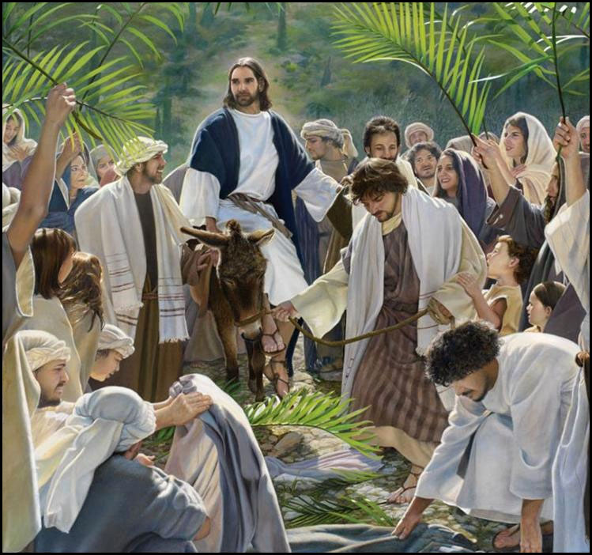
Jesus’ disciples praised Him.
…and they did it in public.
Notes:
What else can we glean from the disciples’ story ?
>Praising Jesus is contagious !
We need to do it in the “public space” of our city.
They did it at Pentecost and 3,000 were saved.

Slide 10
The believers’ story
“So the people, who were with Him when He called Lazarus out of the tomb and raised him from the dead, continued to testify about Him. For this reason also the people went and met Him, because they heard that He had performed this sign.” v17-18
Is my talk about Jesus ?
Notes:
There were more than the 12 who followed Jesus according to vs17-22.
>They didn’t just mention Christ once in a while.
They continued talking about Him all the time. [read screen]
Many more were drawn to trust Jesus to be their King.
Jesus said that what you talk about comes out of your heart.
The world knows that too !
>How much time do I talk about the love of my life ?

Slide 11
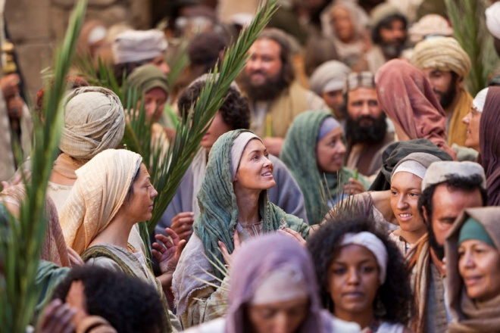
The believers talked about Him.
He filled their thoughts.
Notes:
What can we glean from the other believers’ story ?
>They were no longer complaining about life.
There was hope in their story.
They talked to everyone including Greeks from another race.

Slide 12
The Lord’s story
“But though He had performed so many signs before them, yet they were not believing in Him.”
John 12v37 NASB
Is my life better proof ?
Notes:
It may surprise you to read of Jesus’ reaction to Greeks seeking Him.
In vs23-27 Jesus distances Himself from popularity because of miracles.
>Jesus knows the heart of all men (Jn2v25). [Read screen]
People like a spectacular sign WHEN THEY GET SOMETHING out of it.
But, that does not lead to salvation through a personal trust in Jesus.
>Jesus’ life He gave is more important than all His miracles.
In vs24 & 32-33 Jesus revealed His soon death on the cross. [Read Bible]

Slide 13
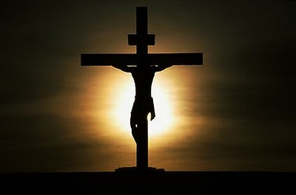
“I will draw all men unto me.”
Is my life a living sacrifice ?
Notes:
Jn12v32-33 is clear that a sacrificial life draws more to faith in Christ than all the miracles He ever did.
>vs25-26 apply this truth to our lives. [Read Bible]
As we take up our cross and follow Him, we spend our life, our days, our hours for Him.
The world calls it losing out on life !
God calls it a living sacrifice, holy acceptable unto Him (Rm12v1).

Slide 14
The Father’s story
“This was to fulfill the word of Isaiah the prophet which he spoke: ‘Lord, who has believed our report ? And to whom has the Arm of the Lord been revealed ?’ ” John 12v38 NASB
Is my life His instrument ?
Notes:
The last living proof that should bring the world to trust Jesus is God’s Word.
>God has been doing great things in this world SINCE CREATION, but humanity refuses to see. [Read Screen]
There is living proof in creation, history and God’s Word (the Bible) ALL in tangible form.
He has spoken in many forms and at many times AND at last in His Son (the very Arm of the Lord) according to Heb1v2.
>Just as the Heavenly Father sent His Son into the world, so He sends us to get the world to believe on Him.
If we are doing His work rather than our own, the world will glorify our Father who is in Heaven (Mt5v16).

Slide 15
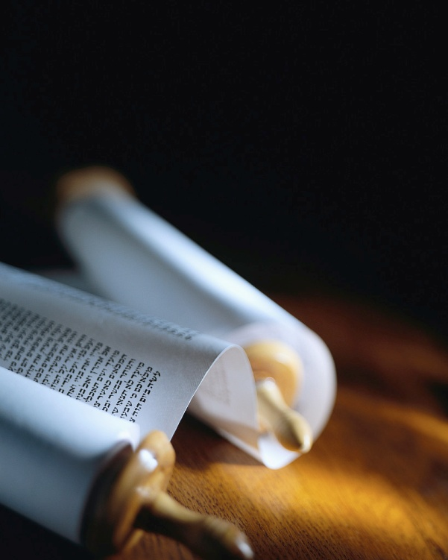
Let’s read this chapter again !
Our lives should be living proof.
Notes:
Now that we have discovered the outline and context of every verse, it is time to listen carefully to each word. [read Jn12 from Bible]
>Will others trust Jesus because of the way I live each and every day ?

Slide 16
Review, react and remember:
Why trust Jesus ENOUGH TO ASK HIM for salvation ?
There are many good reasons.
John 12 shows we can trust Jesus because of His followers : living proof of a transformed life
www.AzBible.yolasite.com
Notes:
Let’s look at the three “R”s once again !

