Slide 1
The Gospel according to John
Why trust Jesus ?
Because of the witnesses…
His words…
His followers…
His death and resurrection.
ABC… All the Bible in its Context
Notes:
>Let’s continue our journey with John… to see Jesus.
>This is one of the most important questions in life !
There are many good reasons to trust Jesus.
Faith in Christ is logical.
True science & accurate history support it.
True Christian faith is never just a leap in the dark !
>The book of John gives the answers why we trust Him…
>Every part of this book of the Bible was written to answer this question : Why trust Jesus ?

Slide 2
The key word in the book of John is believe (98x) meaning trust.
You can trust Jesus thanks to :
The witnesses in ch1-3
His words in ch4-11
His followers in ch12-17
His death & resurrection ch18-21
The key verse is Jn20v31.
Notes:
>By counting the number of times a word is repeated in any book of the Bible we can determine what the subject is.
The Greek word translated “believe” in most English Bibles simply means “trust”.
>By reading the whole book with the key word in mind we can discover where the author is going. He wants you to trust Jesus w/ more than a blind faith. This then is a book to discover AND grow in faith !
This is the message of the book and we can summarize it in a sentence.
>Each section of the book completes the message…
>There is a key verse in the book that summarizes this message.

Slide 3
This is the context of the whole book of John.
“ These have been written so that you may believe that Jesus is the Christ, the Son of God ; and that believing you may have life in His name.
John 20:31 NASB
…the context of every part.
Notes:
>The key verse is the context in which all the others were written.
>The key word is used two times in this one verse !
>This is the reason each story is told in this book.

Slide 4
Let’s continue with John 4-11
Trust Jesus because His Word is :
Convincing, Jn4v1-42
Healing, Jn4v43-5v47
Compassionate, Jn6v1-21
Nourishing, Jn6v22-71
Revealing, Jn7
The list continues…
Notes:
>Let’s continue our journey with John to see Jesus.

Slide 5
John 4-11 is rich in reasons.
Trust Jesus because His Word is :
Liberating, Jn8
Sight giving, Jn9
Leading, Jn10
Life giving, Jn11
We have already look at Jn4v1-42.

Slide 6
Let’s take up our journey in John 4v43.
“After the two days He went forth from there into Galilee. For Jesus Himself testified that a prophet has no honor in his own country. So when He came to Galilee, the Galileans received Him, having seen all the things that He did in Jerusalem at the feast ; for they themselves also went to the feast.”
John 4:43-45 NASB
There were eye witnesses.

Slide 7
The story continues !
“Therefore He came again to Cana of Galilee where He had made the water wine. And there was a royal official whose son was sick at Capernaum. When he heard that Jesus had come out of Judea into Galilee, he went to Him and was imploring Him to come down and heal his son ; for he was at the point of death.”
John 4:46-47 NASB
The witnesses were heard.

Slide 8
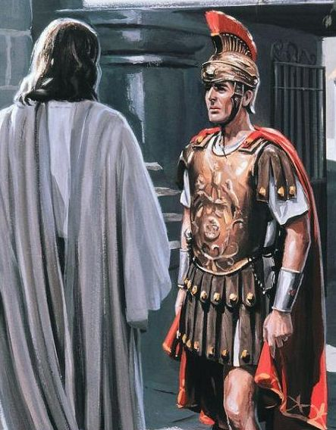
Jesus challenged his faith.

Slide 9
Believing because of signs is just a first step to believing Jesus.
“So Jesus said to him, ‘Unless you people see signs and wonders, you simply will not believe.’ The royal official said to Him, ‘Sir, come down before my child dies.’ ”
John 4:48-49 NASB
Jesus teaches us about trusting.

Slide 10
Jesus wants our confidence.
“Jesus said to him, ‘Go ; your son lives.’ The man believed the word that Jesus spoke to him and started off. As he was now going down, his slaves met him, saying that his son was living.”
John 4:50-51 NASB
He believed Jesus’ word.

Slide 11
Jesus’ word can heal.
“So he inquired of them the hour when he began to get better. Then they said to him, ‘Yesterday at the seventh hour the fever left him.’ So the father knew that it was at that hour in which Jesus said to him, ‘Your son lives’ ; and he himself believed and his whole household.”
John 4:52-53 NASB
His faith in Jesus became solid.

Slide 12
This is the 2nd step of faith.
“This is again a second sign that Jesus performed when He had come out of Judea into Galilee.”
John 4:54 NASB
Jesus wants us to trust Him because of His Word.

Slide 13
Let’s continue our journey !
“After these things there was a feast of the Jews, and Jesus went up to Jerusalem. Now there is in Jerusalem by the sheep gate a pool, which is called in Hebrew Bethesda, having five porticoes. In these lay a multitude of those who were sick, blind, lame, and withered.”
John 5:1-3 NASB
Will Jesus heal everyone ?

Slide 14
Jesus word can heal anyone.
“A man was there who had been ill for thirty-eight years. When Jesus saw him lying there, and knew that he had already been a long time in that condition, He said to him, ‘Do you wish to get well ?’ ”
John 5:5-6 NASB
He chose just one man.

Slide 15
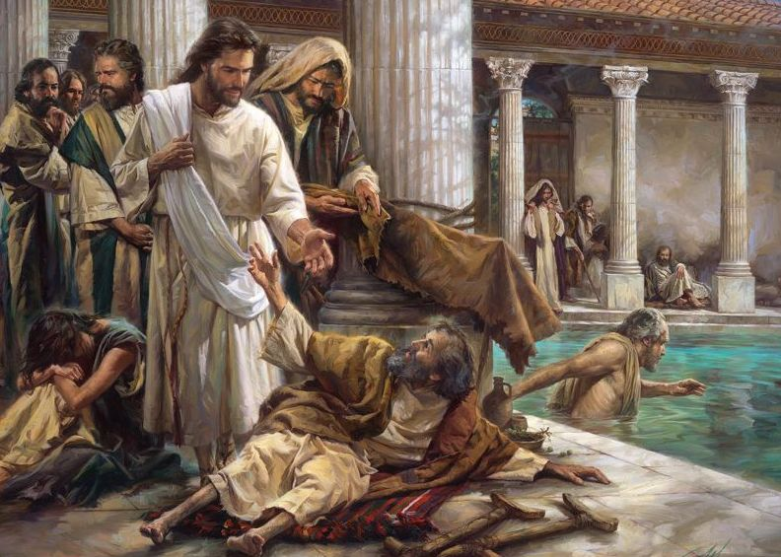
Why me. Lord ?

Slide 16
This man saw no hope of healing.
“The sick man answered Him, ‘Sir, I have no man to put me into the pool when the water is stirred up, but while I am coming, another steps down before me.’ Jesus said to him, ‘Get up, pick up your pallet and walk.’ Immediately the man became well, and picked up his pallet and began to walk.”
John 5:7-9 NASB
Jesus used only His Word.

Slide 17
We must hurry on our journey.
But, don’t forget to read what reaction came from those who refused to believe !
Read all of John 5 in this context : trusting Jesus because of His word.

Slide 18
Jesus word healed many.
“For this reason the Jews were persecuting Jesus, because He was doing these things on the Sabbath. But, He answered them, ‘My Father is working until now, and I Myself am working.’ ”
John 5:16-17 NASB
He healed many by just a word.

Slide 19
Jesus words can heal…
“For just as the Father raises the dead and gives them life, even so the Son also gives life to whom He wishes. …Truly, truly, I say to you, an hour is coming and now is, when the dead will hear the voice of the Son of God, and those who hear will live.” John 5:21 et 25 NASB
…and one day all who trust Him.

Slide 20
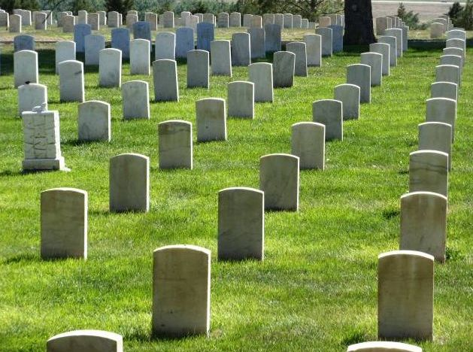
Christ will raise the dead.

Slide 21
What’s the secret ?
“Truly, truly, I say to you, he who hears my word, and believes Him who sent me, has eternal life, and does not come into judgment, but has passed out of death into life.” John 5:24 NASB
Listen to Jesus words as He heals broken lives.

Slide 22
Review, react and remember:
Jesus’ word can heal broken lives.
The Bible is filled with examples.
History is their to remind us.
He will heal one day all who put their faith in Him for their salvation.
You can trust Jesus today.

