Slide 1
A fresh look at our mission !
Let’s ask the Bible some important questions :
Why be a missionary ?
Where can I start ?
The Gospel of John has the answers.
Notes:
If you are a believer in Christ, you have a mission in life.
God has saved you for a purpose.
There is no greater joy than doing His will.
The Bible reveals God’s plan for every one of us.
It reveals God’s plan for our salvation from sin and His plan for our daily lives.
There is much more to God’s plan than a ticket to Heaven !
Every believer in Jesus Christ is called to make disciples.
That’s our mission either at home or over seas.
Before you can be a missionary, you need to know why.
The hardest part of any mission is getting started.
Once you have had the joy of leading a soul to Christ it becomes a passion !
Personal soul winning becomes easy with practice.
The Gospel of John is the soul winners manual.
Let’s “look in The Book” for the answers to these questions.

Slide 2
“Jesus said… as the Father has sent me, I also send you." Jn 20v21
Notes:
Jesus came into the world with a mission.
Now it’s our turn to go !
Or do you think we are taking this verse out of context ?
That’s the reason most people are not soul winners.

Slide 3
“ ‘Let us reason together,’ says the LORD.” Isaiah 1v18 NASB
He is speaking to your heart.
Notes:
Isaiah 1v18 says : “ ‘Come now, and let us reason together,’ says the LORD, ‘though your sins are as scarlet, they will be as white as snow ; though they are red like crimson, they will be like wool.’ ”
God created reason and He gives us reasons to trust Him.
He wants us to trust Him enough to ask Him for forgiveness and salvation.
But, he also wants us to trust Him with our lives, our future, our mission or purpose.

Slide 4
Let’s look at John 1 in the context of trusting Jesus.
Why be a missionary ?
and
Where can I start ?
We can trust the answers.
Notes:
Open your Bible with me to John chapter 1.
I have prepared for you a survey of the Gospel of John to see the context of what we are about to read. [handouts]
You will discover that 7 important questions about any passage or book in the Bible helps us understand the context of any verse we are considering. I have done this for all 66…
1) Who wrote it and who is speaking ?
2) When was it written and the events took place ?
3) To whom was it written and spoken ?
4) What are the natural divisions ?
5) What key word is repeated the most ? “Trust” 98x !
6) What is the message in a simple short sentence ?
7) How can this be put into practice in my life ?
Let’s ask the Bible these two questions… [Read screen]
When we read the answers in the light of their context there is no doubt we can trust Jesus to have the answers.

Slide 5
Let’s read John 1v1-34…
“The next day he saw Jesus coming to him and said, ‘Behold, the Lamb of God who takes away the sin of the world !’ ” John 1v29 NASB
The world needs to know.
Notes:
Let’s read the first half of John chapter one for context…
In verse 29 we find a phrase that is repeated two times in this same chapter. (cf. v29 + 36)
When someone repeats himself, that means it is really important.
Here is the answer to our question : Why be a missionary ?
The world does not know the simple truth that Jesus saves from sin.
We need to point people to Jesus, to get them to look at Him !

Slide 6
Why be a missionary ?
“There is salvation in no one else ; for there is no other name under heaven that has been given among men by which we must be saved." Acts 4v12 NASB
Trusting Jesus is urgent !
Notes:
Jesus did not tell his disciples to build church buildings.
That’s not wrong to do.
He did not tell them to only do social work.
Social work is not wrong either.
He did not tell them to be silent witnesses.
You cannot be silent if you are a witness !
Just try it in a court of law and you will find yourself in contempt of court !
The world needs to hear about Jesus.
There is only one Saviour from sin.
We must be saved by Him or we will be lost for all eternity.
There is nothing more urgent than coming to trust the Lord Jesus Christ.

Slide 7
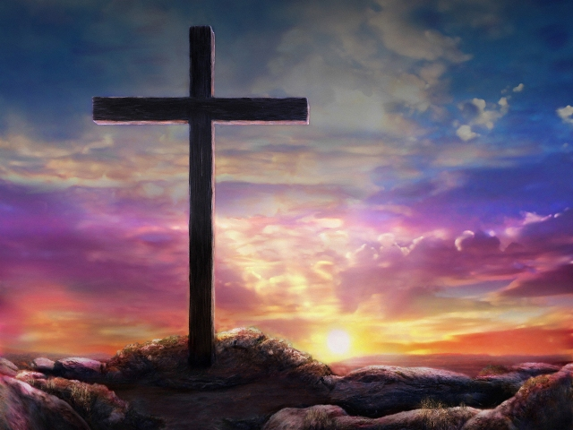
He paid the price.
“Jesus said to him, ‘I am the way, and the truth, and the life ; no one comes to the Father but through Me.’ ”
John 14v6 NASB
There is no other way !
Notes:
The Good News needs to be told !
Paul said in 2 Corinthians 5v14 : “For the love of the Christ constrains us, having judged this : that one died for all, then all have died ; and he died for all, that they who live should no longer live to themselves, but to him who died for them and has been raised.”
Why be a missionary ? [Read screen]
The world need to know that the Lord Jesus is the only way.

Slide 8
So where should we start ?
Let’s find the answer in John 1v35-51...
Imagine the excitement !
Notes:
The hardest part about being a missionary is getting started.
That’s the hardest part of any job !
We all like to procrastinate.
“I’ll do it later when I’ve finished school.”
“I’ll be a missionary when I’m retired.”
“I’ll do it when I have the time.”
We all know the results… the job never gets done !
What does the Bible say ?
Let’s read the answer to our question in the rest of John 1…
Put yourself in their place.
Neither Andrew nor Philip had ever done this before.
They were Jesus’ first missionaries.

Slide 9
John was not a silent witness.
“The next day John was standing with two of his disciples, and he looked at Jesus as He walked, and said, ‘Behold, the Lamb of God !’ The two disciples heard him speak, and they followed Jesus. John 1v35-37 NASB
Let’s start right away !
Notes:
Let’s look at each person in this story.
[read screen…]
Notice that John spoke out load.
You are NOT a witness if you are silent.
John did NOT waste any time.
He spoke about Jesus as soon as he could, as soon as he discovered who He was.
That’s what we need to do.
Every time we keep silent, it becomes easier to remain silent !
John saw immediate results from his spontaneous witness and so will you.

Slide 10
Each one brought one !
“One of the two who heard John speak and followed Him, was Andrew, Simon Peter's brother. He found first his own brother Simon and said to him, ‘We have found the Messiah’ (which translated means Christ). He brought him to Jesus.” John 1v40-42 NASB
He started with his family.
Notes:
Andrew is the second person in this story.
He shows us a secret that many people don’t notice.
[read screen…]
If EVERYONE counts on someone else to talk to others about Christ, NO ONE will !
Andrew did not go out and try to get a crowd to come to Jesus.
He did what we all can do ; he brought one person.
He started with his family.
That’s the best place to begin being a missionary, your own “Jerusalem”.
If you are not a missionary at home, you will never make it in public and certainly not in overseas missions !

Slide 11
You don’t need a crowd.
“Philip found Nathanael and said to him, ‘We have found Him of whom Moses in the Law and also the prophets wrote, Jesus of Nazareth, the son of Joseph.’ Nathanael said to him, ‘Can any good thing come out of Nazareth ?’ Philip said to him, ‘Come and see.’ ”
John 1v45-46 NASB
He invited his friend.
Notes:
The principal is easy to remember : “Each one bring one !”
[read screen…]
Here it is again !
Philip brought just one person to Jesus.
He didn’t try to convert his friend, but left that up to Jesus.
He brought his friend to hear Jesus and so can we.
He did not argue with his friend over his doubts.
He just brought him to the Lord to listen for himself.
If each one in this chapel brought just one other person to hear the Gospel, we would see the congregation double over night. That’s our mission and we can start this week !
We all have unsaved friends and neighbors.
There is no greater way to show friendship than saying, “Come and meet Jesus !”

Slide 12
“Each one bring one !”
“Nathanael answered Him, ‘Rabbi, you are the Son of God ; you are the King of Israel.’ ” Jn 1v49 NASB
The first step in trusting Jesus is often thanks to a witness, someone who testified.
You could be that one.
Notes:
But, does it work ?
[read screen…]
I heard solid statistics that said 80% of the people you invite to church will come.
Most people are curious and with a friend at their side, they will come.
Philip just invited his friend to come and look what happened ! [Read screen]
According to the book of John, there are many reasons to trust Jesus. Just look at the handout I gave you.
The first reason John presents in chapters 1-3 is all the witnesses, the great number of people talking about Jesus.
So let’s do it !
Perhaps you have never tried.
Ask God to make you a missionary this week for just one person.

Slide 13
“Each one bring one !”
Let’s just do it !
Notes:
We don’t need to reinvent the church.
We don’t need to entertain people to get them to come to church.
We don’t need to use publicity stunts.
We just need to follow the pattern set in God’s word.
Soul winning is a personal affair.

Slide 14
Review, react and remember:
Our mission is to help others trust Jesus… enough to ask Him for His forgiveness and salvation.
Our witness may be the first reason others trust Jesus.
If each one brings one there will be twice as many who hear Jesus speak to their heart today !
Let’s look today for that one.
Notes:
Here are the three “R”s of a good Bible study…
>[read screen…]
>[read screen…]
>Don’t try to invite crowds, or even two people.
After presenting the Gospel you can only talk to one person at a time !
After a meeting at the chapel you can only talk to one guest at a time.
Begin by bringing just one person to hear Jesus.
You can do it on a coffee break at work, or working out at the gym, or in your home !
If that person doesn’t continue, chose another one person to make a disciple of the Lord Jesus.
The world begins at our doorstep.
Let’s begin world missions right here at home !

