Slide 1
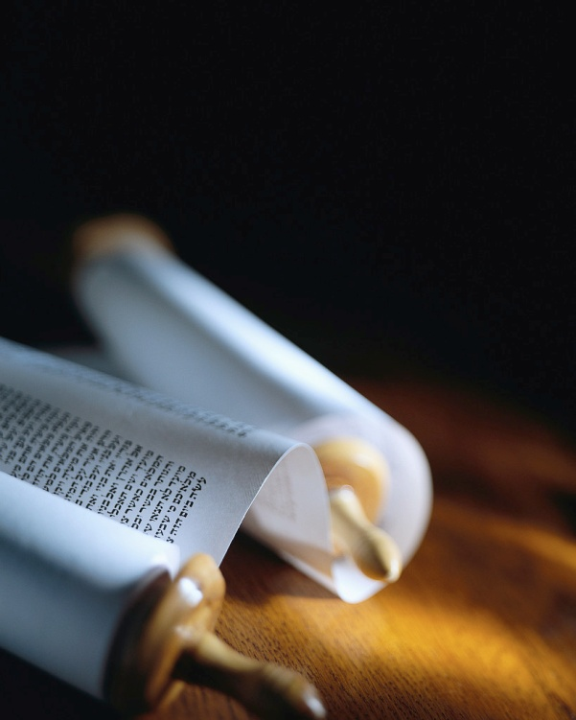
Notes:
Revision of Five Finger Fishing for Men :
161023 Brooklyn Bible Chapel Baltimore MD
161025 Victoria Gospel Chapel Victoria VA w/o projector !
161026 Nokesville Gospel Chapel Nokesville VA
161102 Grace Gospel Chp Richmond VA
Etc… to 2017 ABS & SBC Powerful Living & Hardy Souls
HANDOUTS : Summary of Acts, Questions on Acts 1v18, 290 Questions Jesus asked & A Small fishing net.

Slide 2
What is your mission in life ?
“Jesus said… As the Father has sent me, I also send you." John 20v21 NASB
“Go into all the world and preach the gospel to all creation.”
Mark 16v15 NASB
Let’s let the Lord lead !
Notes:
It has often been said, “Aim at nothing & you are sure to hit it.”
Even the unsaved world has discovered the importance of a “MISSION STATEMENT”.
I found some company missions statements on internet. You can see them yourself at missionstatements.com/fortune.
‘Prpse of Cper Tre+Rbber Co is to earn mny’
‘Dle Fd Co is cmmittd to…spplyng finst… prd’
Our God has a plan for every Christian.[scr]
If He is our LORD, we need to obey Him !

Slide 3
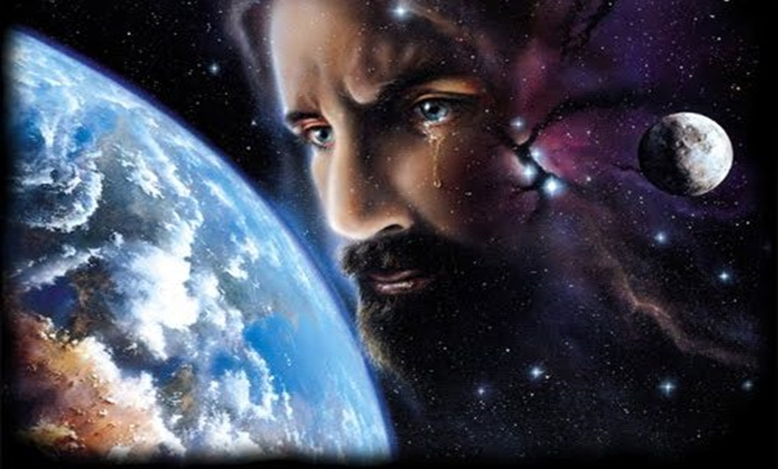
The mission is really big.
MISSION WORLD
Notes:
When Christ 1st came, His mission was Israel.
In Mt15v24, 18v3 + Mk10v6 His obvious objective is to convert the Jews.
He said, “Do not go to the nations, …but go to the lost sheep of Israel.”Mk10v5-6
But, now He says, “Go into all the world and preach the gospel to all creation” in Mk16v15. The mission has changed !
Compare His words in Lk9v3 w/Lk22v25-36.
This is our mission, unchanged for 2k years
Mission World starts at the end of my toes !

Slide 4
What’s the 1st Step ?
“You shall be my witnesses.” Acts 1v8
Let’s talk about Jesus !
Notes:
The hardest part is getting started !
I have a “hand full” of well known verses, so it will be easy to remember each step.
Let’s start with our first finger : Witnessing.
This is a text we all know. [scrn]
Jesus said it, to all of His disciples according to Ac1v3-4, 14-15 & 1Cor15v6.
This is not a request ; this is a prophecy !
You ARE a testimony of what Christ has done in your life, whether you like it or not
Let’s not talk about ourselves, but Him !

Slide 5
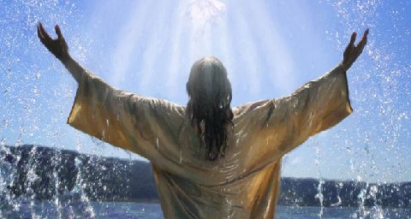
John is an example to follow.
“Jesus took away my sin”
Notes:
John saw Jesus come into his life, he listened to His word, and he received Him as LORD.
After John baptized Jesus, he testified of what he had seen and heard. (Jn1v7,15 & 34)
John told everyone, “Behold the Lamb of God, who takes away the sin of the world.”
Good witnesses tell what JC has done for us, not what we do for Him ! (cf.Jn1v29 & 36)
Good witnesses are faithful, never adding nor subtracting, even if it costs ! (Rev2v18)
A “silent witness” is a contradiction !

Slide 6
The 2nd step is Sowing Seed.
“The seed is the word of God.” Luke 8v11 NASB
“I planted, Apollos watered, but God was causing the growth. 1 Corinthians 3v6 NASB
“Jesus said, Believe me.”
Notes:
No one will get saved by hearing your story!
The story of what Christ did for you just works the soil of curiosity in others’ hearts.
Now’s the time to plant the Seed. [2ndfinger]
Christ’s parables focuse on His Word.[scrn]
Faith comes by hearing…the Word of God
It is absolutely essential to quote Christ, so that a person’s faith is in Him, not in us.[scrn]
Trusting Jesus at His Word (Jn4v21) is the only way anyone will ever ask Him to save them from their sin. (cf Rm10v13)[Handouts]

Slide 7
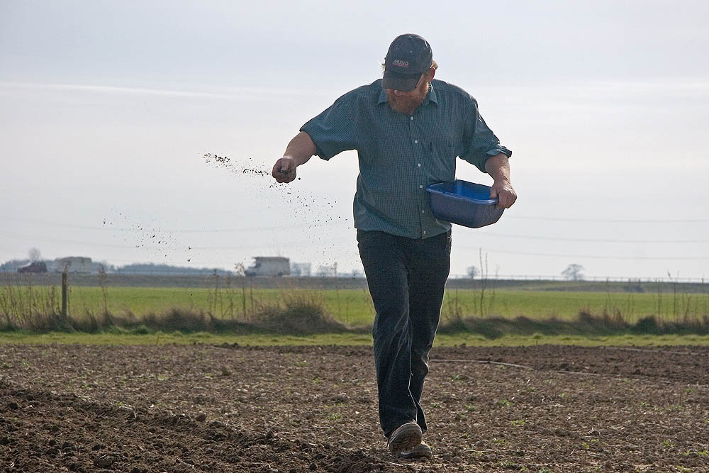
Jesus is our Model to imitate.
Let’s sow liberally.
Notes:
How should we “sow the Good Seed” ?
Mark 4v4 records, “As he was sowing, some seed fell beside the road, and the birds came and ate it up.” Was the Lord wasteful?
Ecclesiastes 11v6 says, “Sow your seed in the morning and do not be idle in the evening, for you do not know whether morning or evening sowing will succeed, or whether both of them alike will be good.”
Plan in your monthly budget to buy Bibles, NT and Gospels to give away each month !

Slide 8
The 3rd step is Leading.
“Follow me,
and I will make you
fishers of men.”
Matthew 4v19 NASB
Use leading questions !
Notes:
When Jesus spoke of being fishers of men, He never said to use a hook to catch people, but a net to draw them, alive and conscious.
Our perfect Model is the Master. [scr]
We need to be made into fishermen, since just having the tools isn’t enough. [scr]
The Methods of the Master are not the world’s commercial methods. [scr]
Jesus used over 290 questions to draw people to a decision about Him.
We often miss this key step. [Handouts]

Slide 9
How did Jesus do it ?
“What do you think about the Christ ?“
Matthew 22v42 NASB
Listen to the response !
Notes:
Jesus asked open questions, where the answer was not a simple “yes” or “no” !
He made people think, because a question demands a response.
After you have intrigued someone by your testimony, and then planted Seeds of God’s Word, now’s the time to ask a good question.
This is one of the best questions ! [scr]
Listen carefully to the response, so you can ask more leading questions, or plant more Seeds with God’s answers !

Slide 10
Answer their questions !
“Nathanael said to him, ‘Can any good thing come out of Nazareth ?’ Philip said to him, ‘Come and see.’ “
John 1v46 NASB
“Let’s look in the Book !”
Notes:
Leading others to Christ is not driving sheep to the slaughter !!!
People have honest, hard questions, before trusting Jesus with their eternity.
Here’s a beautiful example. [scr]
When you don’t know the answer, be honest, and bring the person to the One who has all the answers.
What was the result in Nathanael’s life ?
Jesus took over for Philip & convinced Nat.
Nathanael became a true believer !

Slide 11
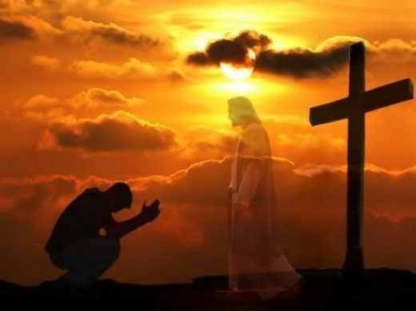
The 4th step is Saving.
“Salvation is of the Lord.”
Notes:
My 4th finger has a gold ring that reminds me only Christ can save a person.
After we have led a person to Christ by our testimony, giving His Word and drawing in the net by questions, we need to leave the rest to God.
He alone can convict of sin, righteousness and judgment by His Spirit. (cf Jn16v8-11)
He alone can forgive sins. (cf Lk5v21)
He alone is able to save. (Jn14v6, Ac4v12)
So, Jonah 2v9 is still true today ! [scrn]

Slide 12
Jesus is again our Model.
“After He had sent the crowds away, He went up on the mountain by Himself to pray ; and when it was evening, He was there alone.”
Matthew 14v23 NASB
Pray all night if necessary.
Notes:
Prayer is essential after sowing God’s Seed.
The spiritual battle begins after the Word of God enters a heart. [scr]
The Enemy of men’s souls will take God’s Word out of their mind, like birds pluck seeds
A lot of activities will suddenly arrive to choke the Word of God that has taken root.
A ton of problems will land in lives where the Word of God has been sown, drying it up.
The privilege of intercession for others’ salvation is wonderful. (cf Rm10v1)

Slide 13
The 5th and final step is discipling.
“Go therefore and make disciples of all the nations, baptizing them in the name of the Father and the Son and the Holy Spirit.” Matthew 28v19 NASB
Start witnessing together.
Notes:
Mission World is not finished yet, when someone becomes a new believer.
The task of making a disciple is just begun.
We are not asked to save anyone, but once they are, we need to walk with them, like Jesus did to make His disciples. [scr]
This is not just teaching doctrine and practice, but learning and doing it together.
You have to get wet too, in order to baptize someone ! …So witness it together.
This is why Jesus wanted to be baptized.

Slide 14
Disciples are not Mentored.
“…teaching them to observe all that I commanded you ; and lo, I am with you always, even to the end of the age.” Matthew 28v20 NASB
“I do the will of my Father”
Notes:
Mentoring is making a clone of yourself.
This is NOT making a disciple of Christ !
Here is the key difference. [scr]
JC did NOT say “teaching them all I have commanded you”, but “teach them to obey.”
We are to teach an attitude, a passion, a love for the Lord, not just information.
Why does He say, “…and lo, I am w/ you” ?
This is the way Jesus made His disciples, by walking w/ them, obeying His Father.
Open God’s Word together & obey it toget

Slide 15
Review, React and Remember :
All Christ’s disciples have a mission:
Acts 1v8 You will be My witnesses..
Acts 5v20 Speak the Words…
Acts 8v30 Philip ran… and asked…
Acts 16v14 The Lord opened her…
Acts 21v16 The disciples went with us
www.AzBible.yolasite.com
Notes:
The 3 R’s of learning are “Repetition, Running with the truth, and Returning for a checkup.
Mission World is huge and requires the mobilization of every Christian !
Let’s talk about Him and not ourselves.
Let’s quote Him without giving arguments.
Let’s lead others to Christ, not our church.
Let’s pray and trust the Lord to save.
Let’s make disciples by walking with them through God’s Word ; obeying it together.
If you missed any refrnces, they are on line

