Slide 1
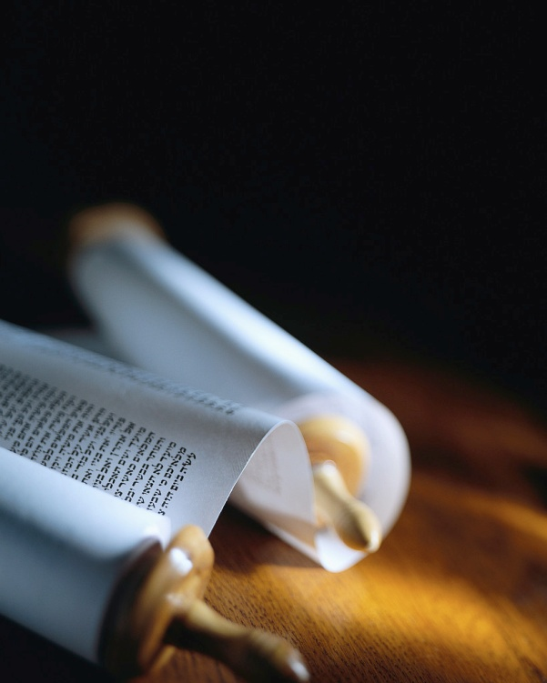
Next
Notes:
Cmptr scrn 100% 1366x768p
Animation Pane 50/50 avec slide mini + no menu above
8 lines max of notes here w/ Zoom here at 250%...
Lines of this length maximum
Presenter view > slide mini + nothing above + zoom notes 3x

Slide 2
Are you ready ?
“Sanctify the Lord God in your hearts: and be ready always to give an answer to every man that asks you a reason of the hope that is in you with meekness and fear.” 1 Peter 3:15
“Sanctify the Lord God in your hearts: and be ready always to give an answer to every man that asks you a reason of the hope that is in you with meekness and fear.” 1 Peter 3:15
Ready for what ?
When should I begin ?
How can I share this with others ?
We all need to be ready.
Next
Notes:
[read] Let’s read Luke 12:37-43…
JC tells us all to be ready.[read]
He will return without warning!
There is another reason to be ready for Christ’s return. [read]
This command of the Lord is for all Christians, because we all have hope after this life.

Slide 3
Ready for the Lord
“Sanctify the Lord God in your hearts: and be ready always to give an answer to every man that asks you a reason of the hope that is in you with meekness and fear.” 1 Peter 3:15
Ready for what ?
When should I begin ?
How can I share this with others ?
Does my life beg the question ?
Next
Notes:
Readiness is the watchword for Christians : “Maranatha !”
The word in Grk for “answer” is “ἀπολογία” or “apologetics”.
That’s right ! All Christians are capable of explaining their faith
Am I ready to talk about JC ?
Do I bring up the subject ?

Slide 4
Ready for every man
“Sanctify the Lord God in your hearts: and be ready always to give an answer to every man that asks you a reason of the hope that is in you with meekness and fear.” 1 Peter 3:15
Ready for what ?
When should I begin ?
How can I share this with others ?
Do I know the worth of a soul ?
Next
Notes:
The main reason we are not ready to talk, is lack of vision.
Jn3v16 says God so loved the world that He gave His Son.
1Jn2v2 says Christ died for the sins of the whole world,
Do I have this vision ?
Do I have the eyes of Christ?

Slide 5
Ready for the tough question
“Sanctify the Lord God in your hearts: and be ready always to give an answer to every man that asks you a reason of the hope that is in you with meekness and fear.” 1 Peter 3:15
Ready for what ?
When should I begin ?
How can I share this with others ?
Am I fearless ?
Next
Notes:
Let’s not miss any open door.
Sometimes we shy away from the tough questions, but that’s just when the world needs you !
Let’s be ready to lead others to the One who has all the answers.
Arguments will not save, but you can lead others to Christ.

Slide 6
Ready with a reason
“Sanctify the Lord God in your hearts: and be ready always to give an answer to every man that asks you a reason of the hope that is in you with meekness and fear.” 1 Peter 3:15
Ready for what ?
When should I begin ?
How can I share this with others ?
Can I give a logical answer ?
Next
Notes:
The Gospel is the reason there is hope.
The Plan of Salvation is the reason we have hope.
The Miracle of Salvation is the reason we know it’s true.
I have prepared a summary of what happens at Salvation. [gift]

Slide 7
Ready by choice
“Sanctify the Lord God in your hearts: and be ready always to give an answer to every man that asks you a reason of the hope that is in you with meekness and fear.” 1 Peter 3:15
Ready for what ?
When should I begin ?
How can I share this with others ?
Is Christ really first in my life ?
Next
Notes:
The 1st step is the hardest.
God doesn’t force anyone to give Him first place in their life.
But, when we do obey, it’s easy to tell others about Him.
Worship IN the sanctuary of the our heart, will lead to witness IN the world at our doorstep.

Slide 8
Ready with the Best
“Sanctify the Lord God in your hearts: and be ready always to give an answer to every man that asks you a reason of the hope that is in you with meekness and fear.” 1 Peter 3:15
Ready for what ?
When should I begin ?
How can I share this with others ?
Is He really the Almighty for me ?
Next
Notes:
He doesn’t ask us to set aside money, nor things, to be ready !
It’s not books nor brains, but a heart filled with His Holy Spirit.
Trust God to speak His Word through you to others.
You can’t save anyone, but He sure can.

Slide 9
Ready with a passion
“Sanctify the Lord God in your hearts: and be ready always to give an answer to every man that asks you a reason of the hope that is in you with meekness and fear.” 1 Peter 3:15
Ready for what ?
When should I begin ?
How can I share this with others ?
Do I love Him more than any other ?
Next
Notes:
Do you have a passion in life?
Heb4v12 says your spirit is the seat of your desires & intentions
Jesus said your words reveal what is really in your heart.
A passion for Christ is easy ☺
When your heart is filled with Christ, He will just shine out.

Slide 10
Ready by effort
“Sanctify the Lord God in your hearts: and be ready always to give an answer to every man that asks you a reason of the hope that is in you with meekness and fear.” 1 Peter 3:15
Ready for what ?
When should I begin ?
How can I share this with others ?
Am I willing to invest “my” time ?
Next
Notes:
Last, but not least, it takes an effort and time to be ready.
Being something you are not today, means a life transformed.
Let’s be honest, most of us are not ready to give an answer to every man we meet !
Memorize the verses I gave…

Slide 11
Ready with the facts
“Sanctify the Lord God in your hearts: and be ready always to give an answer to every man that asks you a reason of the hope that is in you with meekness and fear.” 1 Peter 3:15
Ready for what ?
When should I begin ?
How can I share this with others ?
Can I explain salvation ?
Next
Notes:
« I think » or « I feel » are not truths to trust.
Your testimony is not Gospel truth, but a tool to work the soil.
What the world needs are the facts about salvation, a reason to believe Christ at His Word.
Tell what it is, why and how…

Slide 12
Ready to bring hope
“Sanctify the Lord God in your hearts: and be ready always to give an answer to every man that asks you a reason of the hope that is in you with meekness and fear.” 1 Peter 3:15
Ready for what ?
When should I begin ?
How can I share this with others ?
Is my goal to lead others to Christ ?
Next
Notes:
Col1v27 says Christ in you is the hope of glory and Heaven.
The facts are important, but the goal is to receive Christ.
It’s not the facts in my head that brought me hope but Christ
The facts help us lead others to Christ & He then takes over.

Slide 13
Ready as bold, but self effacing
“Sanctify the Lord God in your hearts: and be ready always to give an answer to every man that asks you a reason of the hope that is in you with meekness and fear.” 1 Peter 3:15
Ready for what ?
When should I begin ?
How can I share this with others ?
Am I weak or meek ?
Next
Notes:
Paul asks in 1Cor2v17, “Who is sufficient for these things ?”.
The manner is just as important as the message.
Meekness ≠ weakness !
Be like a “gentle giant”, who has his strength under control.
Be bold, assured, but gentle.

Slide 14
Ready to be judged
“Sanctify the Lord God in your hearts: and be ready always to give an answer to every man that asks you a reason of the hope that is in you with meekness and fear.” 1 Peter 3:15
Ready for what ?
When should I begin ?
How can I share this with others ?
Do I truly fear God ?
Next
Notes:
Last of all, remember to be ready to be called home.
Our time on earth is short, so we should fear (φόβος) wasting it. (It is incorrect to translate this word as reverence or respect ! We do not just revere God.)
Godly fear truly motivates.

Slide 15
Review, React, Return
1 Peter 3v15 is very clear :
Be ready speak of Christ.
Start by putting Him first.
Spend time learning about Christ’s so great salvation.
Ready for what ?
When should I begin ?
How can I share this with others ?
www.AzBible.yolasite.com
Notes:
The 3 R’s of learning are NOT « reading, writing & arithmetic »
Repetition is the seat of learning.
Running with the new truth is essential.
Re-examining our progress down the road is a key. >[read]

Slide 16
Hebrews 2v3
Thank you, Lord, for saving my soul.
Thank you, Lord, for making me whole.
Thank you, Lord, for giving to me…
Thy GREAT SALVATION so rich and free !
Words by Seth & Bessie Sykes 1929
Music by Phil Laeger © 1945
Notes:
Let’s sing an old chorus that reminds us we have so a great salvation !
Q/A ? Example of being ready to tell of salvation…

