Slide 1
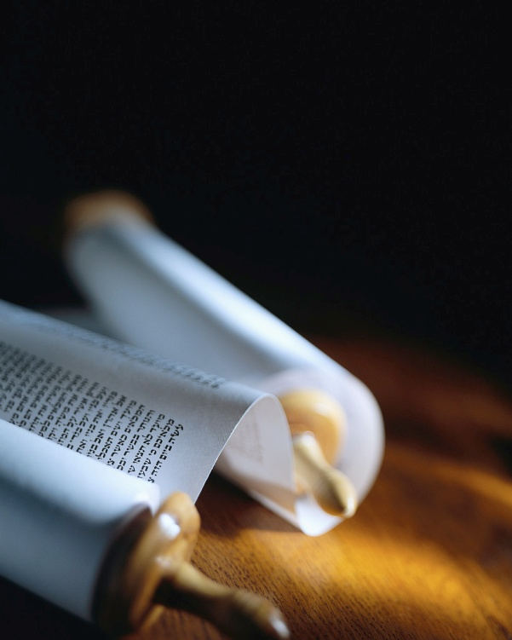
Next
Notes:
My passion is leading others to Christ, but He alone can save !
Heb2:3 says, “How will we escape if we neglect so great a salvation ?”
Let’s make a priority of it.
But, what’s so great about the offer of personal salvation ?

Slide 2
Salvation is like a diamond.
It has many facets !
Next
Notes:
Let’s look in the Bible for what it says about personal and eternal salvation.
I have prepared a summary of some of the key words used in the Bible to describe what God does in a flash, the moment someone is saved. [handouts]

Slide 3
“So great a salvation” Hebrews 2:3
“Blessed be the God and Father of our Lord Jesus Christ, who according to His great mercy has caused us to be born again to a living hope through the resurrection of Jesus Christ from the dead.” 1 Peter 1:3
Who does it ?
When does it take place ?
What does it do to me ?
It’s a genuine miracle !
Next
Notes:
Let’s read Jn3:1-9… [read]
One of the most amazing aspects of salvation is this. [read]
Like Nicodemus, let’s ask some important questions. [read]
Being born again is better than “reformed living”, it’s the beginning of everlasting life.

Slide 4
The Bible reveals the answers.
“Blessed be the God and Father of our Lord Jesus Christ, who according to His great mercy has caused us to be born again to a living hope through the resurrection of Jesus Christ from the dead.” 1 Peter 1:3
Who does it ?
When does it take place ?
What does it do to me ?
God alone can perform new birth.
Next
Notes:
This one verse answers all three questions, if we let it.
The God who caused the pre-existing Christ to be born a man can cause humans to be born again as children of God.
Jn1:12-13 say it is only by God’s power & will one is b.a.

Slide 5
God becomes our Father in Heaven.
“Blessed be the God and Father of our Lord Jesus Christ, who according to His great mercy has caused us to be born again to a living hope through the resurrection of Jesus Christ from the dead.” 1 Peter 1:3
Who does it ?
When does it take place ?
What does it do to me ?
God is no longer distant.
Next
Notes:
The Eternal God and Father of our Lord JC miraculously becomes our Father in Heaven.
In Jn20:17 Jesus says God is His God & Father and now ours.
2Co 6:18 says "I will be a Father to you & you shall be sons & daughters to Me."

Slide 6
God had it all planned.
“Blessed be the God and Father of our Lord Jesus Christ, who according to His great mercy has caused us to be born again to a living hope through the resurrection of Jesus Christ from the dead.” 1 Peter 1:3
Who does it ?
When does it take place ?
What does it do to me ?
New birth is part of His plan.
Next
Notes:
How great is this salvation ?
The One who has great mercy, planned salvation before we were born, almost 2,000 years ago.
Mercy = looking ahead for us.
Grace = after we have sinned.
God is the essence of love because of His mercy (Jn4:8 & 16)

Slide 7
He is praised and happy.
“Blessed be the God and Father of our Lord Jesus Christ, who according to His great mercy has caused us to be born again to a living hope through the resurrection of Jesus Christ from the dead.” 1 Peter 1:3
Who does it ?
When does it take place ?
What does it do to me ?
Let’s share the good news.
Next
Notes:
Who alone should be praised for this miracle of new birth ?
He is praised by over 2 billion on earth, more in Heaven and by an untold number of angels.
Ps22:5 says He inhabits the praises of His people.
The world needs to know this !

Slide 8
All who are truly saved are born again.
“Blessed be the God and Father of our Lord Jesus Christ, who according to His great mercy has caused us to be born again to a living hope through the resurrection of Jesus Christ from the dead.” 1 Peter 1:3
Who does it ?
When does it take place ?
What does it do to me ?
It is once for all.
Next
Notes:
Being born again is NOT a second blessing after salvation.
Notice the past tense !
Notice that he does NOT say, “…has caused some of us to be born again.”
This is your birth certificate.
There is a date and hour !

Slide 9
It’s the first step in new life.
“Blessed be the God and Father of our Lord Jesus Christ, who according to His great mercy has caused us to be born again to a living hope through the resurrection of Jesus Christ from the dead.” 1 Peter 1:3
Who does it ?
When does it take place ?
What does it do to me ?
It’s not an end in itself.
Next
Notes:
God created birth, to teach a spiritual truth, that is just as real.
1Pe2:2 says we should want to grow like new born babies.
Heb5:12-13 & 1Cor3:2 say solid food is normal to mature.
The image of birth says a lot about salvation’s goal.

Slide 10
You can’t loose it, if you choose it.
“Blessed be the God and Father of our Lord Jesus Christ, who according to His great mercy has caused us to be born again to a living hope through the resurrection of Jesus Christ from the dead.” 1 Peter 1:3
Who does it ?
When does it take place ?
What does it do to me ?
Once saved, always saved.
Next
Notes:
It’s a fact: you can’t get unborn.
New birth is forever.
There is no going back, even if you fall along the way.
There is always hope !
Because it occurs the instant you receive Christ, eternal security is always true.

Slide 11
Raised to new life already.
“Blessed be the God and Father of our Lord Jesus Christ, who according to His great mercy has caused us to be born again to a living hope through the resurrection of Jesus Christ from the dead.” 1 Peter 1:3
Who does it ?
When does it take place ?
What does it do to me ?
Everlasting life begins now.
Next
Notes:
The miracle of new birth is the beginning of everlasting life
It’s NOT just an extension of this life, but a resurrection, like when Christ rose from the dead.
It’s NOT an event in the future, but a reality today.
Jn3v12 shows it is for today.

Slide 12
What difference does it make ?
“Blessed be the God and Father of our Lord Jesus Christ, who according to His great mercy has caused us to be born again to a living hope through the resurrection of Jesus Christ from the dead.” 1 Peter 1:3
Who does it ?
When does it take place ?
What does it do to me ?
It’s a totally new life !
Next
Notes:
So how does God do it ?
New birth is necessary, since we are all born the first time in a state of spiritual death.
Rm5:14 says since Adam, everyone is condemned to die.
Eph2:1-2 say it is because our spirit was dead in sin.

Slide 13
A new heart with a new spirit
“You have not received a spirit of slavery leading to fear again, but you have received a spirit of adoption as sons by which we cry out, ‘Abba! Father!’ ” Romans 8:15
Who does it ?
When does it take place ?
What does it do to me ?
It’s a spiritual new birth.
Next
Notes:
Ez11:19 & 26 say God gives a new heart, with a new spirit.
Rm8 explains the miracle. [rea
Note the indefinite article to indicate it is NOT the Holy Spirit.
Rm8:16 speaks of 2 spirits in a born again person, the HS+ours.
God gives a new human spirit.

Slide 14
Regeneration is a new creation.
“Therefore if anyone is in Christ, he is a new creature; the old things passed away; behold, new things have come.” 2 Corinthians 5:17
Who does it ?
When does it take place ?
What does it do to me ?
It starts deep in the heart.
Next
Notes:
Being born again is a miracle.
There is no doubt about it, if you are truly born again, your life is totally transformed.[read]
This is more than intellectual faith, education or reformation.
Desires, intentions & passions all change, with new birth.

Slide 15
Living His life on earth
“I have been crucified with Christ; and it is no longer I who live, but Christ lives in me; and the life which I now live in the flesh I live by faith in the Son of God, who loved me and gave Himself up for me.” Galatians 2:20
Who does it ?
When does it take place ?
What does it do to me ?
It’s a whole new life.
Next
Notes:
As the Greek word in John 3 indicates, this is life from above.
Paul was given a revelation of this life from above. [read]
That’s right, ‘it is no longer I that live, but Christ lives in me’ !
This is truly a great salvation, much more than a simple faith.

Slide 16
Review, React, Return
1 Peter 1:3 reveals one of the greatest aspects of salvation by Jesus Christ.
God performs the miracle.
All true Christians are born again when they are saved.
It totally transforms life.
Who does it ?
When does it take place ?
What does it do to me ?
www.AzBible.yolasite.com
Notes:
Repetition is the seat of learning, running with the truth is essential, and reviewing its effect on me is important.
Let’s do it and share the Good News. [read]

