Slide 1
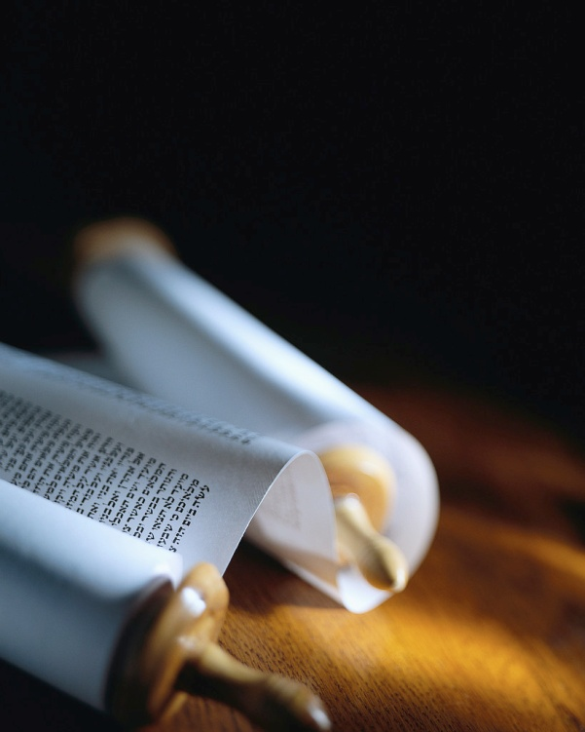
All the Bible in its Context
Notes:
Good morning !
>This morning we have a wonderful Bible text to consider.
But, before we do, let’s make sure we understand its CONTEXT !

Slide 2
All the Bible has a Context !
“Do you understand what you are reading ?”
Acts 8v30 NASB
“How can I ?” Ac8v31 KJV
Notes:
You know how upset a politician is when someone quotes him OUT OF CONTEXT !
Imagine how angry God is when someone quotes Him out of context.
You can MAKE the Bible say almost anything by quoting a text OUT OF CONTEXT.
>After 40 years of missionary work in France, and as I travel across America I like to ask this simple Bible question… (read screen)
Most people do NOT understand what they are reading.
>The very next verse in Acts is another question !

Slide 3
All the Bible in its Context
τουτο πρωτον γινωσκοντες οτι πασα προφητεια γραφης ιδιας επιλυσεως ου γινεται
2 Peter 1v20
This is the first AND most important Bible study rule.
Notes:
The key to understanding the Word of God is reading it in its context.
>We find this verse in 2 Peter 1v20 in the MIDST OF A CONTEXT all about God’s written Word, the Bible, Holy Scripture !
It says “This FIRST KNOW that no Scripture given by a prophet of God can be understood all by itself.”
BEFORE coming to any conclusions about what the Bible is saying, READ THE CONTEXT !
>LOCATION means everything in real estate AND in Bible understanding.
Even is you do not understand Hebrew or Greek, the context of any Bible passage will help you understand its meaning.

Slide 4
Here’s how God says it…
τουτο πρωτον γινωσκοντες οτι πασα
this first know that all
προφητεια γραφης ιδιας επιλυσεως
prophetic writing of its own loosening
ου γινεται
not is made
This is a simple tool for serious Bible study !
Notes:
I am not proposing my way of interpreting the Bible, but God’s way !
>Let’s do a simple word for word translation of this key verse… (read screen)
What a wonderful way of saying it !
You cannot “loosen” a text from its context… they are inter-dependant.
>You don’t need a college degree to understand God’s Word.
This is one of the many SIMPLE tools you can use.
YOU can do serious Bible study by just reading the context !

Slide 5
Let’s do it !
Let’s read Romans 8v1-4…
Ask any Bible text 7 questions :
4. What sections ?
5. What key word ?
6. What sums it up ?
7. What should I do ?
Who is the writer ?
When was it said ?
To whom ?
The Gospel is the power of God.
Notes:
Let’s remember the context of our Bible text.
Help yourself to the SUMMARY of the whole book of Rm.
>Open you Bible with me to Romans 8v1-4… (read)
>You have a summary of this book with SEVEN key QUESTIONS you can ask of any book, chapter, paragraph, verse or single sentence in the Bible.
>Who, when and to whom are very important questions.
Not all the Bible is addressed to YOU !
A promise of prosperity to Israel is not addressed to YOU.
>What, where and how are also key questions.
They set the stage for the verses we are considering today.
>We can summarize the book by quoting Romans 1v16…
I always formulate a question and let the book answer it.
So I would just ask “HOW ?”
EVERY verse in this book is the answer !
That is the CONTEXT of our passage for this morning.

Slide 6
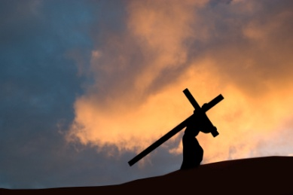
How is the Gospel the power of God for my salvation ?
Notes:
Here is the question that this Bible text answers !
Since the whole book is about the Gospel, this is an explication of how it works, HOW is this Good News about Jesus’ death and resurrection powerful in my life ?
You might have noticed that I read from the NASB.
That is because none of the old Greek manuscripts of the NT contain an added commentary “…who walk not after the flesh, but after the Spirit.”
That is not in the Bible, because as we will see, forgiveness does NOT depend upon our actions, but on the finished work of the L-J-C on the cross.
HE carried the cross, not me !

Slide 7
This is basic Christianity.
“Therefore there is now no condemnation for those who are in Christ Jesus.”
Romans 8v1 NASB
Are you forgiven ?
Notes:
Romans 8v1-4 is not just for the super spiritual Christian !
>No one who trusts the Lord Jesus Christ enough to ask Him to save them will be LOST along the way !
What does it mean to be “in Christ Jesus” ?
When you are saved, you enter INTO relationship with JC.
Eph1-3 uses the words “IN HIM” 8x revealing all we receive IN HIM the day we receive Him as Lord and Savior.
Rm1v18 already REVEALED the WRATH of God against sin.
It does not say His wrath is against the sinner YET… BUT, if you do not receive Christ Jesus as Lord and Savior, you are not IN Christ’s body of all He has saved OUT of the world.
>You stand to be condemned at death without Christ.
Don’t let this moment pass without trusting the L-J-C by asking Him to forgive you for all your sin.
You will no longer be condemned either by others nor, most importantly, by Holy God !

Slide 8
The Gospel is really Good News.
“Wretched man that I am ! Who will set me free from the body of this death ? Thanks be to God through Jesus Christ our Lord !” Rm7v24-25 NASB
Are you delivered ?
Notes:
The context of Romans 8v1 is the chapter just before it.
>In the revelation of the Gospel, God shows us how bad off we are.
He reveals His salvation not only from the PUNISHMENT of sin, but also now from the POWER of sin.
You are not truly saved if you cannot shout for joy, like the Paul does, for deliverance from sin and temptation.
>Jesus said, “By their fruits you will know them.” Mk7v20

Slide 9
Freed from the punishment…
…and the power of sin !
Notes:
The power of God in the Gospel is not limited to forgiveness for our sins.
>The Good News is that God delivers from both the PUNISHMENT and the POWER of sin.
Is there the FRUIT of salvation in your life ?
Are you different from all the others who speed past the 55 mph sign ?
Do you chose to spend a holiday helping someone in the Name of Jesus, rather than enjoying pleasures for yourself ?
Is what you watch on TV or Internet worthy of the L-J-C ?
Have you found victory ?

Slide 10
This is how it works…
“For the law of the Spirit of life in Christ Jesus has set you free from the law of sin and of death.”
Romans 8v2 NASB
It’s more than forgiveness.
Notes:
Let’s continue in our text under consideration.
>The word “law”, νόμος in Greek, is used 196x in the NT and 243x in the Septuagint translation of the OT.
It can mean a rule you must follow or suffer a penalty OR it can mean a statement of the way things work, like a scientific law, an observation of God’s creation works.
There is NO OPTION to the 2nd sense of the word “law”.
You cannot defy laws of physics & just pay a prking ticket.
If I let go of a heavy metal ball it WILL fall to the ground.
You have seen a junk yard magnet over a wrecked car; the moment the power goes on the car jumps up to the crane.
>This is what God does when you are saved.
This is a SPIRITUAL LAW, similar to a LAWS OF PHYSICS, so powerful that you CANNOT stay dead in your sins.
That means THE Spirit of life, the HS of God that raised JC from the dead (verse 8 !) sets you free from sin and death.

Slide 11
It’s not rule keeping.
“For what the Law could not do, weak as it was through the flesh, God did : sending His own Son in the likeness of sinful flesh and as an offering for sin, He condemned sin in the flesh.” Romans 8v3 NASB
Christ has conquered sin !
Notes:
The Gospel or Good News is that we preach Jesus, not a list of rules to follow like Buddhism or even Methodism.
>This text reveals that the other kind of “law” is POWERLESS !
The 10 Commandments were never intended to make anyone a saint.
As it says in Rom7v7 & 13 the purpose of the rule of law was to expose sin and our need of a Savior… this is the context of the text before us.
>The Good News of the Gospel is that Jesus made Himself fully human to live a sinless life.
Notice it says “in the LIKENESS of sinful flesh”… 100% like us but w/o sin!

Slide 12
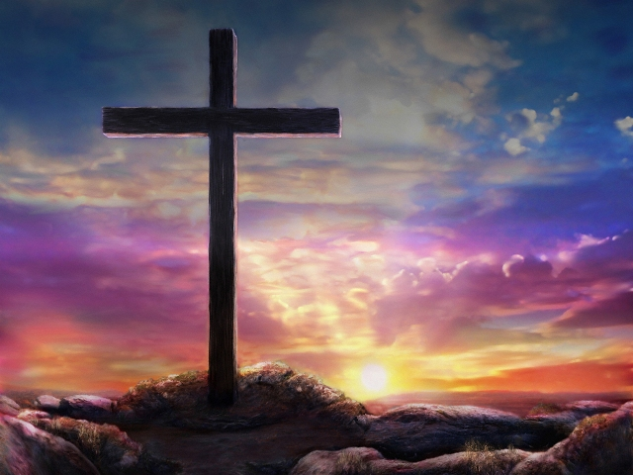
He condemned sin in the flesh !
Notes:
THAT is the Christ who died for our sins according to the Scriptures !
Christ’s perfect life AND death as an offering for sin “condemned sin” as powerless over humans.
The word “condemned”, κατακρίνω in Greek, is the SAME root as in v1.
The power of sin over humans was broken at Calvary because ONE human lived and died a PERFECT life.
That means the He BOTH was an offering FOR sin and OVER sin’s power.

Slide 13
Wow, that’s powerful !
“…so that the requirement of the Law might be fulfilled in us, who do not walk according to {the} flesh but according to {the} Spirit.” Romans 8v4 NASB
It’s a choice you make.
Notes:
As we come to verse 4, the application is really clear.
>This is the answer to our 7th question : What should I do?
The key word we saw repeated 4x in just 4 verses is LAW.
Here it is the RULES that “require” obedience.
Yes, the Christian is not saved by, but TO KEEP the rules !
We are not saved by our WALK, but by Jesus’ WORK.
Thanks to Christ’s Spirit we MAY now fulfill God’s will.
A Christian is NOT a robot, nor a perfect person.
Most Christians don’t “walk according to the Spirit”.
We have the CHOICE to walk to PLEASE our fleshly desires.
He does not say “sit” because we need to advance !
He does not say “run” because this is not a competition.
He says “walk” because that is our everyday life.
The words in {} are not in the original Greek manuscripts.
> God gives a new spirit at salvation making it possible for any Christian to live right, to live a spiritually oriented life !

Slide 14
Review, react and remember:
Romans 8v1-4 has a context.
The book is all about God’s power in the Gospel to save.
Christ died to save from the punishment and power of sin.
Will you trust Him ?
Notes:
I am a teacher and like the three “R”s… except Reading, Writing & Arithmatic do NOT start with “R” !!!!
“Review” means repetition, which is “the seat of learning”.
“React” means it is useless to memorize the facts and not DO anything !
“Remember” means it is a waste to learn, react that day and then forget it.
>Here is what we learned…
>
>
>Will you apply this message from God to your heart ?

