Slide 1
Notes:
160703 San Leandro CA Fairhaven Bible Chapel
(Summary of Mt on each chair)
“Good Morning !”

Slide 2
« Fishers of men »
How can I Become a Fisher of men ?
Mark 1v17
What are the Methods of the Master ?
Luke 5v10, 10v1 and…
How should I Draw in the Net ?
Matthew 16v15
How did the Master do it ?
Notes:
At the beginning of the Gospels, the Lord JC announed His plan to make fishers of men.
He doesn’t only want to save you from your sin, and eternal death, but also offer you the JOY of bringing others to Him.
He wants to transform us into fishermen.
He shows us His methods.
Today, we are going to look at how He draws in His fishing net, in Mt16v15.
Let’s read Mt16v13-16, the context of v15.

Slide 3
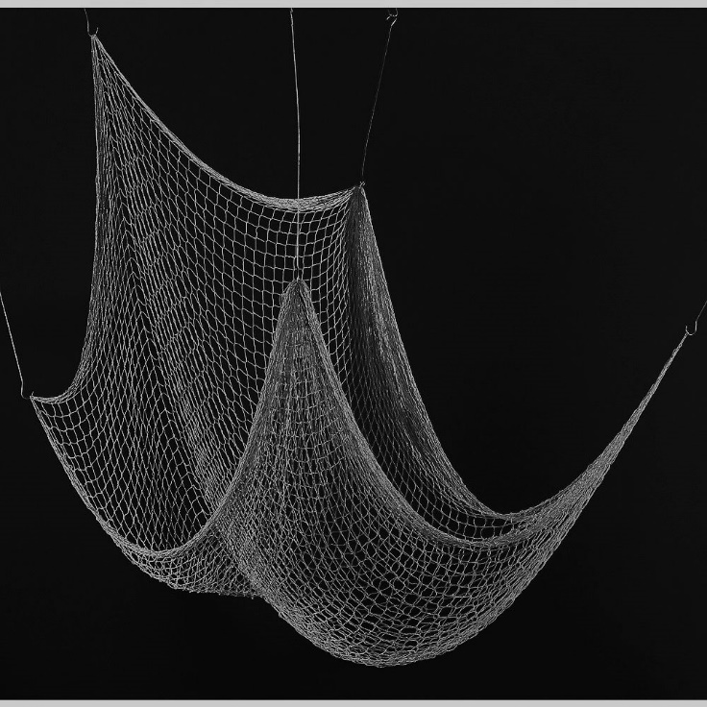
Questions !
« Who do you say that I am ? » Matthew 16v15
There’s no hook !
Notes:
The LJC draws in his fishing net by questions.
After having encircled the fish, with a net of truth, He asks a question. [read]
JC doesn’t just throw out a net.
He gently draws it in.
A questions always expects an answer !
The Master shows us that the work is not finished after sharing the Gospel.
JC doesn’t force anyone to stay in the net, but He draws it in, for a decision.

Slide 4
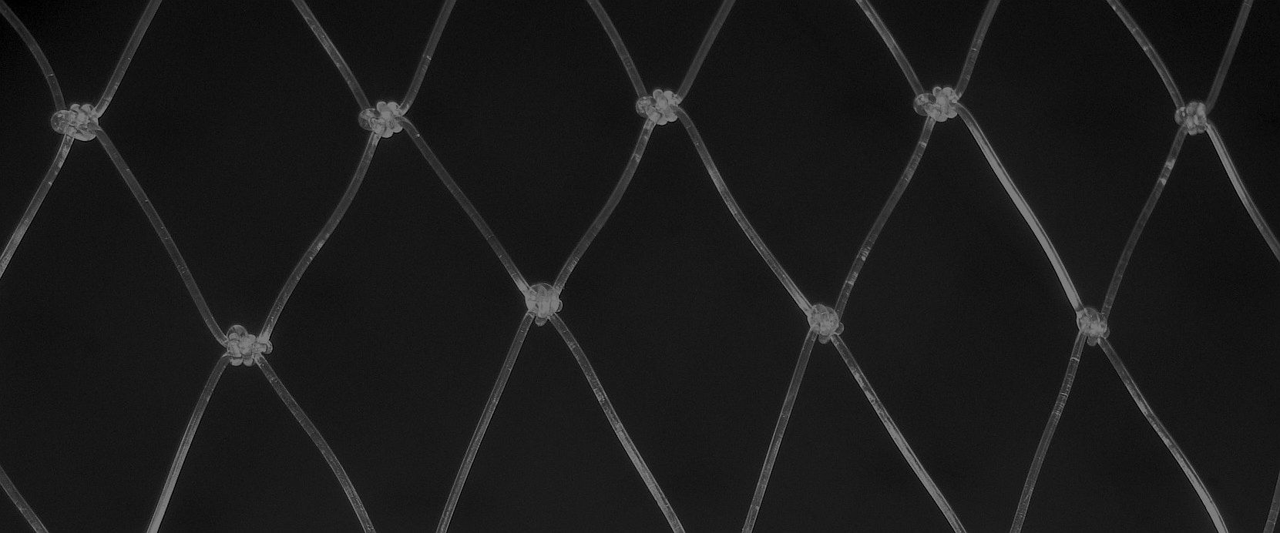
The results ?
« Simon Peter answered, ‘You are the Christ, the Son of the living God.’ » Matthew 16v16
He willingly stayed in the net.
Notes:
Only one person stayed in the net !
Simon committed himself, just as he had accepted his name change. [read]
How could he not obey Jesus as Lord after such a profession ?
Jn 9v22 records, « the Jews had already agreed that if anyone confessed Him to be Christ, he was to be put out of the synagogue. »
Peter was fully conscious of his decision

Slide 5
How can I do like Jesus ?
« Now when Jesus came into the district of Caesarea Philippi, He was asking His disciples, ‘Who do people say that the Son of Man is ?’ » Matthew 16v13
The 1st question is easy.
Notes:
The Master didn’t draw in the net too fast.
Let’s look at the context of the question to which Peter responded. [read]
This 1st question requires no commitment.
This 1st question isn’t looking for a correct answer, to be judged right or wrong.
This 1st question is not looking for a simple response, « yes » or « no ».
The 1st questions of Jesus are easy, but directive into the subject of salvation.

Slide 6
More than 290 questions !
« This very night your soul is required of you ; and now who will own what you have prepared ? »
Luke 12v20
You can’t take it with you !
Notes:
The LJC asked a LOT of questions. [list]
This shoud give us ideas how to draw in the net for a decision.
I have classified 290 of His questions.
The truth that our life will end in the wink of an eye is an importnt to truth to sow[read]
Inflation will make all our savings we have left for our children disapear.
Amos 4v12 says, « Prépare-toi à la rencontre de ton Dieu. » L’avez-vs fait ?

Slide 7
Who ? What ? Why ? When ?
« Why does this generation seek for a sign ? »
Mark 8v12
What’s in your heart ?
Notes:
The questions of Jesus search the heart.
The Master doesn’t ask if this generation is looking for a sign, but why ! [read]
What are your motives ?
If someone will not have confidence in Jesus unless they see a miracle, that is not the faith the Lord Jesus Christ is seeking.
In the parallel texte of Mt16v4, Jesus adds, « Une génération méchante et adultère demande un miracle. »

Slide 8
Believe in what ? …in whom ?
« Jesus said to her, "I am the resurrection and the life ; he who believes in Me will live even if he dies, and everyone who lives and believes in Me will never die. Do you believe this ? »
John 11v25-26
1st believe the Gospel.
Notes:
JC asks a lot of questions about confidence.
The difference between believing something & believing somone is enormous.
In one question, Jesus reveals the two kinds of faith. [read]
He begins by announcing several truths, and then he draws in the net with a question.
Jesus doesn’t ask if she trusts Him, but if she believes the truths he told her.
That’s a 1st step in the right direction.

Slide 9
What would be your answer just after your brother’s death ?
« Yes, Lord ; I have believed that You are the Christ, the Son of God, even He who comes into the world. » John 11v27
It’s time to take the 2nd step and trust Jesus.
Notes:
It’s easy to say you believe the Gospel, but when everything goes wrong, you need more than a confession of faith or a doctrine to believe… You need a God you can trust !
Her answer is positive, but timid. [read]
Her confession of faith is as solid as Peter’s …and neither held up in the crisis.
Faith, even in the truth, doesn’t hold up under adversity.
She went home without Jesus !

Slide 10
Did she really have confidence in Jesus ?
« Jesus said, ‘Remove the stone.’ Martha, the sister of the deceased, said to Him, ‘Lord, by this time there will be a stench, for he has been dead four days.’ » John 11v39
Jesus had one more question for Martha !
Notes:
The Master Fisherman saw her need.
He went straight to the grave site !
The Lord revealed her lack of faith. [read]
She called Him «Lord» with her words, but in her heart she had lost confidence in Him.
How easy it is to make a good confession without trusting all to Christ !
Trying to make it on our own, deciding things without asking God, taking back what He bought, are signs of lost confidence.

Slide 11
Jesus questioned her faith !
« Did I not say to you that if you believe, you will see the glory of God ? » Jean 11v40
She finally truly trusted Him.
Notes:
2Cor13v5 says, «Examinez-vous vous mêmes, pour savoir si vous êtes dans la foi.»
Is your faith in a doctrine or in Christ ?
This question must have stunded Martha.
[read] «If I believe ? Of course I believe !»
The actions of Martha didn’t follow her confession of faith, that she had just given.
But, at last, they did open the tomb, and show their personal confidence in Jesus.
Later, Martha’s actions proved her trust in JC, as she risked her life for him. [Jn12v9-10]

Slide 12
One last question !
« If I told you earthly things and you do not believe, how will you believe if I tell you heavenly things ? »
John 3v12
Jesus wants our confidence.
Notes:
One question about faith is really powerful.
Here is the killer question for an atheist.
True Christian faith is reasonable, solidly confirmed by creation and history. [read]
Our faith is NOT a leap in the dark as all others are, denying science and history.
Our faith is a personal confidence in the Lord Jesus Christ.
The Bible is FULL of names, dates, places and events to convince us to trust Jesus !

Slide 13
Review, React & Remember !
We need to Become Fishers of Men before we use the Methods of the Master. Mk 1v17
The Methods of the Master are not those of this world’s commerce. Lk 5v10, 10v1…
Bringing someone to the Lord by drawing in the net by questions, allows that person to carefully consider before following Christ.
Jesus said, ‘I have a question for you… » Luke 20v3
Notes:
The 3 « R’s » are NOT reading, writing and Arithmetic.
Let’s REVIEW what Christ says about bringing others to Him.
Let’s REACT and not be hearers only of the Word of God.
Let’s REMEMBER what we have heard today, REMEMBER our reaction, and do it !
[lire écran]

