Slide 1
Notes:
160918 Buttonwoods Bible Chapel, Warwick, RI
161012 Roxborough Bible Chapel, Philadelphia, PA
161120 Bethany Bible Chapel Augusta GA
170101 Tulsa OK
170303 ABS Phx AZ
Handouts : ABC questions, Summary of Luke, Questions on Lk5v10, A little net & Questions Jesus Asked

Slide 2
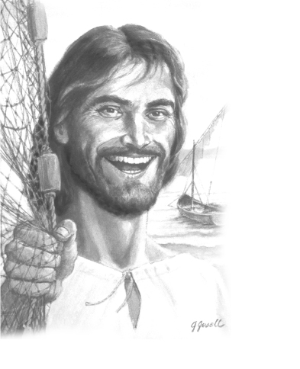
“Do not fear, from now on you will be catching men.”
Luke 5v10
NASB
Notes:
The Lord Jesus Christ has Good News for all believers !
He is able and wants to transform every believer’s life.
The Master’s plan is more than just a future in Heaven.
“From now on” He says, you can be a Fisher of Men ! (survey)

Slide 3
All the Bible in its Context
“Do not fear, from now on you will be catching men.”
Luke 5v10 NASB
How can we have this ?
Notes:
Let’s read the context of today’s verse, Lk5v1-11 to discover 10 of the 70 Methods of the Master.
The context of Lk5v10 is like ours today ; we are all busy with life when Jesus enters our world.
How can I be a fisher of men ?
1st We need assurance.

Slide 4
Peter needed to be saved.
“Do not fear !
From now on
you will be taking men alive.”
Luke 5v10 LITV
We need to ask questions.
Notes:
It’s hard for the unsaved to resist smeone sure of their salvation!
That’s the 1st Method of the Mastr
Let’s check anothr translation.
This is what the Greek NT says.
We are to bring people to JC alive+ conscious not baited+ hk.
JC used 290 open questions !

Slide 5
The Methods of the Master
We can ask a service.
Notes:
So the 2nd Method of the Master is to use a net of truth and draw it in with questions. (290 ques)
According to vs1-3, Jesus asked a service of Peter. This is the 3rd Method of the Master.
Remember the woman at the well and Zacchaeus ?

Slide 6
The Methods of the Master
We need to leave our comfort zone.
Notes:
JC left the comfort of Heaven according to Jn17v7.
Jesus was a carpenter, not a seaman. He hung on as the waves bounced Him up and down. He went out of His comfort zone.
This is the 4th Mthd of the Mstr

Slide 7
Our Model is the Master.
“When He had finished speaking, He said to Simon, ‘Put out into the deep water and let down your nets for a catch.’ ” Luke 5v4 NASB
We must go.
Notes:
Jesus didn’t wait for the lost to come to Him accrdig to Lk19v10
Jesus asked Peter to go out into the deep to catch fish as a lesson on fishing.
The 5th Method of the Master is to go to the lost, not waiting for them to come to a seeker church

Slide 8
“…into deep water…”
We must make the effort.
Notes:
It’s just plain heavy work to sail a fishing boat and drag nets.
The 6th Method of the Master is to make the effort to fish.
Peter must have been tired after a whole night of work, as he says in v5.
But, what is a soul worth ?

Slide 9
Who made the fish come ?
“When they had done this, they enclosed a great quantity of fish, and their nets began to break ; so they signaled to their partners in the other boat for them to come and help them. And they came and filled both of the boats, so that they began to sink.”
Luke 5v6-7 NASB
We are workers with God!
Notes:
The 7th Method of the Master is to involve us in His miracle.
The Bible reminds us that “the Lord opened her heart” (Ac16v14) and “God opened a door” (Ac14v27, 1Co16v9 & 2Co2v12).
All the glory goes to Him.

Slide 10
Peter had never seen this !
We need to worship Him.
Notes:
Peter’s net broke !
Suddenly, Peter realized Who was in the boat with him !
He fell to his knees before J.
We do not save anyone ; we only bring them to the Savior.
This is the 8th Method of the Master to keep us humble.

Slide 11
What are you waiting for ?
“When Simon Peter saw that, he fell down at Jesus' feet, saying, ‘Go away from me Lord, for I am a sinful man!’ ” Luke 5v8 NASB
Jesus has forgiven the past.
Notes:
Peter stopped in his tracks !
Past sins are what most often keep us from bringing others to Christ. [read screen] “Who am I, a poor sinner myself ?”
1Jn1v9 says, “If we confess our sins He is faithful + just…
Don’t let the past stop U today.

Slide 12
We have a choice.
We need to follow Him.
Notes:
The 9th Method of the Master that we discover in this true story is free will. Will you follow Jesus ?
Not every Christian becomes a Fisher of Men, but they could !
We are NOT talking about a spiritual gift of evangelism to reach crowds, but a job for us all.

Slide 13
Does Jesus want poor beggars ?
“When they had brought their boats to land, they left everything and followed Him.” Luke 5v11 NASB
They gave it all to Jesus.
Notes:
Perhaps you didn’t understand the job description !
The text says, “they left everything” and yet they took care to bring their boats to the shore ! Later, Mt8v24 says Jesus was again in the boat with them.
This is 10th Mthd of the Master

Slide 14
Review, React and Remember :
All Christians are called to lead others to Christ.
Lk5v10 reveals 10 of the 70 Methods of the Master.
Let’s start “from now on” !
www.AzBible.yolasite.com
Notes:
The three R’s really should be :
REMEMBERING God’s Word .
RUNNING with the truths.
RETURNING for a check-up.
[Read Screen]
You can find this PPT at AzBible.

