Slide 1
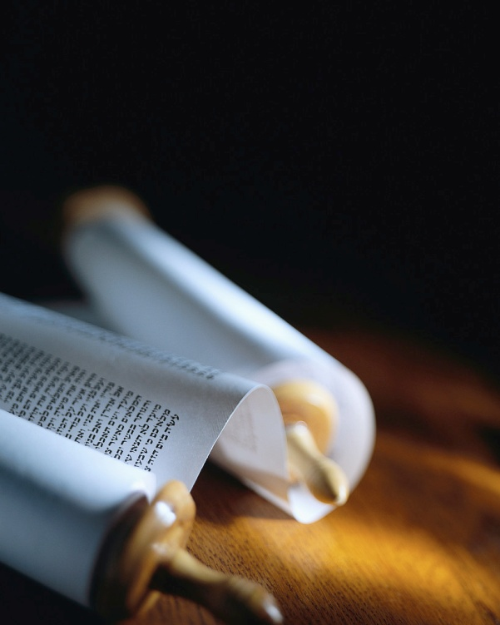
Notes:
160310 Revision
161110 Preston Gospel Chapel Maxton NC
Handouts : ABC ques, Summaries Lk & Mt, Ques Lk5v10, Little Net & 290 Jesus’ questions

Slide 2
The Methods of the Master
“The fruit of the righteous is a tree of life, and he who wins souls is wise.”
Proverb 11v30 NKJV
#1 Make soul winners !
Notes:
The Lord JC not only saves from sin, but He transforms lives.
He calls every Christian to become a Fisher of Men.
He left us an example to follow.
Jesus said, “Follow ME and I will make you fishers of men”.
The Method of the Master is to MAKE believers fishermen.
Just having a fishing net doesn’t make me a fisherman !
Becoming a fisherman is a total transformation of life.
Do you want to be a winner in life ? [read screen]
This verse pictures what a righteous person accomplishes.
You can see it’s like fruit from the Tree of Life in Heaven !
Others can take that fruit, and find everlasting Life in Jesus.
A fruit baring Christian is “winsome” !
Leading people to JC is the most awesome thing you can do
You can be a soul winner !
I’m not talking about being a gifted evangelist, just a simple personal soul winner.

Slide 3
Everyone can bring one.
“Now after this the Lord appointed seventy others, and sent them in pairs ahead of Him to every city and place where He Himself was going to come.” Luke 10v1 NASB
# 2 Alone, but not alone !
Notes:
Jesus said, “You SHALL BE My witnesses…”
So why not be a good one ?
Jesus chose 12 of His disciples to be apostles to Israel.
They were His first missionaries, but here He named others !
These 70 apostles, for that is what the Greek verb is, were sent to prepare people to receive the Lord. [read screen]
Notice they didn’t hold big tent meetings, but they did the personal “ground work” to bring people to Jesus.
You may feel alone, but you are NOT alone in bringing people to Jesus.
This very important Method of the Master is fellowship with at least one other believer while winning souls to Christ.
Notice He did NOT SAY we must be two every time we lead someone to Christ, but at least two IN THE CITY for fellowship.
That’s the minimum for a local assembly according to Mt18v20.

Slide 4
Get the mission straight.
"Carry no money belt, no bag, no shoes; and greet no one on the way. Luke 10v4 NASB
“Do not go in the way of the Gentiles, and do not enter any city of the Samaritans, but rather go to the lost sheep of the house of Israel.” Mt10v5-6
# 3 Keep to the objective.
Notes:
If you aim at the wrong goal, that’s what you’ll hit !
The 4 Gospels are a manual to bring people to Christ.
We have our mission “cut out” for us by the Master.
Let’s read the mission statement for the 70. [read screen]
No one in this room follows these orders ! No money, no possessions, no shoes and no talking on the way… Why not ?
This is NOT OUR MISSION ! Let’s read the context.
Jesus is very precise about “Mission Israel”. [read screen]
They were not to bring the nations to Christ, but Israel.
We can learn a big lesson from this: the importance of following the mission given to us by the Master.
We cannot deviate from the mission we have, and expect the “Lord of the Harvest” to bless us.
What exactly then is our mission today ?
HANDOUTS : Summaries of Matt & of Luke w/ Questions on Luke 10v1

Slide 5
Our mission is the world !
“He said to them, ‘When I sent you out without money belt and bag and sandals, you did not lack anything, did you?’ They said, ‘No, nothing.’ And He said to them, ‘But now, whoever has a money belt is to take it along, likewise also a bag, and whoever has no sword is to sell his coat and buy one.’ ”
Luke 22v35-36 NASB
# 4 Prepare yourself.
Notes:
After Israel rejected Jesus, He said, “Go into all the world and preach the gospel to all creation.” Mark 16v15
It is really important to get the mission straight !
Do we have a mandate to preach the Kingdom of Heaven or a mandate to announce the Good News of Salvation ?
The Gospel of the Kingdom of God is Salvation, but the Kingdom of Heaven will come to Israel in the future.
The Kingdom of Heaven is never mentioned in Acts or later.
The difference in the mission can be seen in this text. [read]
Our mission is much longer, much farther and much more dangerous than Israel… so the preparation is more important.
Jesus is saying we now need to consider finances, material things (perhaps books in our bag) and even personal security.
Perhaps you need to spend $ on a Bible, books or B college
Perhaps you need to get rid of extra baggage useless things
Perhaps you need to arm yourself “to give an answer…”

Slide 6
How to get started ?
“When Jesus came to the place, He looked up and said to him, ‘Zaccheus, hurry and come down, for today I must stay at your house.’ ” Luke 19v5 NASB
# 5 Look for open doors.
Notes:
The hardest part in leading someone to the Lord is beginning the conversation. What is the Method of the Master ?
Jesus invited Himself into people’s lives ! [read screen]
Notice how Jesus looked for an open door.
There was a crowd on the street, according to vs 3, but Jesus was looking for the man he wanted to save.
This was not the first time Jesus invited himself into a life.
At 12 years old, He invited Himself into the Temple scholars’ circle, asking them questions according to Luke 2v46.
At 30, Jesus invited himself into Peter’s life, asking him to lend his boat according to Luke 5v3.
Later, He invited himself into villages all over Israel, Lk 10v1.
At the well of Sychar, He invited himself into the life of the Samaritan woman according to John 4v7.

Slide 7
Sow the Seeds of the Gospel.
“The sower went out to sow his seed; and as he sowed, some fell beside the road, and it was trampled under foot and the birds of the air ate it up.” Luke 8v5 NASB
# 6 Sow generously !
Notes:
Planting a “Seed truth” of the Gospel is not difficult.
It is not teaching, but simply announcing the Good News.
1 Corinthians 1v21 reminds us that God uses what the world calls “the foolishness of preaching” to save people.
All the Christian education in the world cannot save a soul !
The Method of the Master is to sow His Seed in hearts.
This text is talking about Jesus according to Mt 13v37. [read]
Even Jesus saw the majority of His Seed sown never grew.
If the birds stole the Seed, He just sowed it again !
Jesus was never discouraged, and neither should we be !
So the Method of the Master is to sow liberally.
Make ever day count, sharing the Good News of Salvation.
(Show leather bound Bible and suggest a monthly budget.)

Slide 8
Let’s not forget the essentials.
“Jesus began to preach and say, ‘Repent, for the kingdom of heaven is at hand.’ ” Mt 4v17 NASB
“Come to Me, all who are weary and heavy-laden, and I will give you rest.” Matthew 11v28 NASB
# 7 Explain repentance.
Notes:
Too often we forget the basics ! Or perhaps we are afraid ?
For years, I heard that Christ died for my sins, but I didn’t know what to do about it.
It is important to inform people about the Good News, but they need to know the Way of Salvation.
This is how the Master does it ! [read screen]
It is essential to trust Jesus when He says we need to repent.
Even the demons believe & tremble, but they do not repent.
Believing the truth of the Gospel is essential, but it needs to move us to sorrowful repentance. Salvation is from sin !
Believing the Gospel does not save, but it leads me to the One who can save me. It is only the Savior who saves !
It is essential to come to Jesus and ask for salvation. [Read]
Salvation is by the grace of God through our faith in Jesus who does the miracle when we repent and ask Him to save.
“For whoever will call on the Name of the Lord will be saved.” Rm 10v13

Slide 9
Is that all ?
“After He had sent the crowds away, He went up on the mountain by Himself to pray ; and when it was evening, He was there alone.” Matthew 14v23 NASB
# 8 Pray after sowing.
Notes:
Our part is to bring others to Christ, not argue nor “convert” them, and certainly not try to convict them of sin.
That is the work of God.
Jesus said, "He (the Spirit of God), when He comes, will convict the world concerning sin and righteousness and judgment.” John 16v8
Even the Lord Jesus Christ did not force anyone to follow Him, but He asked them, and prayed for them.
Our work is not done after giving someone the Gospel.
We often pray before, but we really need to pray after someone has heard the Good News.
That is when the spiritual battle begins ! [read screen]
Are we willing to pray all night for someone’s salvation ?
It certainly is worth it.
Today’s last Method of the Master for soul winning is easy.
The Throne of Grace is open to all believers.
We have the privilege and responsibility to intercede for the unsaved to receive Christ as their Lord and Savior.

Slide 10
Review, React and Remember :
The Methods of the Master are being :
Active in a local Christian Assembly
Clear objective of personal salvation
Prepared in Bible, body & belongings
Looking to see open doors & hearts
Generous with the Gospel
Callers to repentance from sin
Prayerful after sowing the Seed
www.AzBible.yolasite.com
Notes:
The three “R”s of learning are NOT Reading, Writing and Arithmetc, but Review, React and Remember.
Let’s review quickly what we have seen in God’s Word !
[read screen]

