Slide 1
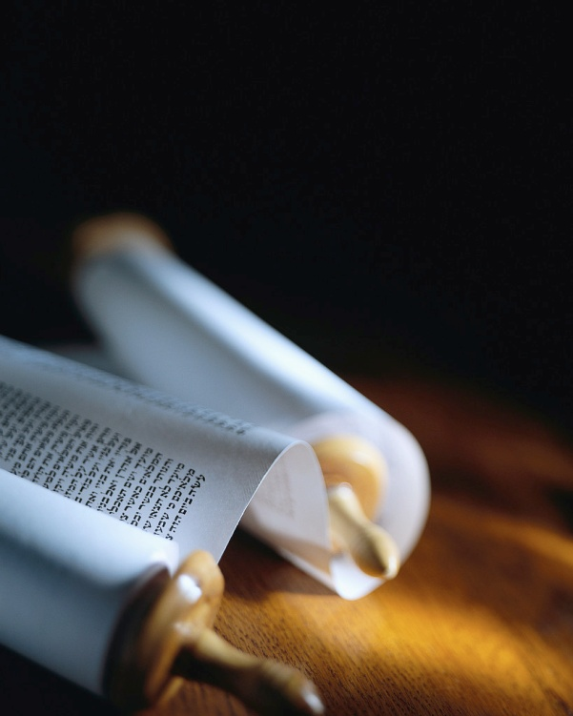
Notes:
160710 Lafayette CA Sun Valley Bible Chapel
(Summary of “John” on each chair)
“Good morning !”
“Let’s read our verse for today in its context, Jn21v1-11…”
[next slide]

Slide 2
The fisherman’s net
“Simon Peter went up and drew the net to land, full of large fish, a hundred and fifty-three; and although there were so many, the net was not torn.” John 21v11 NASB
Why didn’t it break ?
Notes:
In our series about Fishing for Men, we need to take a good look at the net.
This is the key verse in this story. [read]
2x in this verse, the word “net” is used.
1st , Peter obeyed and drew in the net.
We already saw in Mk1v17, Lk5v10 & 10v1 that all believers are called to be fishermen.
The net didn’t break this time.
Lk5v6 says their nets broke the first time.
The # of large fish is given for a reason.
Do you have a strong net for fishing ?

Slide 3
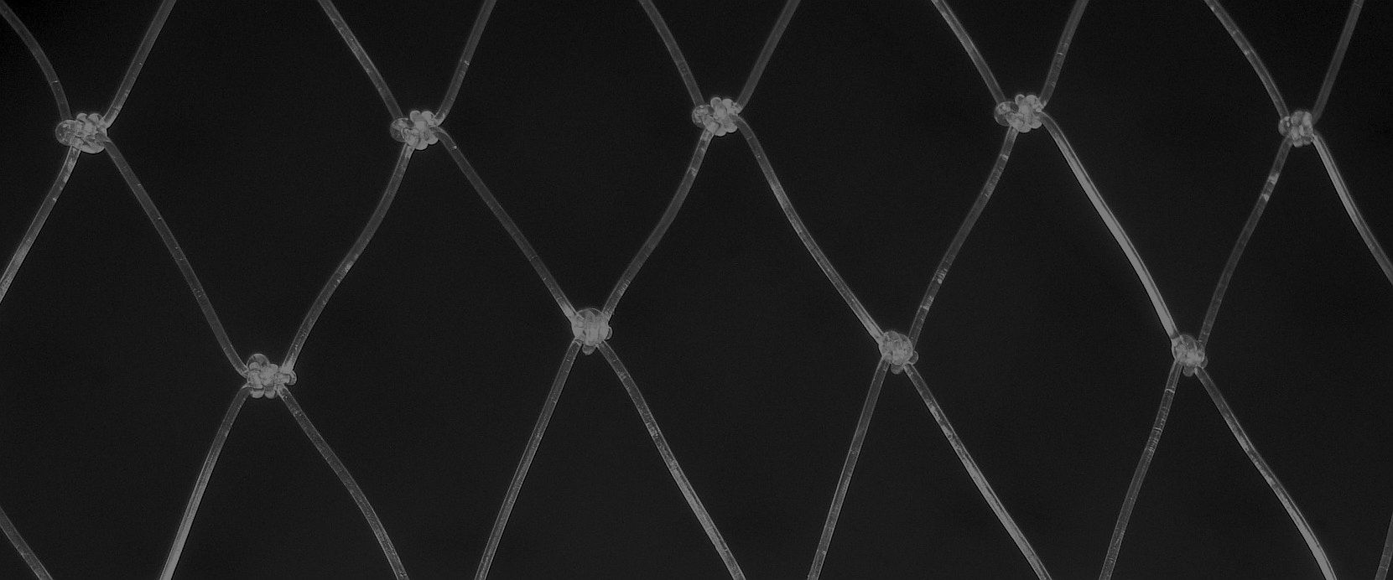
There are all kinds of nets.
“A man who flatters his neighbor Is spreading a net for his steps.” Proverbs 29v5 NASB
“He must have a good reputation with those outside the church, so that he will not fall into reproach and the snare of the devil.” 1 Timothy 3v7 NASB
Jesus’ net is not a trap !
Notes:
The word “net” appears 71x in the Bible.
What kind of net should we use ?
47x in the OT a net is a trap. [read]
Only 4x in the OT is the net for fishing.
5x in the NT the net is a trap. [read]
2x in the NT the net is a huge fishing net.
1x in the NT it’s a dredge to catch evrythng
But, 12x in the NT the net is a little net !
JC gives us a little net that will not break.
2Cor4v2 says, “Not walking in craftiness nor handling the word of God deceitfully.”

Slide 4
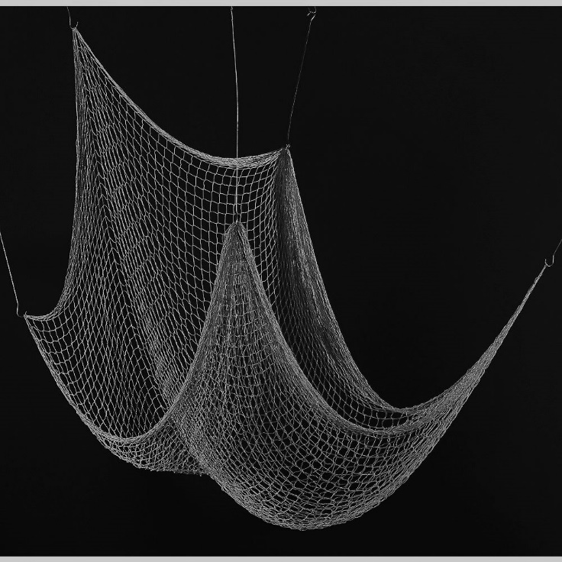
Our fishing net is small.
“When He had finished speaking, He said to Simon, ‘Put out into the deep water and let down your nets for a catch.’ ” Luke 5v4 NASB
Let’s avoid the big speeches.
Notes:
In all the texts where JC speaks of fishing, the Grk word is “diktuon”, that is a small net.
Just as in Jn21v11, JC asks each one of us to “let down your little nets”. [read]
We only need to announce the truths of the Gospel, not miracles, nor arguments.
1Cor1v22-24 says, “For indeed Jews ask for signs and Greeks search for wisdom ; but we preach Christ crucified, …Christ the power of God and the wisdom of God.”

Slide 5
So what should be our net ?
“I delivered to you as of first importance what I also received, that Christ died for our sins according to the Scriptures,…”
1 Corinthians 15v3 NASB
Truths that interconnect !
Notes:
The interconnected truths of the Gospel form a strong, but open fisherman’s net.
Remember, JC never used a hook and line to catch people, but truth & open questions.
The 1st strong thread in our net should be the truth about Jesus Christ. [read]
2Cor4v5 says, “we do not preach ourselves but Christ Jesus as Lord.” God with us.Mt1v23
Who He is and what He did are truths that interconnect at the Cross.
What he did is our 2nd strong thread !

Slide 6
Unavoidable truths
“Jesus said to him, ‘I am the way, and the truth, and the life ; no one comes to the Father but through Me.’ ” John 14v6 NASB
“And there is salvation in no one else ; for there is no other name under heaven that has been given among men by which we must be saved.’ ” Acts 4v12 NASB
Each thread is important !
Notes:
Just as a too many threads no longer is a net, but a wall, so a net too open is no good.
Our net needs enough threads to stop fish.
Well sown together, a good net draws fish in the right direction. [read]
The 3rd strong thread of truth is the that there is only One Way of Salvation.
It is not enough to tell the Good News.[r]
We need to explain how to be saved.
Mt7v13 says, “Enter through the narrow gate ; for the gate is wide …to destruction.”

Slide 7
Saving truths
"Whoever will call on the Name of the Lord will be saved." Romans 10v13
You must ask Him to save you.
Notes:
Are you ready to be surprised ?
Many people are ready to be saved, just after hearing the basics. [read]
We need to be ready to guide them to the Savior, Who alone can save. [read]
The Way of Salvation is by faith, believing Christ enough to call on His Name.
Just believing the truth does not save.
Jam2v19 says, “You believe that God is one. You do well ; the demons also believe, and shudder.”

Slide 8
Eternal truths
“It is appointed for men to die once and after this comes judgment.” Hebrews 9v27 NASB
“He rose from the dead and ordered us to preach to the people, and solemnly to testify that this is the One who has been appointed by God as Judge of the living and the dead. Acts 10v41-42 NASB
Most people are in denial !
Notes:
Some truths are obvious, but avoided.
We live in a world of self delusion +denial.
This 4th strong thread in the net brings to mind the fear of the Lord. [read]
No one leaves this planet alive w/o Christ.
The Fear of the Lord is the beginning of wisdom, according to Ps111v10, Prov1v7, etc.
Even death doesn’t save us from judgmnt
The sad fact is that most people live in denial of this very obvious truth.
We need to speak the truth in love.

Slide 9
Unknown truths
“When a righteous man turns away from his righteousness, commits iniquity and does according to all the abominations that a wicked man does, will he live ? All his righteous deeds which he has done will not be remembered for his treachery which he has committed and his sin which he has committed ; for them he will die.” Ezekiel 18v24 NASB
There’s no “scale” !
Notes:
The common belief that good deeds will out weigh bad deeds is mortal.
God is a good Judge ; He will not excuse a murderer because he/she gives to charities !
This 5th thread in the net is often unknown.
No matter what you have done in the past, when you sin, you are guilty. [lire]
Jn3v36 says, “He who believes in the Son has eternal life ; but he who does not obey the Son will not see life, but the wrath of God abides on him.”

Slide 10
Universal truths
“All have sinned and fall short of the glory of God.” Romans 3v23 NASB
“The wages of sin is death, but the free gift of God is eternal life in Christ Jesus our Lord.” Romans 6v23 NASB
We are all guilty & condemned !
Notes:
Truths that include everyone are powerful.
In this one text, two truths are revealed.
The 6th thread in our net is universal.[read]
We have all done wrong sometime.
The 7th thread is also universal.
We all miss the mark of goodness.
There are other universal truths. [read]
The 8th thread in our net is bad news.
The 9th thread is very Good News !
3 of 4 threads in our net are bad news.

Slide 11
Hope filled truths
“The Son of Man has come to seek and to save that which was lost.” Luke 19v10 NASB
“For in Him all the fullness of Deity dwells in bodily form.” Colossians 2v9
The God-Man, Jesus…
Notes:
A fishing net is not meant to pull fish down, but to lift them up.
The 10th thread in our net says people don’t even know where they are, like fish unaware of the dangers in the ocean. [read]
Christ has taken the 1st step towards us.
The 11th thread tells us who He is. [read]
There is hope when God is on our side !
Jn12v47 says, “I did not come to judge the world, but to save the world.”

Slide 12
Amazing truths
“He was pierced through for our transgressions, He was crushed for our iniquities ; the chastening for our well-being fell upon Him, and by His scourging we are healed.” Isaiah 53v5 NASB
He took our place !
Notes:
The red thread through our net amazing !
No one could have imagined such a truth.
The 12th thread reveals why Christ died.
It’s not complicated, but amazing ! [read]
The miracle of substitution, suffering in our place, draws the hardest heart to Him.
Why would He take my place ?
Love has no explanation it’s just declared
Jn3v16 says, “God SO loved the world, that He gave His only begotten Son…”

Slide 13
Powerful truth
“The blood of Jesus His Son cleanses us from all sin.”
1 John 1v7 NASB
Redeemed by His blood !
Notes:
There is one truth more attacked than any.
Yet, it is the most powerful of them all.
The 13th thread in our net is this. [read]
1Pe1v18-19 says, “You were not redeemed with perishable things like silver or gold from your futile way of life inherited from your forefathers, but with the precious blood…”
Heb9v14 says, “How much more will the blood of Christ, …cleanse your conscience from dead works to serve the living God ?”

Slide 14
Reassuring truths
“Christ has been raised from the dead, the first fruits of those who are asleep.”
1 Corinthians 15v20 NASB
He’s a living Savior !
Notes:
How can we be sure of being saved ?
The 14th thread (7 each way) completes our little net with confidence. [lire]
This truth contains two interconnected !
The resurrection of Jesus assures the resurrection of those He has saved.
He is a living Savior, not a dead hero.
Without this thread in your net, there is a huge hole and no one will be captured by a Gospel without the resurrection.

Slide 15
Review, React and Remember :
Christ is the Savior.
He died because of our sins.
He alone can save.
There is a judgment.
Good deeds don’t outweigh bad ones.
All have sinned.
We all miss the mark
Sin leads to death.
God’s gift is life.
Christ seeks sinners.
Jesus is God with us.
He died in our place.
His blood paid our redemption.
His resurrection is the guarantee of ours.
www.AzBible.yolasite.com
Notes:
The 3 “R’s” are NOT “reading, writing and arithmetic” !
They are review, react and remember.
Let’s review what makes a good net.
Remember, it’s just a little net, but one that will not break.
[read]
Have you trusted Christ enough to ASK Him to save you from your sin ?
All the verses can be found on this site !

