Slide 1
All the Bible in its Context
John 11
This is the last chapter of John 4-11
“I trust Jesus because…
His Word…
is life giving !”
Let’s read the whole text…
Notes:
Good morning !
>Turn in your Bible with me to John chapter 11.
>Every verse in the Bible has a context.
>This is the ultimate reason to trust Jesus at His Word… to trust Him with your Life !
>So let’s read what it’s all about… (READ JOHN 11…)

Slide 2
There is no greater promise !
“Jesus said to her, ‘I am the resurrection and the life ; he who believes in Me will live even if he dies.’
John 11v25 NASB
He said it ! Do I believe it ?
Notes:
The Bible is full of promises, but this is the best.
>Jesus used His WORD to give hope.
Because He had always kept His promises, His WORD gave life to Martha and she immediately went to call Mary.
After losing my wife, my heart too beats again with life at the WORD of Jesus in this verse.
>Remember the context of all these chapters : His WORD !
Faith comes by hearing the WORD of God.

Slide 3
This is no pie in the sky promise.
“So Jesus then said to them plainly, ‘Lazarus is dead.’
John 11v14 NASB
Jesus is talking about real physical death.
Notes:
Many people “spiritualize” Jesus’ WORD saying…
“Sure His WORD gives life to my emotions, but not to the rest of me !”
“My intellect remains unmoved and my body is still going to die !”
>Jesus wants it to be very clear what He is saying.
His WORD can give life to the whole person : body, soul and spirit.
>Let there be no doubt, Jesus’ WORD is powerful.

Slide 4
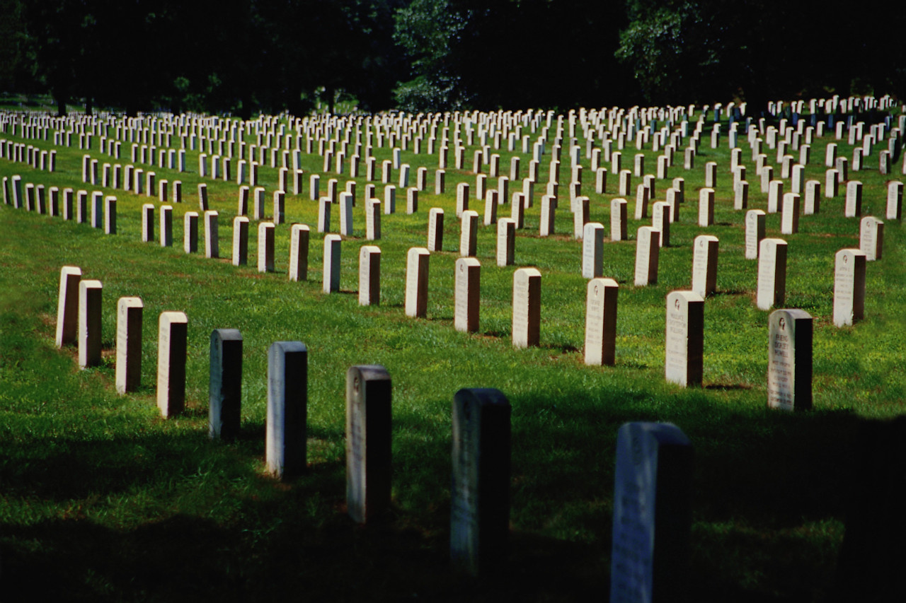
We will all die some day.
Notes:
This is our greatest problem !
The Bible has been talking about DEATH since Adam and Eve.
DEATH is a reality that we must face.

Slide 5
“Death” or “die” is mentioned in this short story 12x.
A word repeated so many times shows us what a text is about.
Here death is the context into which Jesus brings His Word.
Jesus Word brings hope.
Notes:
This chapter has a repeated key word !
It is DEATH.
>Here we go again with a simple way to study the Bible.
Underline the word that is most repeated.
>This is the context of everyone of the verses.
And into this context of DEATH, Jesus brings His WORD.
>We are often at loss for words in the face of death… not Jesus !

Slide 6
What other words are repeated ?
Vs 1-6 Sick is repeated 5x
Vs 7-16 Go is repeated 5x
Vs 17-38 Come is repeated 10x
Vs 29-44 Said is repeated 6x
Vs 45-57 Chief priests and Pharisees are mentioned 7x
These are five key words.
Notes:
John 4-11’s theme is trusting Jesus because of His WORD.
Here in John 11 the theme is trusting Jesus because of His WORD in the face of DEATH.
>There are 5 other key words in this chapter that help us “rightly divide the Word of Truth” as the Bible says in 2Tim2v15… (click repeatedly)
>Let’s look at the verses in each one of these contexts starting with the key word “sick”.

Slide 7
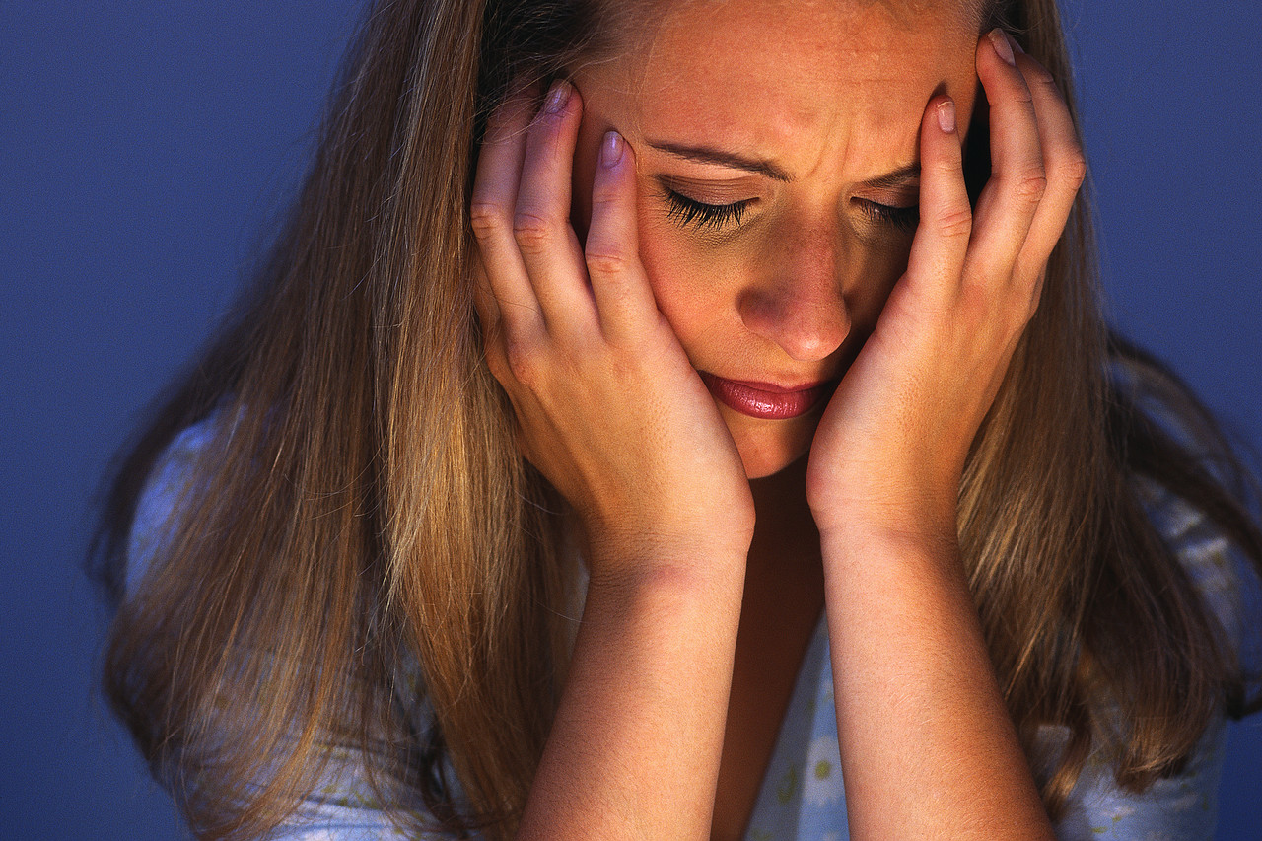
Jesus has a Word for those who are sick.
Notes:
No one ever dies of good health !
When we are sick, it’s scary.
Sometimes we get so sick that we want to die.
But, Jesus WORD can give life to our whole being.

Slide 8
John 11v1-6 is about being sick.
“Now a certain man was sick, Lazarus of Bethany, the village of Mary and her sister Martha. It was the Mary who anointed the Lord with ointment, and wiped His feet with her hair, whose brother Lazarus was sick. So the sisters sent word to Him, saying, ‘Lord, behold, he whom You love is sick.’ ”
John 11v1-3 NASB
Jesus’ love never changes.
Notes:
These few verses use the word “sick” 5 times.
>Before Lazarus ever got sick, this family knew Jesus loved them.
That’s important.
We need to have a relation with Jesus because of Who He is, not just because of what He can do for us.
They called Him Lord !
>Almighty God is LOVE and that will never change… healthy or sick.

Slide 9
Why does He allow suffering ?
“But when Jesus heard this, He said, ‘This sickness is not to end in death, but for the glory of God, so that the Son of God may be glorified by it.’ Now Jesus loved Martha and her sister and Lazarus. So when He heard that he was sick, He then stayed two days longer in the place where He was.”
John 11v4-6 NASB
He wants us to trust Him.
Notes:
So why does an almighty Lord let us get sick ?
>It’s in His plan.
Being sick is a forewarning of death that is final.
It’s a wake up call, so that we don’t end up dead without God.
Being sick can show how much God loves us. (JEH’s question)
>The end goal of ALL sickness is to encourage us to trust Him.

Slide 10
Jesus has a Word about going to the needy.
Notes:
Let’s look at the next set of verses where the word “go” is repeated 5x.
Our God is not a far away… He is not a deist’s god.
He GOES to a world of dying people to save them.

Slide 11
John 11v7-16 is about going.
“Then after this He said to the disciples, ‘Let us go to Judea again.’ The disciples said to Him, ‘Rabbi, the Jews were just now seeking to stone You, and are You going there again?’ "
John 11v7-8 NASB
He goes despite the cost.
Notes:
Look at verses 7 to 16 with me.
>Jesus was training His disciples to go to a dying world despite the danger.
>Remember what it cost Jesus to give us life.
He did die, just as the disciples were afraid !
Are we willing to follow the Master to bring the WORD of life to a dying world ?

Slide 12
He is going to end death.
“…after that He said to them, ‘Our friend Lazarus has fallen asleep; but I go, so that I may awaken him out of sleep.’ The disciples then said to Him, ‘Lord, if he has fallen asleep, he will recover.’ …So Jesus then said to them plainly, ‘Lazarus is dead.’ ”John 11v11-14 NASB
His Word is clear.
Notes:
Jesus goes with a mission.
>He was not going to TRY to help Lazarus, but He was SURE He would raise him from the dead, by just a WORD.
Jesus is predicting the future in this story.
>Jesus’ WORD must have surprised his disciples because of its assurance.

Slide 13
When He decides to go is always the right time.
“I am glad for your sakes that I was not there, so that you may believe ; but let us go to him.”
John 11v15 NASB
He has an ultimate goal.
Notes:
We often wonder why God waits to answer our prayers.
God’s timing is not always our timing !
>IMAGINE Jesus saying that He didn’t want to be at Lazarus’ bedside, in his greatest hour of need !
He was there, but Lazarus could not see Him.
So it is today, when someone is dying, God is there… invisible.
He said he cares even for a sparrow that falls to the ground.
He wants us to trust His WORD : “Low, I am with you until the end.”
>Trust Him that His plan is best.

Slide 14
Jesus has a Word for those who come to Him.
Notes:
Now let’s look at verses 17 to 38.
The word “come” is repeated 10 times !
That is because it is so important to COME to Jesus.

Slide 15
Jesus waits for us to come.
“Martha therefore, when she heard that Jesus was coming, went to meet Him,… Therefore, when Mary came where Jesus was, she saw Him, and fell at His feet, saying to Him, "Lord, if You had been here, my brother would not have died."
John 11v20 & 32 NASB
Remember He took the first step.
Notes:
Jesus once said : “Come to Me, all who are weary and heavy-laden, and I will give you rest !” Mt11v28
>Notice HOW Martha came to Jesus.
She fell at His feet in reverence.
She knew who He was, the Almighty God.
She stated what she knew ; that He was able to save the dying.
>When we pray, let’s always remember that it is God who took the 1st step in sending His Son to save us.

Slide 16
His Word is an offer of life.
“Jesus said to her, ‘I am the resurrection and the life; he who believes in Me will live even if he dies, and everyone who lives and believes in Me will never die. Do you believe this?’ ” Jn11v25-26
He wants us to trust Him.
Notes:
God takes the first step, but He will never force Himself upon us.
>By His WORD He OFFERS salvation from eternal death.
How many times does He have to repeat it : “Believe in Me !”
He even challenges Martha… and us, with a question.
>It is not enough to believe about Him, but He wants us to believe IN Him, to TRUST Him.

Slide 17
John 11v39-44 “Jesus said” 6x
“Then Jesus raised His eyes, and said, ‘Father, I thank You that You have heard Me. I knew that You always hear Me ; but because of the people standing around I said it, so that they may believe that You sent Me." John 11v41-42 NASB
What could clearer ?
Notes:
Finally, let’s look at verses 39 to 44 where Jesus SPOKE a WORD 6 times.
>First His WORD was addressed to His Father.
Jesus prays for us and His prayer is ALWAYS answered.
His WORD in prayer is powerful.
>Jesus again underlines His goal to encourage faith in Him by His WORD.

Slide 18
Jesus even has a Word for the dead.
Notes:
WE can only talk to the living.
JESUS can make the dead live again, by His WORD.
There is no more powerful WORD than Jesus’.

Slide 19
His Word can raise the dead.
“When He had said these things, He cried out with a loud voice, ‘Lazarus, come forth.’ The man who had died came forth, bound hand and foot with wrappings, and his face was wrapped around with a cloth. Jesus said to them, ‘Unbind him, and let him go.’ ” John 11v43-44 NASB
His Word gives life.
Notes:
We recently studied John chapter 10v3 where the Lord called Himself the Good Shepherd : “He calls his own sheep by name and leads them out.”
If the Lord does not call you by NAME, you will not be resurrected to eternal life.
That is why it is so important to make peace with God now and be like Lazarus, prepared for his NAME to be called.
>We can imagine that all who had died would have risen from the dead if Jesus had called their NAMES, but He did not call them.
Jesus said in Jn 5v24 : "Truly, truly, I say to you, he who hears My WORD, and BELIEVES Him who sent Me, has eternal LIFE, and does not come into judgment, but has passed out of death into life.”
>One thing is sure, even His greatest enemies had to admit everyone would believe on Him if they know what He can do with just a WORD !

Slide 20
Review, react and remember:
Why can we trust Jesus ?
His Word gives life.
His Word gives hope.
His Word surpasses death.
His Word is unlimited power.
You can take Him at His Word.
Notes:
Let’s not lose what we have heard today !
>The question of this book is still the same : WHY trust Jesus ?
>We have seen many reasons today summed up in one word : LIFE !
>This gives us hope and revives our dying hearts.
>His WORD goes beyond the grave.
>His WORD has no limit.
>Let’s take Him at His WORD for life !
His disciples said to Jesus : “Lord, to whom shall we go? You have WORDS of eternal LIFE.” John 6v68

