Slide 1
All the Bible in its Context
John 10v1-42
The key word repeated 98x in the Gospel of John is believe.
This book reveals the many reasons to trust Jesus Christ.
What are those reasons ?
Notes:
>The key to understanding the Bible is to read AND examine the CONTEXT of the passage you are considering !
>Our text to consider today is John chapter 10 that we will read IN ITS CONTEXT in just a few minutes.
>The key word repeated 98 times IS the CONTEXT of the BOOK in which chapter 10 is found.
That word is “believe”, meaning to TRUST.
>This BOOK answers the big question : Why should we trust Jesus ?
>Do YOU know WHY so many people trust Him today ?

Slide 2
There are 4 major reasons.
You can trust Jesus because of
His witnesses, ch1-3
His Word, ch4-11
His followers, ch12-17
His death & resurrection, 18-21
Why His Word ?
Notes:
>By examining the context of chapter 10, you will discover that the WHOLE book reveals 4 major reasons to trust Jesus.
>Let’s review them quickly… [read screen]
>Chapter 10 is IN the IMMEDIATE context of trusting Jesus because of His WORD.

Slide 3
His Word is…
Convincing, ch4v1-42
Healing, ch4v43-5v47
Compassionate, ch6v1-27
Nourishing, ch6v22-71
There are more reasons…
Notes:
>Jesus’ words take up MORE chapters in this Gospel than any other reason to trust Him !
>Let’s examine how “faith comes by hearing” His Word… [read screen]

Slide 4
His Word is…
Revealing, ch7
Liberating, ch8
Sight giving, ch9
Leading, ch10
Life giving, ch11
At least 9 reasons to trust Jesus because of His own Word !
Notes:
>The list of reasons to trust Jesus because of His Word continues… [read screen]

Slide 5
There is the context of John 10.
We trust the Lord Jesus because His Word leads us.
How does He do it ?
Notes:
>So there really is a CLEAR CONTEXT to chapter 10.
>The unique message of this chapter is that Jesus can LEAD you to trust Him by His Word.
>Let’s ask an important question : “How does he do it ?”

Slide 6
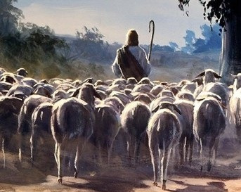
Let’s read John chapter 10.
The word sheep is repeated 15 times in this chapter.
Notes:
>In reading God’s Word we will experience the LEADING of the Lord… [read John 10]
>Instead of counting sheep, let’s count His Words !
At the birth of Jesus we read about shepherds and that is no coincidence.
It was a prophetic sign according to Ps80v1 : “Oh, give ear, Shepherd of Israel, You who lead Joseph like a flock; You who are enthroned above the cherubim, shine forth !”

Slide 7
He is the Shepherd of Israel.
“And thou Bethlehem, land of Juda, art in no wise the least among the governors of Juda; for out of thee shall go forth a leader who shall shepherd my people Israel.” Matthew 2v6 NASB
Compare Micah 5v2 !
Notes:
>The Messiah wants to lead His chosen people to quiet pastures.
>The prophecy could not be clearer about Jesus’ birth in Bethlehem.
>This is a quote from God’s Word given to Israel in Micah 5v2 : “But as for you, Bethlehem Ephrathah, too little to be among the clans of Judah, from you One will go forth for Me to be ruler in Israel. His goings forth are from long ago, from the days of eternity.”
Jeremiah 31v10 also says : “Hear the word of the LORD, ô nations, and declare in the coastlands afar off, and say, ‘He who scattered Israel will gather him And keep him as a shepherd keeps his flock.’ ”

Slide 8
Jesus is like a shepherd.
“This figure of speech Jesus spoke to them, but they did not understand what those things were which He had been saying to them.”
John 10v6 NASB
He is not a herdsman.
Notes:
>Jesus used many PARABLES which are FOCUSED IMAGES to lead His disciples to trust Him.
>Let’s try to UNDERSTAND HOW He leads !
>First we can notice that He did not say He was a herdsman, much less a cowboy DRIVING cattle !

Slide 9
How does a shepherd work ?
“Truly, truly, I say to you, he who does not enter by the door into the fold of the sheep, but climbs up some other way, he is a thief and a robber. But he who enters by the door is a shepherd of the sheep.”
John 10v1-2 NASB
He is not a sheep stealer.
Notes:
>Let’s think about SHEPHERDS.
>Unlike a rodeo, the shepherd enters on foot into the fold, very gently.
>Jesus does not grab people for the Kingdom, nor force them to be His sheep.

Slide 10
He uses His voice.
“To him the doorkeeper opens, and the sheep hear his voice, and he calls his own sheep by name and leads them out. When he puts forth all his own, he goes ahead of them, and the sheep follow him because they know his voice.”
John 10v3-4 NASB
His Word becomes personal.
Notes:
>The shepherd’s only instrument to lead his sheep is his VOICE !
>When Jesus speaks to His Father, our Creator, He opens our heart’s door for Christ to come in and call us to follow Him.
>Notice how He calls His sheep by name.
Until you hear God’s Voice as a personal message for you there is no real trust.

Slide 11
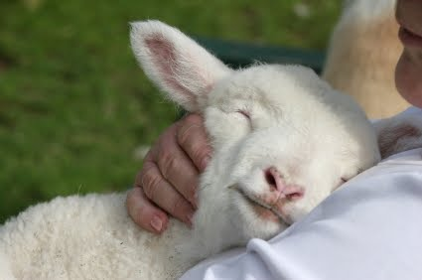
We don’t even need to see Him.
Faith comes by hearing.
Notes:
>Miracle of miracles, God’s Word is invisible, but it draws us to trust Him.
>Romans 10v17 says : “So faith comes from hearing, and hearing by the word of Christ.”

Slide 12
The Word of God protects us.
“A stranger they simply will not follow, but will flee from him, because they do not know the voice of strangers. …Truly, truly, I say to you, I am the door of the sheep. All who came before Me are thieves and robbers, but the sheep did not hear them.”
John 10v5-8 NASB
His voice is unique.
Notes:
>God’s Word not only calls us, but it PROTECTS us after we are called to follow Him.
>The more we familiarize ourselves with His Word by reading it every day, the safer we are.
>God’s Word stands out from all other so that His followers can recognize a fraud !

Slide 13
The Word of God invites us.
"I am the door ; if anyone enters through Me, he will be saved, and will go in and out and find pasture.
John 10v9 NASB
It is not an exclusive club.
Notes:
>ANYONE can enter into this precious relationship.
>What can be clearer ???
>Salvation from sin is offered to anyone who will TRUST Jesus when he speaks about confession, repentance and forgiveness.

Slide 14
His Word is more than just talk.
“The thief comes only to steal and kill and destroy; I came that they may have life, and have it abundantly. I am the good shepherd ; the good shepherd lays down His life for the sheep. He who is a hired hand, and not a shepherd, who is not the owner of the sheep, sees the wolf coming, and leaves the sheep and flees, and the wolf snatches them and scatters them. He flees because he is a hired hand and is not concerned about the sheep.” John 10v10-13 NASB
He paid the ultimate price.
Notes:
>Why is it so important to listen to God’s Word to come to trust Jesus ?
>There are MANY false religions in this world of thieves !
They will ALL let you down.
>ONLY Jesus went all the way to death to save those who trust Him… not Buddah, not Mohamed, no one !

Slide 15
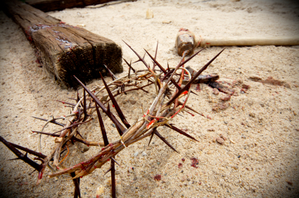
He gave His life for our sins.
Will you fully trust Him ?
Notes:
>Jesus not only talked the talk, He walked the walk !
>He kept His Word and always will.

Slide 16
He repeats His Word.
“I am the good shepherd, and I know My own and My own know Me, even as the Father knows Me and I know the Father ; and I lay down My life for the sheep. I have other sheep, which are not of this fold ; I must bring them also, and they will hear My voice ; and they will become one flock with one shepherd.” John 10v14-16 NASB
Let there be no mistake !
Notes:
>In case you didn’t get it, “repetition is the secret to learning” !
>He is more than ‘A’ shepherd… He is the ‘GOOD’ shepherd.
Not only is His WORD for the Children of Israel, but for ALL those who come to trust Him from all families of the world.
>The key to faith in Jesus is hearing His voice !

Slide 17
Let’s listen to the Shepherd.
“For this reason the Father loves Me, because I lay down My life so that I may take it again. No one has taken it away from Me, but I lay it down on My own initiative. I have authority to lay it down, and I have authority to take it up again. This commandment I received from My Father.” John 10v17-18 NASB
He is truly trust worthy !
Notes:
>Jesus Word leads us even further.
>Not only did He predict His death, but He said He would rise again.
>After the resurrection His disciples realized how trust worthy He really was.
He proved that He is able to save us from eternal death.

Slide 18
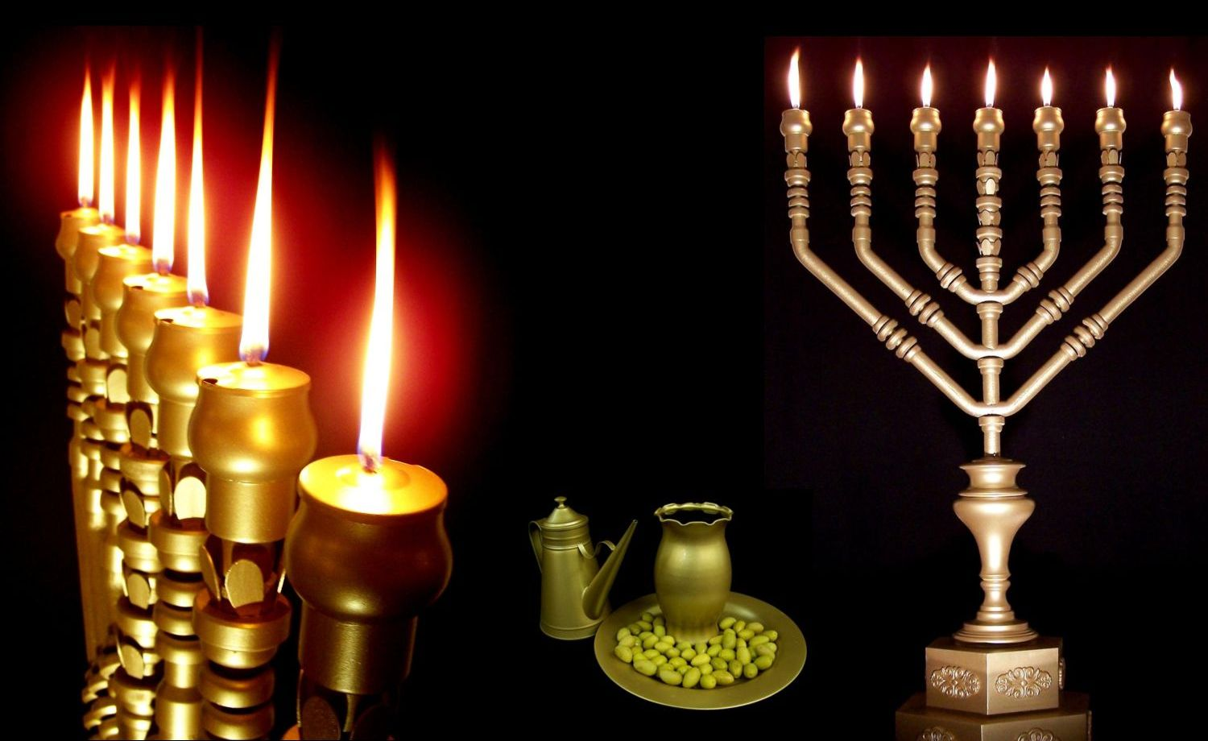
There is more in the context.
It was Hanukkah !
Notes:
>What a wonderful way to learn why Jesus calls Himself the good Shepherd, but there is even more !
>He did not chose this season by chance.

Slide 19
The feast of lights for Israel.
“At that time the Feast of the Dedication took place at Jerusalem ; it was winter, and Jesus was walking in the temple in the portico of Solomon. The Jews then gathered around Him, and were saying to Him, "How long will You keep us in suspense? If You are the Christ, tell us plainly." Jesus answered them, "I told you…” John 10v22-25 NASB
The Messiah had come.
Notes:
>This week was Hanukkah for Israel.
>There is no feast of Dedication in the Law of Moses.
Jesus chose the celebration of the rededication of Nehemiah’s temple after its desecration by the Greek Antiochus… the relighting of the Menorah lampstand.
>Jesus had just said in John 9v5 : "While I am in the world, I AM THE LIGHT OF THE WORLD.“
Many of the Children of Israel believed His Word and knew Messiah had come, so that was the big question at this feast !
Jesus’ Word is very clear : “I told you, but you did not believe”.

Slide 20
It was a matter of trust.
“…and you do not believe ; the works that I do in My Father's name, these testify of Me. But you do not believe because you are not of My sheep. My sheep hear My voice, and I know them, and they follow Me.” John 10:25-27 NASB
He leads by His Word.
Notes:
>Some trusted Him and others did not.
>Those who let Him LEAD them by His Word TRUSTED Him and became His followers.
>The theme of His Word that leads is STILL in the forefront.

Slide 21
The image is still of sheep.
“…and I give eternal life to them, and they will never perish ; and no one will snatch them out of My hand. My Father, who has given them to Me, is greater than all ; and no one is able to snatch them out of the Father's hand. I and the Father are one.”
John 10v28-30 NASB
As God He is trust worthy.
Notes:
>The picture of sheep is STILL in Jesus’ words.
>Those who follow Jesus because of His Words receive the gift of salvation, eternal life.
>There is no greater security than this !

Slide 22
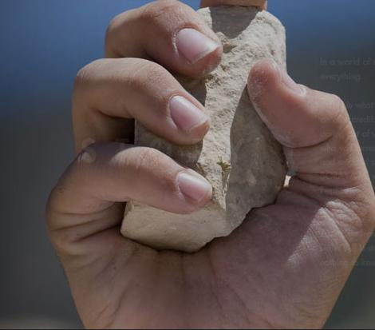
Jesus couldn’t be clearer !
He is God.
Notes:
>Perhaps you have not understood.
>But, the enemies of Jesus did understand !

Slide 23
The lines were drawn.
“The Jews picked up stones again to stone Him. Jesus answered them, ‘I showed you many good works from the Father ; for which of them are you stoning Me ?’ The Jews answered Him, ‘For a good work we do not stone You, but for blasphemy ; and because You, being a man, make Yourself out to be God.’ ” John 10v31-33 NASB
He leads you to a choice.
Notes:
>Jesus’ Word leads to a choice.
>Not all the Children of Israel rejected Jesus, but the “Jews” did, the religious leaders who controlled the nation of Israel at that time.
>Today, as two thousand years ago, the choice is yours : Is Jesus God ?

Slide 24
You have made yourself god.
“Jesus answered them, ‘Has it not been written in your Law, 'I said, You are gods !!!’ ? If he called them gods, to whom the word of God came (and the Scripture cannot be broken), do you say of Him, whom the Father sanctified and sent into the world, 'You are blaspheming,' because I said, 'I am the Son of God’ ?” John 10v34-36 NASB
This is refusing to be led.
Notes:
>If you reject God from Heaven, you put yourself above Him.
>Jesus lead them, again by His Word, to realize that they had made themselves into gods !
>There is no neutral ground : either you let Jesus lead you by His Word or you set yourself up as god.

Slide 25
A final plea to trust Jesus !
“If I do not do the works of My Father, do not believe Me ; but if I do them, though you do not believe Me, believe the works, so that you may know and understand that the Father is in Me, and I in the Father.” Jn 10v37-38 NASB
At least believe the witnesses !
Notes:
>Jesus is compassionate and terribly patient.
>He knows we sometimes need to back up and examine the first reasons to trust Him.
>What is essential is to trust Him for whatever reason and begin the route with Him today.
Then, eventually you will come to listen to His Word in every detail and let Him lead you totally !

Slide 26
Review, react and remember:
We can trust Jesus because he leads us by His Word.
When we hear His voice as we read His Word, it convicts.
We can choose to listen or just turn away like lost sheep !
The Shepherd is calling.
Notes:
>Let’s QUICKLY review, but SERIOUSLY react and ALWAYS remember what we have learned today.
> [read screen]
>Let’s pray that we will trust Jesus as He leads us by His Word.

