Slide 1
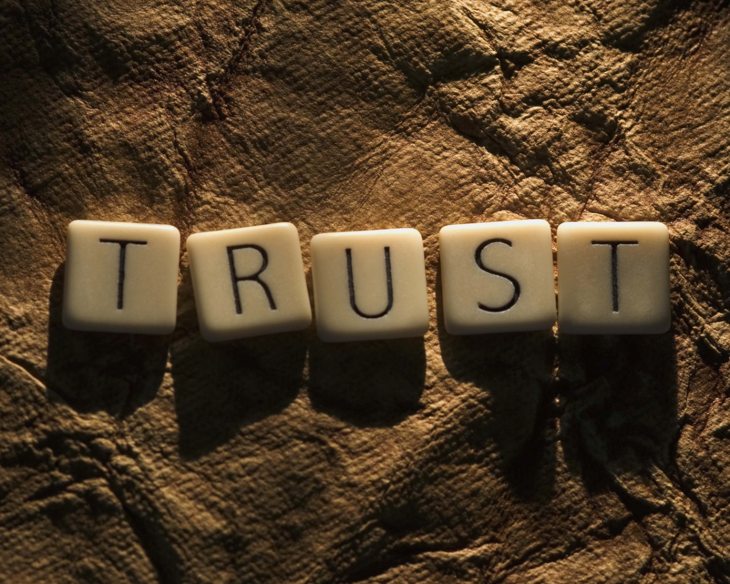
Why trust Jesus ?
The world needs to know !
Notes:
TRUST ! There’s not much of it in this world.
I took the bus the other day and a poor fellow asked the driver to trust him that he would pay for the ride the next day.
We all waited… and waited… and waited… but, the driver refused to let him ride.
The atmosphere was getting pretty tense in the bus.
So I said, real loud, “IN GOD WE TRUST…all others pay cash !”
The bus roared with laughter and the man got off.
That gave me an open door to speak to the man in front of me about Jesus.
> This is the question people are thinking, but don’t dare ask.
I like to say, “So I bet you want to know why I trust Jesus ! Well, let me tell you !”
> Can you answer the question ?
The world wants to know… and NEEDS to know to be saved.

Slide 2
Our faith is reasonable.
“ ‘Come now, and let us reason together,’ says the LORD, ‘though your sins are as scarlet, they will be as white as snow ; though they are red like crimson, they will be like wool.’ ”
Isaiah 1v18 NASB
Let’s look at the reasons.
Notes:
The Christian faith is NOT a “leap in the dark” as other religions !
[READ]
It is NOT the opposite of true science and good reasoning.
Don’t ever let anyone tell you that reason and belief are opposites.
> Our faith is NOT just an mental belief without reason.

Slide 3
The Gospel according to John
“These have been written so that you may believe that Jesus is the Christ, the Son of God ; and that believing you may have life in His name.”
John 20v31 NASB
There are reasons to believe.
Notes:
EACH book of the Bible has a theme, a purpose.
[READ]
The Gospel of John answers the question, “Why trust Jesus ?”
> That’s the reason we often give this Gospel to our friends !

Slide 4
All the Bible in its Context
Simple tools for serious study…
Find the answers in the Bible.
4. Natural divisions ?
5. Repeated words ?
6. What sums it up ?
7. How can I apply it?
Who is speaking ?
When was it said ?
To whom ?
Use commentaries just as a check of your discoveries.
Notes:
Before we take a verse here or there out of its context, let’s look at the “big picture” of the whole book.
> I like to ask 7 questions before I am sure I understand any one verse…
> The most important three questions come first.
The Bible is inspired, but it is not always God speaking.
But, most importnt of all, not all the Bible is addrssd to you !
> The last three questions protect us from imposing our ideas on God’s word…
> You might have noticed that there is no question, “What do the commentaries say ?”
Commentaries should be consulted last ! If no one agrees with you, it’s time to start over and find the right answers in the Bible ☺

Slide 5
A Bible book summary
The Gospel of John
4. There are 4 natural sections to the book.
5. The key word is ‘Believe’ used 98x !
6. John 3v16 sums it up: why trust Jesus ?
7. Trust Him, Jn20v31
The writer was an eyewitness.
It was written in the first century AD.
He addresses ‘you’ where ever you are
www.AzBible.yolasite.com
Notes:
I would like to offer you two pages of notes to each person… [ABC questions + John]
Take a minute to look over the summary of the Gospel of John.
> You will notice that all the answers come from the Bible itself.
> I have done this for all 66 books of the Bible, but in Fr.
Since I now spend 6 months each year in North America, I am translating these book surveys into English.
> You can find all the French ones and the new English translations at this web site.

Slide 6
Let’s look over the Book.
John 1-3
We can trust Jesus because of all the witnesses.
This is a first good reason.
Who talked about Jesus ?
Notes:
We have already seen WHY & FOR WHOM this book was written.
Now, let’s walk thru it
> The first natural section of the book is well known.
> A first good REASON to trust Jesus is because so many people do… and they talk about Him.
Anyone can be a witness, even an unsaved person or a piece of paper.
This reminds us how important it is to name the Name of J.
> It’s not mature faith, but it’s a start.
> Let’s see how people began to trust Jesus because of people talking about him.

Slide 7
John the baptizer testified.
“He came as a witness, to testify about the Light, so that all might believe through him.”
John 1v7 NASB
Many then trusted Christ.
Notes:
John POINTED PEOPLE to Christ.
> [READ] He said at least twice, “Behold the lamb of God !” Jn1v29 & 36
> The word “TESTIFIED” is repeated 6x in John 1.
Remember that any word repeated over and over is the key word, the subject of the passage.

Slide 8
Andrew witnessed to Peter.
“He found first his own brother Simon and said to him, ‘We have found the Messiah’ (which translated means Christ). He brought him to Jesus.”
John 1v41-42 NASB
He began in his family.
Notes:
“Each one bring one” is a good lesson we can learn from this book about witnessing.
> [READ] Bringing people to Christ to hear Him is NOT difficult.
> Andrew didn’t “convert” his brother, but left that up to Jesus.
Isn’t this what you want to do; BRING PEOPLE to JESUS ?

Slide 9
Philip witnessed to a friend.
“Philip found Nathanael and said to him, ‘We have found Him of whom Moses in the Law and also the Prophets wrote, Jesus of Nazareth,’… Nathanael said to him, ‘Can any good thing come out of Nazareth ?’ Philip said to him, ‘Come and see.’ ” Jn 1v45-46 NASB
He began with his friend.
Notes:
Don’t expect to bring a crowd to Christ !
In fact, if you bring one person to Christ, you will have your hands full to make a disciple.
If you bring more than one to the chapel, it will be hard to talk to several people after the meeting.
> [READ] Instead of arguing, he just said, “Come and see !”
Jesus then convinced Nathaniel that He was the Messiah, the Savior.
> Telling a friend what Jesus has done for you may be the first reason they come to trust Him.

Slide 10
An answered prayer in Cana is even a testimony.
“This beginning of His signs Jesus did in Cana of Galilee, and manifested His glory, and His disciples believed in Him.”
John 2v11 NASB
All creation testifies !
Notes:
There are many forms of testimony that can lead someone to trust Jesus.
> [READ] The water turned into wine spoke loudly about trusting Him.
> Rm1 tells us that all human beings are without excuse, because even the rocks cry out to trust Jesus.
That’s why even a piece of paper, a tract or a bumper sticker can be a witness.

Slide 11
Unsaved people can even be witnesses.
“ ‘Rabbi, we know that you have come from God as a teacher ; for no one can do these signs that you do unless God is with him.’ ”
John 3v2 NASB
He came because he heard.
Notes:
Nicodemus heard the testimony of MANY people.
> Jesus was the “buzz” in the Sanhedrin, yet they certainly did not trust Jesus.
[READ] How did he “know” ? In the mouth of 2 or 3 witnesses…
> He trusted Jesus enough to come to Him and listen to Him.

Slide 12
John continues his journey.
John 4-11
We can trust Jesus because of His Word.
This is a second good reason.
“Faith comes by hearing.”
Notes:
The next section of this book is the largest… and for a very good REASON !
> Over and over John shows how Jesus’ Word is the NEXT GOOD REASON people trust Him.
> After trusting a testimony about Jesus, hearing Him makes our faith in Him more sure.
> The Bible says in Rm10v17, “Faith comes from hearing, and hearing by the word of Christ.”

Slide 13
The Samaritan woman testified.
“It is no longer because of what you said that we believe, for we have heard for ourselves and know that this one is indeed the Savior of the world.”
John 4v42 NASB
Their faith became solid.
Notes:
Remember the story of the Samaritan woman ?
Her whole city came to Christ, thanks to one person’s testimony.
> So how did it happened ?
[READ] They moved from trusting Jesus because of a witness, to trusting Him because of His own Word.
When you think about your own journey with Jesus, this is probably what happened.
You trusted Him enough to listen to Him, because others were first talking about Him.
> Mature faith in Christ comes from hearing Him yourself.
That’s why it’s so important to quote Jesus when we lead someone to Him.

Slide 14
A Centurion trusted Him.
“Jesus said to him, ‘Go ! Your son lives.’ The man believed the word that Jesus spoke to him and started off.”
John 4v50 NASB
John 4-11 are filled with stories about Jesus’ Word
Notes:
The same chapter contains another wonderful example.
> [READ] In v53 it says he and his WHOLE house then trusted Jesus.
> We don’t have the time today to talk in detail about all the examples of coming to faith in Christ by hearing His Word.

Slide 15
Trust Him because His Word is…
Convincing, John 4v1-42
Healing, John 4v43-5v47
Compassionate, John 6v1-27
Nourishing, John 6v22-71
Revealing, John 7
Liberating, John 8
Sight giving, John 9
Guiding, John 10
Life giving, John 11
“You have the Words of Life.”
Notes:
When Jesus speaks He CAPTURES our trust.
> Here is a simple outline of John 4-11 about the effect of Jesus’ Word.
[READ]
> In Jn6v68 Peter verbalizes what we now know about the Word of Life !

Slide 16
There is still another reason to trust Jesus.
John 12-17
We can trust Jesus because of His followers.
This is a third good reason.
They are living proof !
Notes:
The third natural section in the Gospel of John is just as important.
> Let’s think about chapters 12-17.
> A true follower of Jesus is PROOF that He can really transform a life.
> The REASONS to trust Jesus are piling up !
> People began trusting Him when they saw Jesus’ disciples LIVE like Jesus in whom they believe.
That’s a good reminder for us to live a holy life.

Slide 17
Lazarus was living proof.
“The chief priests planned to put Lazarus to death also ; because on account of him many of the Jews were going away and were believing in Jesus.” John 12v10-11 NASB
Many trusted Jesus.
Notes:
It’s hard to deny reality when it’s “in your face”.
> [READ] Living proof BOTHERS people and MAY become dangerous to your health !
> Notice they did not JUST believe the reports about Jesus, but trusted Him !

Slide 18
Jesus wanted this.
“I do not ask on behalf of these alone, but for those also who believe in Me through their word; that they may all be one… so that the world may believe that You sent Me. John 17v20-21 NASB
They will trust Jesus if…
Notes:
Again there are MANY stories in Jn12-17 to illustrate God’s plan.
> [READ] Jesus prayed that Christian unity would cause trust in Him.
> How are we doing ?
Not so well.
Many turn from Jesus because of our divisions.
But, I have seen others trust Christ because they saw the love and grace that some Christians show.

Slide 19
The ultimate reason to trust Jesus is because of the Gospel.
John 18-21
We can trust Jesus because He died for our sins & rose again.
This is the fourth good reason.
He is really trust worthy !
Notes:
Like reaching the end of a journey, the best part is kept for last.
> Let’s think about the Gospel in chapter 18-21.
> We have seen many reasons to trust Jesus, but SALVATION is the ultimate REASON.
> All four REASONS to trust Jesus are linked and need to arrive at this one.
> No one has or will ever do what Jesus did. He alone is CAPABLE and trust worthy.

Slide 20
Jesus was in full control.
“Jesus said to Peter, ‘Put the sword into the sheath ; the cup which the Father has given me, shall I not drink it ?"
John 18v11 NASB
He was not trapped.
Notes:
Jesus went to the cross deliberately out of love for us.
> Twice Peter tried to stop Him, but Jesus was in control.
[READ]
> Jesus’ death was not a tragic mistake, but a triumphant sacrifice.

Slide 21
He is Almighty God.
“Pilate said to Him, ‘So you are a king ?’ Jesus answered, ‘You say correctly that I am a king. For this I have been born, and for this I have come into the world, to testify to the truth. Everyone who is of the truth hears My voice.’ ”
John 18v37 NASB
He is not from this world.
Notes:
Pilate & the Centurion RECOGNIZED Him… and Israel will too, one day.
> [READ]
Jesus commands respect.
> He is not just human, but Divine, Almighty and Eternal.

Slide 22
He gave His life for us.
“Therefore when Jesus had received the sour wine, He said, ‘It is finished !’ and He bowed His head and gave up His spirit.
John 19v30 NASB
There is no greater love !
Notes:
No one took His life, but he offered it of His own free will.
In Jn10v17-18 He said, "For this reason the Father loves Me, because I lay down My life so that I may take it again. No one has taken it away from Me, but I lay it down on My own initiative. I have authority to lay it down, and I have authority to take it up again. This commandment I received from My Father."
> How can we not trust Jesus when we hear His last words ?
[READ]
> In Jn15v13 Jesus said, "Greater love has no one than this, that one lay down his life for his friends.”

Slide 23
He rose from the dead.
“When it was evening on that day, the first day of the week, …Jesus came and stood in their midst and said to them, ‘Peace be with you.’ And when He had said this, He showed them both His hands and His side. The disciples then rejoiced when they saw the Lord.”
John 20v19-21 NASB
There is no greater power.
Notes:
The best REASON to trust Jesus is that He is alive today !
> [READ]
The Bible says He gave them many infallible proofs, Ac1v3.
> Two thousand years later He continues to come & convince hearts.
This is the Good News we preach, not a list of truthes we believe, which is good, but we preach Christ !

Slide 24
So what’s the application ?
We need to talk about Him, Jn1-3
We need to quote Him, Jn4-11
We need to live for Him, Jn12-17
We need to praise Him, Jn18-21
…if we want the world to trust Jesus !
Let John be our guide.
Notes:
What can we do with what we have seen today ?
If you have not trusted Jesus enough to ask Him for forgiveness of you sins, now is the time to do it.
If you have received the living Lord Jesus into your heart, His Spirit is speaking to you about bringing others to Jesus.
> We can follow the pattern of this book…
>
>
>….
> The Gospel of John is a “how-to” manual for the believer.

Slide 25
Review, react and remember:
The world needs to know why they should trust Jesus !
We have the answers in the Gospel according to John.
It’s not that complicated !
Become a soul winner today
Notes:
I am a teacher at heart and believe firmly in the REAL three “R”s.
> Notice we have been talking about trusting Jesus, not just believing truths ABOUT Him… even the Devil believes and trembles, but he does not TRUST Jesus.
> The REASONS we trust Jesus are : 1) because of so much testimony, 2) because of His Word, 3) because of His followers and 4) because of the Gospel.
> Let’s “brag on Jesus”, quote Him, live like Him and share the Gospel !

