Slide 1
The Gospel of John 4v1-42
Why have faith in Jesus ?
ABC… All the Bible in its Context

Slide 2
Let’s remember the context !
John uses the word “believe” 98 times in this book.
That’s what it’s all about...
why should I trust Jesus ?
It’s more than believing facts about Him.

Slide 3
This book reveals several reasons we have faith in Jesus.
Jn1-3 the witnesses
Jn4-11 Jesus’ words
Jn12-17 his followers
Jn18-21 the Gospel
It’s good to review !

Slide 4
Remember the witnesses ?
John the baptist gave his testimony because of Jesus’ baptism.
The disciples were witness at Cana because of Jesus’ transforming power.
Nicodemus confessed what he saw because Jesus give new life.
That’s powerful stuff !

Slide 5
But, what about His words ?
Can He convince me to trust Him by His Word ?
Let’s continue our journey with Jesus in John’s Gospel.

Slide 6
Let’s listen to Jesus talk.
Open your Bible with me
to the Gospel of John 4v1-42.
Let’s look for any repeated key words.

Slide 7
Notice John 4v7-15.
“There came a woman of Samaria to draw water. Jesus said to her, "Give Me a drink." For His disciples had gone away into the city to buy food. Therefore the Samaritan woman said to Him, "How is it that You, being a Jew, ask me for a drink since I am a Samaritan woman?" (For Jews have no dealings with Samaritans.) Jesus answered and said to her, "If you knew the gift of God, and who it is who says to you, 'Give Me a drink,' you would have asked Him, and He would have given you living water." She said to Him, "Sir, You have nothing to draw with and the well is deep; where then do You get that living water? "You are not greater than our father Jacob, are You, who gave us the well, and drank of it himself and his sons and his cattle?" Jesus answered and said to her, "Everyone who drinks of this water will thirst again; but whoever drinks of the water that I will give him shall never thirst; but the water that I will give him will become in him a well of water springing up to eternal life." The woman said to Him, "Sir, give me this water, so I will not be thirsty nor come all the way here to draw." NASB
Water 8x + Drink 6x = 14x

Slide 8
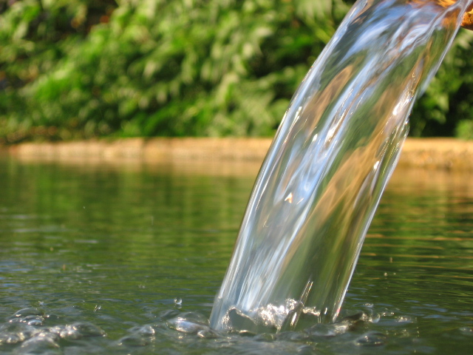
It’s all about water !

Slide 9
vs7-15 use these key words 6x !
“Jesus answered and said to her, ‘Everyone who drinks of this water will thirst again ; but whoever drinks of the water that I will give him shall never thirst ; but the water that I will give him will become in him a well of water springing up to eternal life.’"
John 4v13-14 NASB
By zooming into to the central verses we get the message.

Slide 10
Everyone needs to drink.
“Jesus answered and said to her, ‘Everyone who drinks of this water will thirst again ; but whoever drinks of the water that I will give him shall never thirst ; but the water that I will give him will become in him a well of water springing up to eternal life.’"
John 4v13-14 NASB
There is a thirst that only Jesus can satisfy.

Slide 11
What is that thirst ?
“The woman said to Him, ‘Sir, give me this water, so I will not be thirsty nor come all the way here to draw.’”
John 4v15-16 NASB
She missed the point and so do a lot of people.

Slide 12
Jesus answered her prayer anyway.
“The woman said to Him, ‘Sir, give me this water, so I will not be thirsty nor come all the way here to draw.’
He said to her, ‘Go, call your husband and come here…’
John 4v15-16 NASB
What is this living water ?

Slide 13
We could imagine many things.
Was He speaking of giving her an abundant prosperous life ?
or
Was He speaking of giving her the Holy Spirit that day ?
What does the Bible say ?
Notes:
> Imagination is fine, but not for Bible study !
> The bubbling spring sounds like Jn10v10 where he said : “I am come that they might have life, and that they might have it more abundantly.” But, that is not the context of Jn4. He is not offering prosperity.
> Many think this refers to Jn7v38-39 where He said : "He who believes in Me, as the Scripture said, 'From his innermost being will flow rivers of living water.' But this He spoke of the Spirit, whom those who believed in Him were to receive; for the Spirit was not yet given, because Jesus was not yet glorified.” Again, the context is not Pentecost !

Slide 14
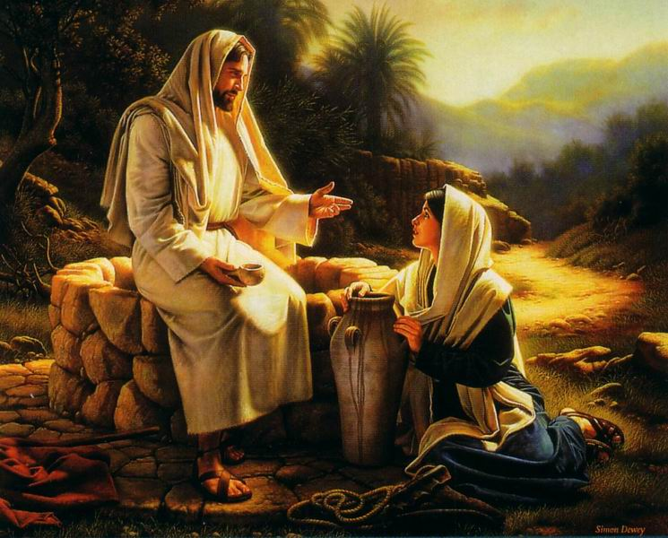
He just spoke to her.

Slide 15
Jesus just talked to her.
“He said to her, ‘Go, call your husband and come here.’ The woman answered and said, ‘I have no husband.’ Jesus said to her, ‘You have correctly said, 'I have no husband'; for you have had five husbands, and the one whom you now have is not your husband; this you have said truly.’ ”
John 4v16-18 NASB
His word was the water.

Slide 16
She was thirsty for the truth.
“The woman said to Him, ‘Sir, I perceive that You are a prophet. Our fathers worshiped in this mountain, and you people say that in Jerusalem is the place where men ought to worship.’
John 4v19-20 NASB
We all are, down deep inside.

Slide 17
He gave her more water.
“Jesus said to her, ‘Woman, believe Me, an hour is coming when neither in this mountain nor in Jerusalem will you worship the Father. You worship what you do not know ; we worship what we know, for salvation is from the Jews.”
John 4v21-22 NASB
It was clear clean water.

Slide 18
He gave her lots of water.
“But an hour is coming, and now is, when the true worshipers will worship the Father in spirit and truth ; for such people the Father seeks to be His worshipers. God is spirit, and those who worship Him must worship in spirit and truth."
John 4v23-24 NASB
It was all about the truth.

Slide 19
The water of His word was having an effect on her.
“The woman said to Him, ‘I know that Messiah is coming (He who is called Christ) ; when that One comes, He will declare all things to us.’ Jesus said to her, ‘I who speak to you am He.’ ”
John 4v25-26 NASB
What did she do ?

Slide 20
She was converted by Christ.
“So the woman left her water pot, and went into the city and said to the men, ‘Come, see a man who told me all the things that I have done ; this is not the Christ, is it ?’ ”
John 4v28-29 NASB
She confessed the truth.

Slide 21
Jesus’ Word is convincing.
“Many more believed because of His word ; and they were saying to the woman, ‘It is no longer because of what you said that we believe, for we have heard for ourselves and know that this One is indeed the Savior of the world."
John 4v41-42 NASB
This is the water of life.

Slide 22
What is the application for us ?
“Let the one who is thirsty come ;
let the one who wishes
take the water of life without cost.
Revelation 22v17 NASB
This is in the same context of the word of Christ.

Slide 23
Are you already a Christian ?
“Christ also loved the church and gave Himself up for her, so that He might sanctify her, having cleansed her by the washing of water with the word, that He might present to Himself the church in all her glory, having no spot or wrinkle or any such thing; but that she would be holy and blameless.”
Ephesians 5v25-27 NASB
His Word is like water !

Slide 24
Review, react and remember:
Our journey with Jesus in the Gospel of John is to lead us to faith in Christ.
The witnesses help us trust Him.
But the words of Jesus are even more convincing and powerful for believers.
It’s like cool clean water from the well for a thirsty soul in search of truth.
Arizona Bible Courses

