Slide 1
All the Bible in its Context
Who is writing & speaking ? cf. v1
When ? cf. v1 & 7…near 586 BC
To whom ? cf. v2, 4, 6 & 13…King+
Natural divisions ? vs1-5 and 6-22
Key words ? “You” 25x “LORD” 14x
Summary ? The LORD sees You repented, but returned to your sin !
7. True repentance is… cf. vs18-20

Slide 2
Let’s follow the story.
There are 6 natural divisions in 2 big ones :
vs1-5 Promise of Peace for Repentance (v5)
vs1 In the Context of Losing a War…
vs2-5 You will have a peaceful end
vs6-22 Bringing Back Babylon for Returning to sin (v22)
vs6-7 In the Context of Winning a War…
vs8-10 Real Repentance Releasing Slaves
vs11-19 Returning to their old ways…
vs20-22 Return of Nebucadnetsar & Ruin of Judah
They broke their promise.

Slide 3
Let’s read Jeremiah 34…
Notice the key words : “You” & “LORD”
Notice the natural divisions : 1-6, 6-22
Notice the key verses : vs15-16
Why was God so angry ?

Slide 4
Promises are to be kept !
“Although recently you had turned and done what is right in My sight, each man proclaiming release to his neighbor, and you had made a covenant before Me in the house which is called by My name. Yet you turned and profaned My name, and each man took back his male servant and each man his female servant whom you had set free according to their desire, and you brought them into subjection to be your male servants and female servants.” Jer34v15-16 NASB
Repentance is a promise.

Slide 5
“I will not return to my sin.”
“I will give the men who have transgressed My covenant, who have not fulfilled the words of the covenant which they made before Me, when they cut the calf in two and passed between its parts, the officials of Judah and the officials of Jerusalem, the court officers and the priests and all the people of the land who passed between the parts of the calf, I will give them into the hand of their enemies and into the hand of those who seek their life. And their dead bodies will be food for the birds of the sky and the beasts of the earth.” Jer34v20 NASB
“…over my dead body !”

Slide 6
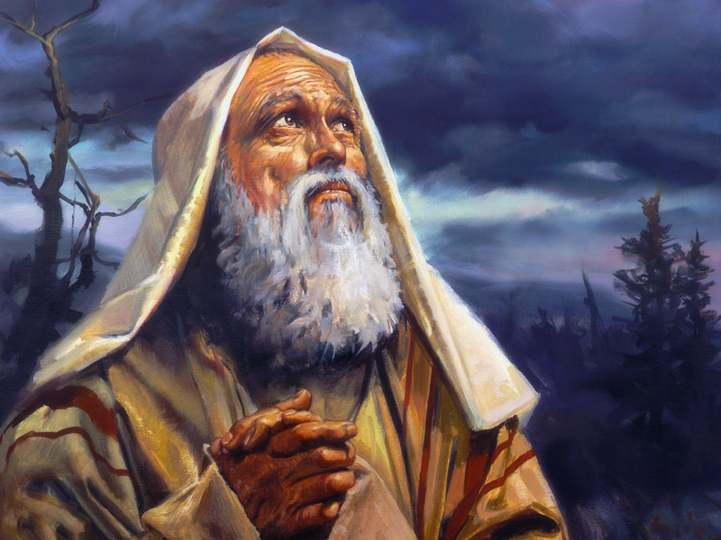
Abraham learned this faithfulness.
Genesis 15v9-19

Slide 7
“So He said to him, ‘Bring Me a three year old heifer, and a three year old female goat, and a three year old ram, and a turtledove, and a young pigeon.’ Then he brought all these to Him and cut them in two, and laid each half opposite the other ; but he did not cut the birds. The birds of prey came down upon the carcasses, and Abram drove them away.

Slide 8
Now when the sun was going down, a deep sleep fell upon Abram ; and behold, terror and great darkness fell upon him. God said to Abram, ‘Know for certain that your descendants will be strangers in a land that is not theirs, where they will be enslaved and oppressed four hundred years. But I will also judge the nation whom they will serve,

Slide 9
and afterward they will come out with many possessions. As for you, you shall go to your fathers in peace ; you will be buried at a good old age. Then in the fourth generation they will return here, for the iniquity of the Amorite is not yet complete.’ It came about when the sun had set, that it was very dark, and behold, there appeared a smoking oven and a flaming torch

Slide 10
which passed between these pieces.
On that day the LORD made a covenant with Abram, saying, "To your descendants I have given this land, From the river of Egypt as far as the great river, the river Euphrates:
Genesis 15v9-18 NASB

Slide 11
What does this mean ?
Entering into a covenant relation with our holy God is no light matter.
It is kept forever, even unto blood.

Slide 12
How are we concerned ?
Eternal salvation from sin, offered freely, is also a covenant relation with God.
We are to repent and trust
He will forgive.

Slide 13
The New Testament
“And when He had taken a cup and given thanks, He gave it to them, saying, ‘Drink from it, all of you ; for this is My blood of the covenant, which is poured out for many for forgiveness of sins.
Matthew 26v27-28 NASB
It cost blood and separation.

Slide 14
Just like Jeremiah 34v18-19
Jesus was separated from His Father on the cross.
“My God, my God, why have your forsaken me ?” Matthew 27v46 NASB
The covenant was sealed.

Slide 15
Dare we go back on our repentance ?
“For in the case of those who have once been enlightened… and then have fallen away, it is impossible to renew them again to repentance, since they again crucify to themselves the Son of God and put Him to open shame.”
Hebrews 6v4-6 NASB
What is true repentance ?

Slide 16
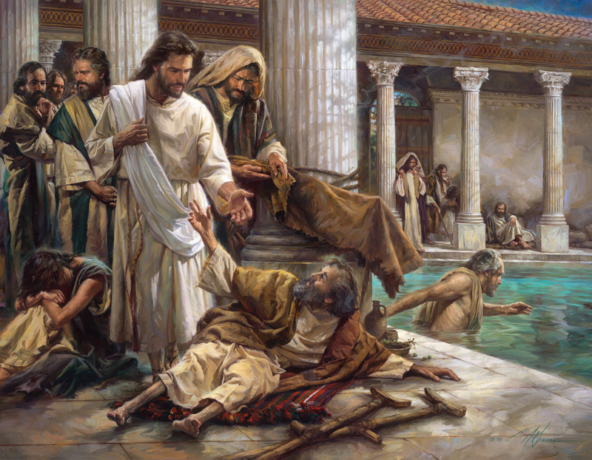
“Do not sin anymore.”Jn 5v14 NASB
Deliverance has a double purpose.

Slide 17
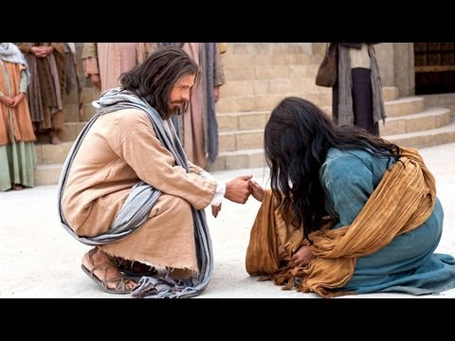
“Go, and sin no more !”
This is true repentance.

Slide 18
Review, react and remember:
Jeremiah 34 teaches true biblical repentance from sin.
“These things… are written for our instruction.” 1 Cor10v11
Repentance is turning from sin.
www.AzBible.yolasite.com

