Slide 1
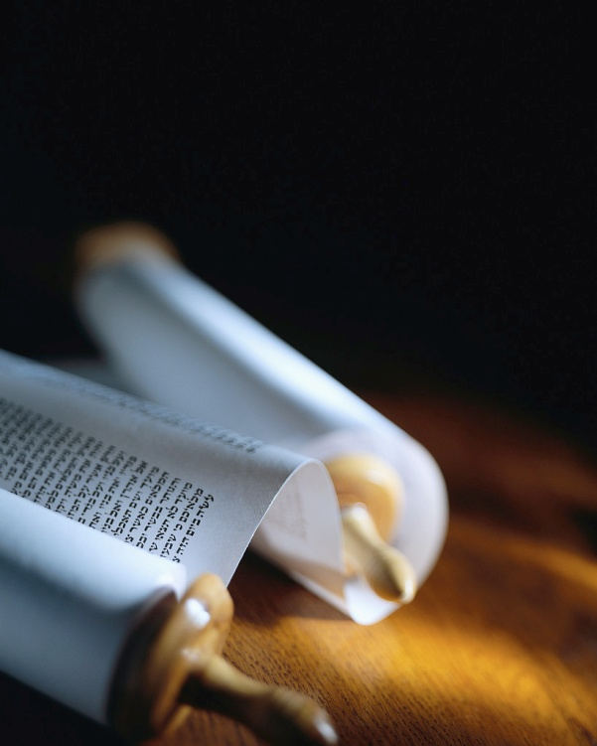
Next
Notes:
My passion is leading others to Christ, but He alone can save !
Heb2:3 says, “How will we escape if we neglect so great a salvation ?”
What’s so great about the offer of personal salvation ?
Let’s read 1Timothy 2:1-7…

Slide 2
Salvation is like a diamond.
It has many facets !
Next
Notes:
Let’s look in the Bible for what it says about personal and eternal salvation.
I have prepared a summary of some of the key words used in the Bible to describe what God does in a flash, the moment someone is saved. [handouts]

Slide 3
Redemption
“You were not redeemed with perishable things, like silver or gold… but, with precious blood of Christ, as of a lamb unblemished and spotless.” 1 Peter 1:18-19
What is it ?
When does it take place ?
How does it affect my life ?
It’s part of the miracle of salvation.
Next
Notes:
One of the amazing aspects of salvation is being redeemed.
Let’s ask the Bible some very important questions. [read]
Here is a key verse that answers all 3 questions. [read]
Peter is writing to born again Christians (v3) about salvation.

Slide 4
Redemption is a costly affaire.
“You were not redeemed with perishable things, like silver or gold… but, with precious blood of Christ, as of a lamb unblemished and spotless.” 1 Peter 1:18-19
What is it ?
When does it take place ?
How does it affect my life ?
Eph1:7&Heb9:12 The ultimate price.
Next
Notes:
Ps49:7-8 says, “No man can by any means redeem his brother or give to God a ransom for himself, for the redemption of his soul is costly.”
Good deeds & money cannot pay the debt of our sin.
The L JC paid with His blood.

Slide 5
Redemption is from an old way life.
“You were not redeemed with perishable things, like silver or gold from your futile way of life inherited from your forefathers…” 1 Peter 1:18
What is it ?
When does it take place ?
How does it affect my life ?
Eph1:14&Titus2:14 It’s a new ownership !
Next
Notes:
Prov14:12+16:25 say, “There is a way which seems right to a man but its end is the way of death.”
Our key verse puts it bluntly[r
It’s not a recovery program, back to a former “good life”.
That’s good, only in this life.
God takes over to save you !

Slide 6
Redemption is to God’s Kingdom.
“You were not redeemed with perishable things, like silver or gold… but, with precious blood of Christ, as of a lamb unblemished and spotless.” 1 Peter 1:18-19
What is it ?
When does it take place ?
How does it affect my life ?
It is for a new life in Christ.
Next
Notes:
Col1:13-14 say, “He rescued us from the domain of darkness, and transferred us to the kingdom of His beloved Son, in whom we have redemption, the forgiveness of sins.” and more !
You were bought with a price for a purpose. (1Cor6:20)

Slide 7
It takes place at salvation.
“You were not redeemed with perishable things, like silver or gold… but, with precious blood of Christ, as of a lamb unblemished and spotless.” 1 Peter 1:18-19
What is it ?
When does it take place ?
How does it affect my life ?
1Cor1:30 He became our Redeemer.
Next
Notes:
Ga3:13 says “Christ redeemed us from the curse of the Law.”
Notice the past tense again.
All who are saved have been instantly redeemed.
The work was done at Calvary but the payment is made the instant someone receives Christ.

Slide 8
Like forgiveness, redemption is timeless.
What is it ?
When does it take place ?
How does it affect my life ?
“You were not redeemed with perishable things, like silver or gold… but, with precious blood of Christ, as of a lamb unblemished and spotless.” 1 Peter 1:18-19
Salvation has always included redemption.
Next
Notes:
Job19:25 says, “I know my Redeemer lives”.
The sacrificial substitute is not a new concept to the OT.
The only thing that changed is that Christ has come and the work is done.
Justification is now possible.

Slide 9
Redemption is once for all.
“You were not redeemed with perishable things, like silver or gold… but, with precious blood of Christ, as of a lamb unblemished and spotless.” 1 Peter 1:18-19
What is it ?
When does it take place ?
How does it affect my life ?
There is no going back.
Next
Notes:
You might have heard about, or even seen, “back sliders”.
Our Redeemer never changes
The Lamb of God not only lived a life unblemished by sin, but He is spotless and perfect.
Redemption depends on the Redeemer not the redeemed.

Slide 10
Redemption is very personal.
“You were not redeemed with perishable things, like silver or gold… but, with precious blood of Christ, as of a lamb unblemished and spotless.” 1 Peter 1:18-19
What is it ?
When does it take place ?
How does it affect my life ?
Have you been redeemed ?
Next
Notes:
Unlike, for the nation of Israel, redemption today, is for saved individuals.
Notice that He does NOT say the Church as a whole body is redeemed, but each person.
Rm10:13 says we must call on the Name of the L to be saved.

Slide 11
Redemption is a reason to worship.
“You were not redeemed with perishable things, like silver or gold… but, with precious blood of Christ, as of a lamb unblemished and spotless.” 1 Peter 1:18-19
What is it ?
When does it take place ?
How does it affect my life ?
Is He precious to you ?
Next
Notes:
Ps107:2 says, “Let the redeemed of the LORD say so, whom He has redeemed from the hand of the adversary.”
Redemption is worth talking about because of its cost.
The assembly that worships well witnesses well !

Slide 12
Redemption leads to justification.
“You were not redeemed with perishable things, like silver or gold… but, with precious blood of Christ, as of a lamb unblemished and spotless.” 1 Peter 1:18-19
What is it ?
When does it take place ?
How does it affect my life ?
Has He done the miracle in you ?
Next
Notes:
Rom3:24 says, “Being justified as a gift by His grace through the redemption which is in JC.”
Christ came to call, forgive, redeem, justify+glorify as a work in progress. (Rm8:30 & He9:15)
Redemption is a key part of so great a salvation ! (Ga4:5)

Slide 13
Review, React, Return
1 Peter 1:18-19 reveal the redemption in salvation.
It is a costly miracle.
Christ’s work is applied the moment we receive Him.
My life belongs to Him !
What is it ?
When does it take place ?
How does it affect my life ?
www.AzBible.yolasite.com
Notes:
Let’s look at what we have seen in God’s Word…

Slide 14
Redeemed, how I love to proclaim it ! Redeemed by the blood of the Lamb ; redeemed through His infinite mercy, His child, and forever I am. Redeemed, redeemed, redeemed by the blood of the Lamb ; redeemed, redeemed, His child and forever I am.
Notes:
Let’s sing an old favorite !

Slide 15
Redeemed, and so happy in Jesus, no language my rapture can tell ; I know that the light of His presence with me doth continually dwell.
Redeemed, redeemed, redeemed by the blood of the Lamb ; redeemed, redeemed, His child and forever I am.

Slide 16
I think of my blessed Redeemer, I think of Him all the day long ; I sing, for I cannot be silent ; His love is the theme of my song.
Redeemed, redeemed, redeemed by the blood of the Lamb ; redeemed, redeemed, His child and forever I am.

